Slide 1


Class 2 – September 14
Does Anyone Govern the Internet?
A look at internet subject matter jurisdiction and net neutrality

Slide 2
Admin Crap
Presentation / comment sign-up sheet:
  11/24 students signed up
  You can always change pres+3 vs. 6-page comment up to one week before
  → Presentations / comments details / notes next slides
Yom Kippur next week
October 5 Election cancel – “makeup” “cocktail hour” class October 6 17h-18h30(ish) via Zoom (link in MyCourses and…)
→ new syllabus v2 on am.com/mcgill
No new students? First time ever!
Notes:
October 7 - Cybersecurity and the Law only conflict

Slide 3
Presentations + Comments
Langage – français sans problème pour présentation et / ou commentaire
News items need my “approval” (but well done so far!)
I will email you before with timing
If you send slides to me right up to time of presentation (preferably before class), I’ll have them on my computer
  PPT(X), link to Google Slides, PDF. NOT Keynote! If you really want Keynote bring your Mac up
Recall: comments due: (1) Monday 3 PM 7 days later (for Pres+3 page comment), (2) Monday 12:00:01 AM for 6-page of your week; both submitted via email
Notes:
QUESTIONS?????

Slide 4
Comments
3-page
6-page
A paragraph or two summarizing case or news
Focusing the rest on some specific aspect and your thoughts about it (see next slide)
Research good but not required
Proper footnotes, no need for bibliography
More room for summary
Can focus on 2 separate aspects, or 1 aspect more in depth (see next slide)
Really should do at least some minimal research
Proper footnotes, bibliography not required but good if you did a ton of research

Slide 5
“Aspects”, e.g.
“I think the dissent in this case was right because…”
“This case led to an interesting development in jurisprudence / legislation which I would like to explain and talk about…”
“After this news thing happened, the government decided to pass this law, but they were dumb because…”
“Boy this news thing was fascinating because… [the law does not address this issue, and it should, here’s some ideas!]
(…)

Slide 6
Presentations / Comments & Essay
Q: Can my presentation and essay (or 6-page comment) be on the same subject matter as m final essay? Like if I find a news item that fits as an essay topic? Or if my comment is an interesting enough topic it could be a paper?
A: Yes, that’s fine, BUT I will expect more from you in the essay, and the essay should not really be a simple expansion of your comment, should be more
Notes:
QUESTIONS?????

Slide 7
Other announcements
Tech law Club and IP Club?

Slide 8
In the News
Jennifer Zhu presentation

Slide 9

In the News
Notes:
Chris will be presenting this two classes from now but it is huge news so I wanted to bring it up

Slide 10
So Let’s THINK ABOUT something…

Slide 11
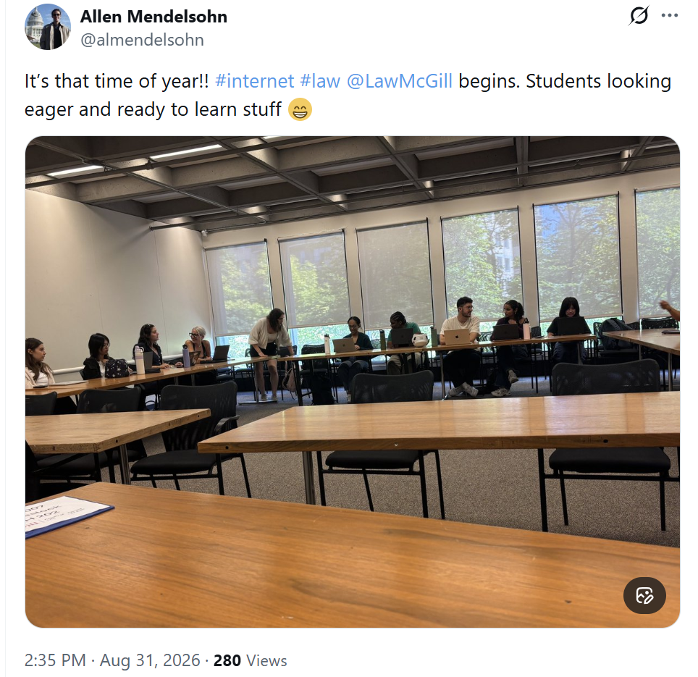
Recall:

Slide 12
CLASS EXERCISE
Prof. Mendelsohn is an a**hole. I asked him nicely to remove that Tweet, and he refused. I need to go after both him and X to get that Tweet taken down. But there seem to be a buttload of legal issues here, like _____________________

Slide 13
TURN TO YOUR NEIGHBOURS AND DISCUSS FOR A FEW MINUTES… think about all the parties involved

Slide 14
What have you got?

Slide 15
Legal Issues – what I’ve got
Government regulation?
Twitter in USA
@almendelsohn – who is that?
Your “privacy” →
Your right to your image or name
My copyright in the photo
Is this criminal?
McGill liability?
X Terms / PP?
Is X even responsible?
I want the internet to “forget” I ever took Prof. AM’s course, now it won’t; he’ll stain me forever

Slide 16
WHO OR WHAT HAS JURISDICTION OVER THE INTERNET? DOES ANYBODY? or…

Slide 17
is there some government agency or independent body I can complain to so that PROF. mendelsohn will remove that tweet???

Slide 18
Introductory Notes
Looking at Canada here (and USA & Euro, but distinctly)
“Extraterritoriality” next week → subject matter jurisdiction vs. territorial jurisdiction

Slide 19

Canada - CRTC
Notes:
CLICK banner to go to site
Show Internet list

Slide 20

Meet Vicky Eatrides, CRTC Chair
Became Chair Jan 2023 (5 yr term)
Previously Assistant Deputy Minister Innovation, Science and Economic Development Canada
MANY Government jobs since mid-2000s
“Vicky held several leadership roles at the Competition Bureau over a twelve-year period, including Senior Deputy Commissioner in charge of enforcing criminal and civil provisions of the Competition Act.” (CRTC website)
Started as regulatory lawyer @ Stikeman Elliott
Notes:
- Replaced Ian Scott who had held various executive positions in the communications industry, including at Telesat Canada, Telus and Call-Net Enterprises
- 5 year term

Slide 21
What does the CRTC do?
“[The CRTC] is an administrative tribunal that that operates at arm’s length from the federal government… regulates and supervises broadcasting and telecommunications in the public interest.”
Broadcasting Act → CanCon esp.
Telecommunications Act
(+ others - Radiocommunications Act, CASL)
Notes:
Broadcasting Act – All that CanCon crap

Slide 22
What does the CRTC give us?
Public Notices / Notices of Consultations
Information bulletins / circulars
Regulatory Policies
Orders
Decisions
→ All theoretically independent and not political
Notes:
→ Increasing level of authority

Slide 23
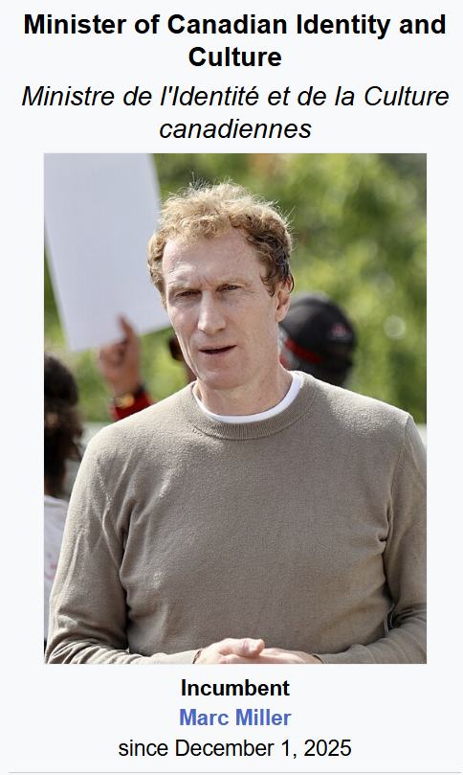
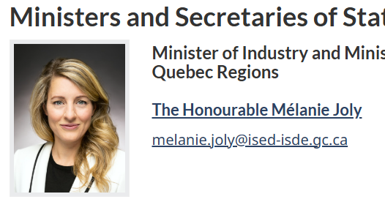
Still kinda political? - Ministers
Broadcasting Act
Telecommunications Act
Notes:
Canadian Identity and Culture for Broadcasting Act → Formerly Minister of Cdn Heritage
Minister of Industry for Telecommunications Act e.g. wireless

Slide 24

New(-ish) Minister!
Role:
???????????
Click on link above → Just goes to Innovation, Science and Economic Development Canada (ISED) (same as Joly’s department)

Slide 25
Still kinda political?
Telecommunications Act
47. The Commission [ed. – CRTC] shall exercise its powers and perform its duties under this Act and any special Act
(…)
(b) in accordance with any orders made by the Governor in Council under section 8 or any standards prescribed by the Minister [ed. – Industry Minister] under section 15.
Notes:
Minister – Industry Mel Joly

Slide 26
Oh yeah, it’s all politics baby
News Release June 2026:
Government of Canada announces immediate support to strengthen Canadian culture and ensure Canadian content remains affordable
“The minister (Miller) is also directing the Canadian Radio-television and Telecommunications Commissions (CRTC) to review its recent decision to regulate online streamers and Canadian broadcasters.” (re Online Streaming Act, I’ll get back to that)

Slide 27
Telecommunications Act
Section 2
telecommunications means the emission, transmission or reception of intelligence by any wire, cable, radio, optical or other electromagnetic system, or by any similar technical system;
intelligence means signs, signals, writing, images, sounds or intelligence of any nature
Section 4
…does not apply in respect of broadcasting by a broadcasting undertaking…
→ So the Broadcasting Act applies to those circumstances
Section 4.1 (new!)
…does not apply in respect of the making available of news content on or by a digital news intermediary in respect of which the Online News Act applies
Notes:
Note 1993, not written for the internet, BUT used that way

Slide 28
Telecommunications Act s. 7
Canadian Telecommunications Policy
It is hereby affirmed that telecommunications performs an essential role in the maintenance of Canada’s identity and sovereignty and that the Canadian telecommunications policy has as its objectives
(a) to facilitate the orderly development throughout Canada of a telecommunications system that serves to safeguard, enrich and strengthen the social and economic fabric of Canada and its regions;
(b) to render reliable and affordable telecommunications services of high quality accessible to Canadians in both urban and rural areas in all regions of Canada;
(c) to enhance the efficiency and competitiveness, at the national and international levels, of Canadian telecommunications;
(d) to promote the ownership and control of Canadian carriers by Canadians;
(e) to promote the use of Canadian transmission facilities for telecommunications within Canada and between Canada and points outside Canada;
(f) to foster increased reliance on market forces for the provision of telecommunications services and to ensure that regulation, where required, is efficient and effective;
(g) to stimulate research and development in Canada in the field of telecommunications and to encourage innovation in the provision of telecommunications services;
(h) to respond to the economic and social requirements of users of telecommunications services; and
(i) to contribute to the protection of the privacy of persons.

Slide 29
Does the broadcasting act cover the internet? Well it’s complicated. Didn't useD to be. teaching this topic used to be much easier! FML.

Slide 30
Public Notice CRTC 1999-197
“Therefore, pursuant to subsection 9(4) of the [Broadcasting] Act, the Commission exempts persons who carry on, in whole or in part in Canada, broadcasting undertakings of the class consisting of new media broadcasting undertakings, from any or all of the requirements of Part II of the Act or of a regulation thereunder. New media broadcasting undertakings provide broadcasting services delivered and accessed over the Internet, in accordance with the interpretation of "broadcasting" set out in…”
→ The “New Media Exemption”
Notes:
Act – Broadcasting Act
“new media broadcasting undertakings” → online video

Slide 31
CRTC 1999-197 (cont.)
“The Commission wishes to clarify that, for the purpose of the Act, a single corporate entity (or other person) may carry on more than one distinct broadcasting undertaking. It considers that the new media activities of a company (or any person) involve a separate undertaking from any other type of broadcasting undertaking that the company or person is licensed to operate”
Notes:
So Bell, Videotron, Rogers, etc. who do many of the things (ISP+)

Slide 32
Reference re Broadcasting Act
2012 SCC 4
F:
None really, it’s a reference! CRTC asked Fed CA to make a determination
BUT parties – Artists / producers (App.) v. ISPs (Resp.), because had vested interest in case
Issue:
Whether Internet Service Providers are “broadcasting undertakings” when they provide end‑users with access to “broadcasting” through Internet

Slide 33
Reference re Broadcasting Act
Held:
Heck no (same as at Fed CA)
Ratio:
“the terms “broadcasting” and “broadcasting undertaking”, interpreted in the context of the language and purposes of the Broadcasting Act , are not meant to capture entities which merely provide the mode of transmission”
Notes:
Which merely – foreshadowing! (re net neutrality)

Slide 34
Reference re Broadcasting Act
“The Act makes it clear that ‘broadcasting undertakings’ are assumed to have some measure of control over programming”
Policies of Act – “freedom of expression and journalistic, creative and programming independence enjoyed by broadcasting undertakings”
“An ISP does not engage with these policy objectives when it is merely providing the mode of transmission”

Slide 35
Reference re Broadcasting Act
Takeaway:
ISPs (when acting as such, i.e. just access) are not “Broadcasting Undertakings” →
Not subject to Broadcasting Act →
CRTC won’t regulate them in that context
Note → ISPs will be more involved in the future, see e.g. GoldTV in coming classes

Slide 36
CRTC
Internet - Our Role
What we do
We regulate the wholesale rates charged by large telephone and cable companies to competitors who access their networks in order to offer their services. We don’t generally regulate the rates charged by Internet service providers to their retail customers.
Retail Internet rates, quality of service and business practices
In general, we don’t intervene in rates, quality of service issues, or business practices of Internet service providers as they relate to retail customers.
However, we want to ensure that all Internet data is treated fairly and that no content or content creator is given an advantage or is disadvantaged by differential pricing practices…. [ed. – foreshadowing class part 2!]

Slide 37
CRTC
Internet - Our Role
Wholesale Internet rates and quality of service
Smaller Internet service providers must use part of a large telephone or cable company’s network to offer Internet and other services to their retail customers. We promote competition in the Internet market by requiring telephone and cable companies to provide access to parts of their networks. This promotes competition, increases choice and ensures greater affordability of Internet services for Canadians.
To ensure competitors can continue meeting the needs of Canadians, the CRTC requires large telephone companies to provide access to their fibre networks. This enables competitor to offer higher-speed Internet services to Canadians. At the same time, the CRTC encourages continued investments to connect more Canadians to higher-speed networks.

Slide 38
Traditional CRTC Conclusion
The CRTC may regulate access to the internet, but not the content of the internet.
→ See e.g. 2nd subject of this class → net neutrality…
(BUT BUT BUT… this is changing. Or has changed already! Stand by, all be relvealed next week!)

Slide 39
Traditional CRTC Conclusion in effect:
Telecom Regulatory Policy CRTC 2019-269
“The Internet Code”
“a mandatory code of conduct for providers (i.e. Internet service providers [ISPs]) of retail fixed Internet access services (Internet Services)”
The Internet Code will:
make it easier for individual customers to obtain and understand the information in their Internet service contracts;
establish consumer-friendly business practices for the Internet service industry where necessary;
contribute to a dynamic Internet service market; and
further the policy objectives out in paragraphs 7(a), (b), (f), and (h) of the Telecommunications Act.
Notes:
Note bold → There was a wireless code in 2017
7(a) etc → economic ones generally

Slide 40
Traditional CRTC Conclusion in effect:
Telecom Regulatory Policy CRTC 2019-269
The Internet Code
Among other things, the Code covers:
Easy to understand contracts
Clearer information about prices
Bill shock protection
Greater flexibility

Slide 41



(Old) parting thought for this section
Notes:
Foreshadowing!

Slide 42
“Traditional” → CRTC Present
“The CRTC will be taking on new responsibilities under two internet-regulation bills introduced by the Liberals and focused on regulating digital platforms like Facebook, Google and Netflix. Heritage Minister Pablo Rodriguez has said he wants to see the CRTC “modernized” to meet these new responsibilities.”
(National Post, Sept 1, 2022)
Notes:
We’ll start seeing these next week

Slide 43
THROTTLE THIS!
Net neutrality

Slide 44
Net Neutrality Defined
“Network neutrality is best defined as a network design principle. The idea is that a maximally useful public information network aspires to treat all content, sites, and platforms equally. This allows the network to carry every form of information and support every kind of application”
Tim Wu, http://www.timwu.org/network_neutrality.html , A Proposal For Network Neutrality paper, June 2002, U Virginia Law School
Notes:
Tim Wu – A Proposal For Network Neutrality paper, June 2002, U Virginia law school (now at Columbia)

Slide 45
Net Neutrality Defined
“the idea that Internet service providers (ISPs) should treat all data that travels over their networks fairly, without improper discrimination in favor of particular apps, sites or services”
-- Electronic Frontier Foundation (EFF)
“broadband providers must treat all internet traffic the same regardless of source”
-- U.S. Court of Appeals

Slide 46
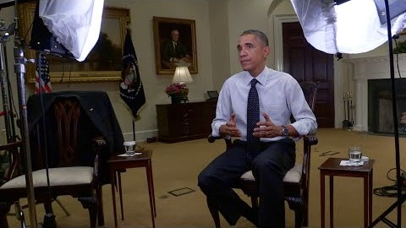
Hear it from someone important
https://youtu.be/uKcjQPVwfDk

Slide 47

Canadian History - 2005
Telus workers on strike, set up a website called Voices for Change; Telus blocked access to the site for its subscribers!
Notes:
Telus workers on strike, set up a website called Voices for Change; Telus blocked access to the site by its subscribers

Slide 48
s. 27(2) Telecommunications Act
No Canadian carrier shall, in relation to the provision of a telecommunications service or the charging of a rate for it, unjustly discriminate or give an undue or unreasonable preference toward any person, including itself, or subject any person to an undue or unreasonable disadvantage.
Canadian carrier → for our purposes, ISPs & mobile providers

Slide 49
“ITMP framework” - Telecom Regulatory Policy CRTC 2009-657
Review of the Internet traffic management practices of Internet service providers
(ITMP = Throttling)
Telecommunications Act:
Content of messages
36. Except where the Commission approves otherwise, a Canadian carrier shall not control the content or influence the meaning or purpose of telecommunications carried by it for the public.
Notes:
ITMP → Throttling!

Slide 50
“ITMP framework” - Telecom Regulatory Policy CRTC 2009-657
(para. 122) “The Commission finds that where an ITMP would lead to blocking the delivery of content to an end-user, it cannot be implemented without prior Commission approval.”
(126) “the Commission finds that use of an ITMP resulting in the noticeable degradation of time-sensitive Internet traffic will require prior Commission approval”
Notes:
ITMP → Throttling!

Slide 51
Broadcasting and Telecom Decision CRTC 2015-26
Complaint against Bell Mobility Inc. and Quebecor Media Inc., Videotron Ltd. and Videotron G.P. alleging undue and unreasonable preference and disadvantage in regard to the billing practices for their mobile TV services Bell Mobile TV and illico.tv
F → Bell and Videotron not charging against data caps for their mobile TV services (“zero rating”)
Held → violates 27(2)
Note: we call this the “Mobile TV Decision”
Notes:
Precursor to the 2017 stuff

Slide 52
Mobile TV decision
Step 1: → Are they subject to the (Telecommunications) Act?
“The Commission therefore rejects Bell Mobility’s and Videotron’s arguments that the relief claimed pursuant to the Telecommunications Act should be denied on the basis that they are not subject to that Act. Section 4 of the Telecommunications Act does not apply as a shield to the application of the Telecommunications Act in this case given that Bell Mobility and Videotron are acting as Canadian carriers in providing transport and data connectivity services required for the delivery of their mobile TV services”
Step 2: → Violates 27(2)?
“The Commission therefore finds that in providing the data connectivity and transport required for consumers to access their respective mobile TV services on their mobile devices, Bell Mobility and Videotron have given a preference in favour of subscribers of their respective mobile TV services, as well as in favour of their own services, and have subjected consumers of other audiovisual content services, and other services, to a corresponding disadvantage.”
Notes:
Section 4 → Telecom Act doesn’t apply to broadcasters
Note → “undue and unreasonable” → so it might be reasonable to do so???

Slide 53
CRTC 2017-104 (Policy) and
2017- 105 (Decision)
April 20, 2017
105 refers to 104, 104 refers to 105, 105 uses 104 criteria
CRTC standard practice (see also SCC)
Teaching confusion for your instructor!

Slide 54
Telecom Decision CRTC 2017-105
Roseline Rustveld presentation

