Slide 1


Doe 464533 v. N.D.
By Molly Hamilton
4 November 2024

Slide 2



Overview
  Background
  Facts
  Procedural History
  Doe 464533 v N.D., 2016 ONSC 541
    Issues
    Reasoning
  Doe v N.D., 2016 ONSC 4920
    Issues
    Reasoning

Slide 3
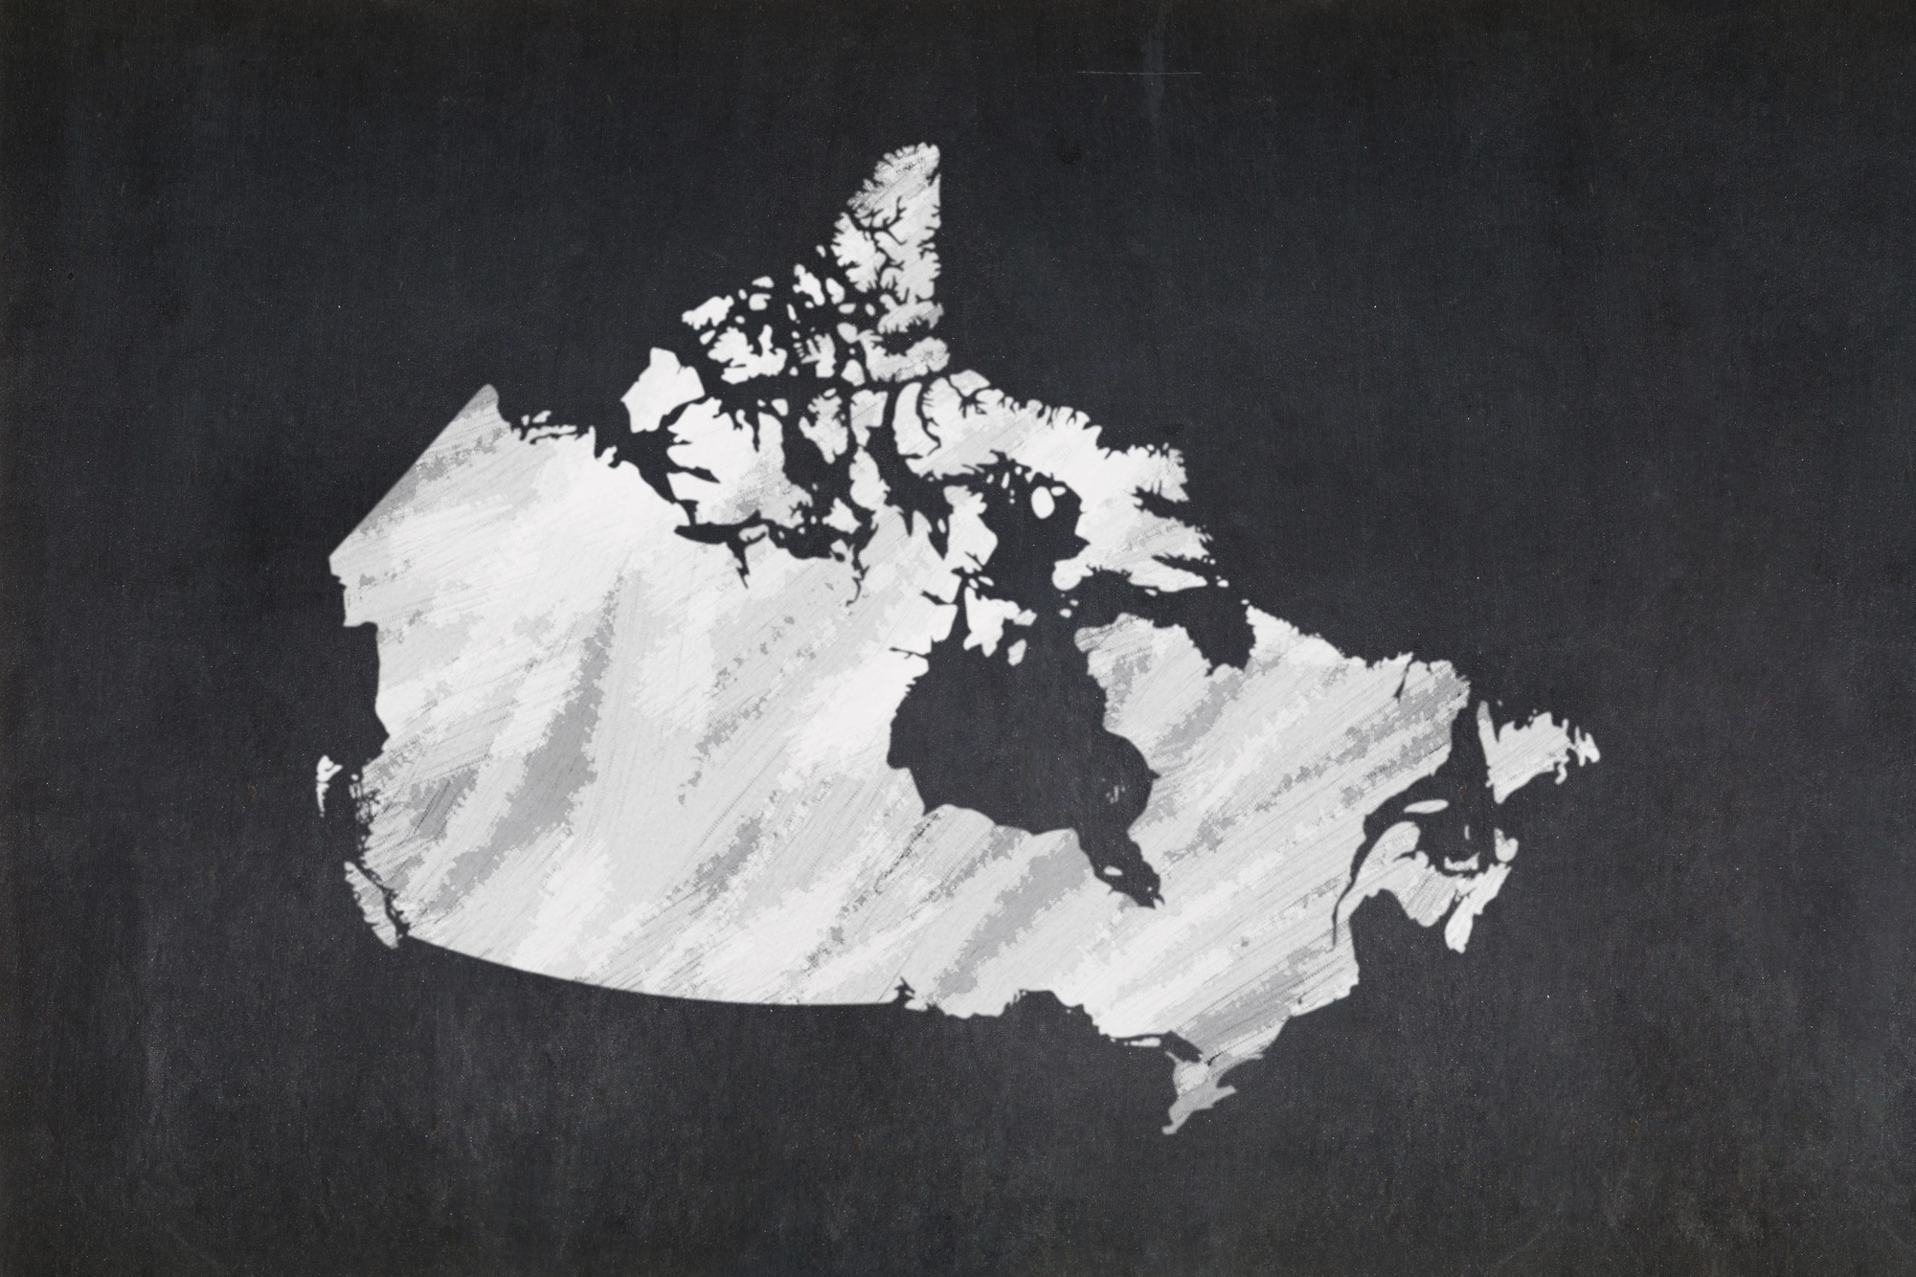

Background
  No decisions in Canada concerning a victim seeking civil damages for the non-consensual distribution of intimate images.
  In 2014, Parliament amended section 161.1 of the Criminal Code.
    “Anyone who publishes an intimate image of a person without that person’s consent is guilty of an offence”
    Can be sentenced up to five years in prison
  November 2015, Province of Manitoba enacted legislation to create the tort of non-consensual distribution of intimate images.
    Came into force in January 2016
    No other province at the time had similar legislation

Slide 4
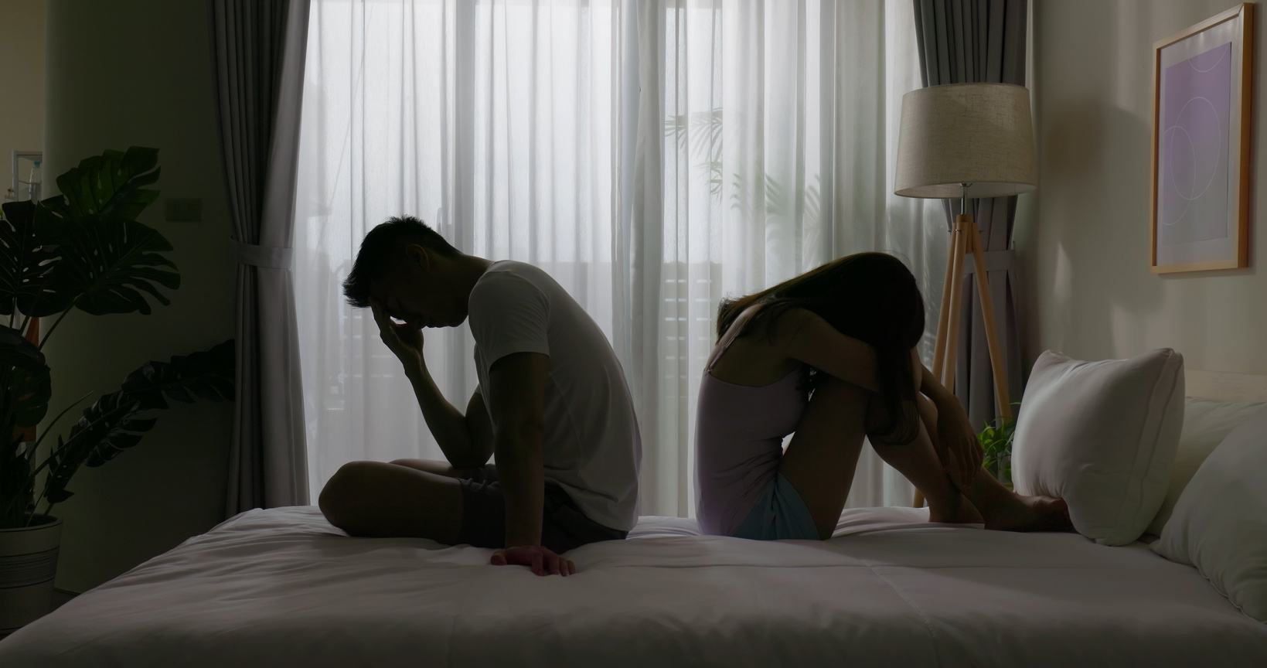
Facts
  Doe and N.D. dated in their last year of high school.
  August 2011, N.D. asks Doe for a sexually explicit video of herself.
  Although she refused, he continued to ask her over the following months.
  In November 2011, Doe recorded a video of herself.
  N.D. posted the intimate video of her on a pornography website without her knowledge or consent
  December 2011, Doe learns that N.D. posted the video on an internet pornography website, and that he shared the videos with friends

Slide 5

Facts
  Video had been online for three weeks before it was removed
  No way to know how many times the video was viewed, downloaded, or if it had been copied onto other media storage devices, or recirculated
  Significant and long-lasting consequences for Doe
    Couldn’t sleep or eat
    Taken to crisis intervention centre at a hospital
    Depression and panic attacks
    Fear of long-term consequences

Slide 6




Procedural History
First judgement rendered
Action commenced
Feb. 2012
Aug. 2015
July 2016
Fall 2011
Sept. 2012
Jan. 2016
N.D. informed Doe’s lawyer that he was unwilling either to settle or to defend the action.
Second judgement rendered
Doe’s lawyer sent demand letter to N.D.

Slide 7

Doe 464533 v. N.D.
2016 ONSC 541

Slide 8



Issues
Is there a remedy for victims of non-consensual distribution of images in the common law?
If so, what is the legal basis upon which claims might be founded?

Slide 9

Reasoning
Legal basis for claim
Breach of Confidence
Intentional Infliction of Mental Distress
Invasion of Privacy

Slide 10

Breach of Confidence
Grant v. Winnipeg Regional Health Authority (2015): The unauthorized use of confidential information to the detriment of the party communicating it, and from which damage ensued, may lead to a cause of action.
Three elements:
  The information must have the necessary quality of confidence about it
  Information must have been imparted in circumstances importing an obligation of confidence
  Must be unauthorized use of that information to the detriment of the party communicating it.
      essential element: harm to plaintiff

Slide 11
Breach of Confidence
  Necessary quality of confidence
    The video shared was private and personal.
    Not made to be publicly available
  Imparted in circumstances importing an obligation of confidence
    Video was given to N.D. on the understanding that he would treat it as confidential
  Unauthorized use of that information to the detriment of the party communicating it.
    Doe experienced emotional and psychological harm
    Possible future adverse impact on career and employment prospects

Slide 12

Intentional Infliction of Mental Distress
Prinzo v. Baycrest Centre for Geriatric Care (2002):
  Conduct that is flagrant and outrageous
  Calculated to produce harm; and
    Clearly foreseeable that the actions of the tortfeasor would cause harm to the victim.
    Kind of harm must have been intended or known to happen.
    Defendant must have desired to produce the mental distress or known that this type of harm was going to happen.
  Resulting in a visible and provable injury
    Doesn’t have to just be physical injury
  Malicious purpose is not required

Slide 13
Intentional Infliction of Mental Distress
  Conduct that is flagrant and outrageous
    Knew she was hesitant to share with him intimate and private images and videos
    Said that the video was only for him
    Posted the video on the very day he got it from her, and shared it with friends.
  Calculated to produce harm; and
    “[...] entirely foreseeable that posting an intimate video of a young woman - who had provided it in the expectation that it would remain confidential - on a public website, and share the video with peers, would cause the person whose trust has been betrayed in this fashion extreme emotional upset and understandable psychological distress.” (para. 31)

Slide 14
Intentional Infliction of Mental Distress
3. Resulting in a visible and provable injury
    N.D.’s conduct didn’t cause actual physical harm
    His conduct caused significant psychological harm
      Taken to a crisis centre at the hospital
      Depression
      Extensive counselling
      Remains emotionally fragile and vulnerable

Slide 15

Invasion of Privacy
Jones v. Tsige (2012): recognized the existence of the tort of invasion of privacy known as intrusion upon seclusion.
Prosser, “Privacy” four-tort catalogue
  Intrusion upon the plaintiff’s seclusion or solitude, or into his private affairs*
  Public disclosure of embarrassing private facts about the plaintiff**
  Publicity which places the plaintiff in a false light in the public eye
  Appropriation, for the defendant’s advantage, of the plaintiff’s name and likeness.

Slide 16
Invasion of Privacy
  Intrusion upon Seclusion
    “One who intentionally intrudes, physically or otherwise, upon the seclusion of another or his private affairs or concerns, is subject to a liability to the other for invasion of his privacy, if the invasion would be highly offence to a reasonable person”
  Elements:
    Must be something in the nature of prying or intrusion
    Intrusion must be something which would be offensive or objectionable to a reasonable person
    The thing into which there is prying or intrusion must be, and be entitled to be, private; and
    The interest protected by this branch of the tort is primarily a mental one. It has been useful chiefly in the gaps left by trespass, nuisance, the intentional infliction of mental distress, and whatever remedies there may be for the invasion of constitutional rights
  Charter considerations
    Right to Privacy = section 8
    Common law developed in a way to be consistent with Charter.

Slide 17
Invasion of Privacy
2. Public disclosure of embarrassing private facts about the plaintiff
    Public disclosure, and not a private one
    Private facts, and not public ones;
    The matter made public must be one which would be offensive and objectionable to a reasonable man of ordinary sensibilities
  Judge adopts Restatement with modification:
    “One who gives publicity to a matter concerning the private life of another is subject to liability to the other for invasion of the other’s privacy, if the matter publicized or the act of the publication (a) would be highly offensive to a reasonable person, and (b) is not of legitimate concern to the public” (para 46).

Slide 18
Invasion of Privacy
In this case:
  N.D posted on the internet a privately-shared and highly personal intimate video
  He made public an aspect of the plaintiff’s private life
  A reasonable person would find such activity to be highly offensive

Slide 19
Reasoning
Remedies
Damages
Injunctive Relief
Procedural Directions
  Simplified Procedure
  Look at similar cases
    B.M.G. v. Nova Scotia (2007)
    Blackwater v. Pint (2005)
  General Damages = $50,000
  Aggravated Damages = $25,000
  Punitive Damages = $25,000
  Order directing defendant to immediately destroy any and all intimate images or recordings of the plaintiff
  Permanently prohibiting the defendant from publishing, posting, sharing or otherwise disclosing in any fashion any intimate images or recordings of the plaintiff
  Prohibiting the defendant from communicating with the plaintiff or members of her immediate family, indirectly or directly.
  Allow plaintiff to not use her real name, and allow her to use “Jane Doe”
  Publication ban

Slide 20

Doe 464533 v. N.D.
2016 ONSC 4920

Slide 21
Procedural History
First judgement rendered
Action commenced
Feb. 2012
Aug. 2015
July 2016
Fall 2011
Sept. 2012
Jan. 2016
N.D. informed Doe’s lawyer that he was unwilling either to settle or to defend the action.
Second judgement rendered
Doe’s lawyer sent demand letter to N.D.

Slide 22
Facts
  Defendant seeks to set aside the findings on liability and the awards of damages, interest and costs
  2012-2015: On and off negotiations to come up with a settlement
  May 20, 2015: email from N.D saying he doesn’t have the money
  August 11, 2015: N,D, informs Doe that he was not signing a settlement and he would not be filing a defence
  December 2016: N.D. asks for the new date but was never given the new date.
  February 2016: N.D. retains counsel, who sought to get the earliest day possible to have this motion to set aside the default judgement heard.

Slide 23

Issues
Can the default judgement rendered January 2016 be set aside?

Slide 24
Reasoning
Mountain View Farms Ltd. v. McQueen test
Whether the motion was brought promptly after the defendant learned of the default judgement;
Whether there was a plausible excuse or explanation for the defendant’s default in complying with the Rules;
Whether the facts established that the defendant has an arguable defence on the merits
The potential prejudice to the moving party should the motion be dismissed and the potential prejudice to the responding party should the motion be allowed; and
The effect of any order the Court might make on the overall integrity of the aministration of justice

Slide 25


Reasoning
Mountain View Farms Ltd. v. McQueen test
Promtness | Plausible Excuse or Explanation | Arguable Defence | Prejudice | Effect of Order

Slide 26

Decision
  Motion was granted and judgement was set aside
  Defendant ordered to pay plaintiff $10,000

Slide 27

Conclusion
  Plaintiff appealed the second judgement
    Leave to appeal was denied
  Uncertain of the first judgement’s value as precedent
    CanLii shows 51 cases have treated the first decision

Slide 28
Thank You

