Slide 1
Class 8 – November 11 1. Still some defamation stuff 2. My Image is My Own – Rights to your image and reputation online [and “revenge porn” tbd] 3. Forget Me Not? – the Right to Be Forgotten in Europe (and Canada?) and Introduction to European Data Protection (Presentations)

Slide 2
Admin Crap
EXAM:
Take home it is! (3-hour fixed date)
Apologies for “class bleed”…
Related: apologies for lack of guests
Course Evaluations now open on Mercury

Slide 3
In the News
Government of Canada orders the wind up of TikTok Technology Canada, Inc. following a national security review under the Investment Canada Act
November 6, 2024
Today, the Honourable François-Philippe Champagne, Minister of Innovation, Science and Industry, made the following statement:
“As a result of a multi-step national security review process, which involves rigorous scrutiny by Canada’s national security and intelligence community, the Government of Canada has ordered the wind up of the Canadian business carried on by TikTok Technology Canada, Inc. The government is taking action to address the specific national security risks related to ByteDance Ltd.’s operations in Canada through the establishment of TikTok Technology Canada, Inc. The decision was based on the information and evidence collected over the course of the review and on the advice of Canada’s security and intelligence community and other government partners.
“The government is not blocking Canadians’ access to the TikTok application or their ability to create content. The decision to use a social media application or platform is a personal choice…
The government’s decision was made in accordance with the Investment Canada Act, which allows for the review of foreign investments that may be injurious to Canada’s national security.

Slide 4
Now where were we…

Slide 5
Defamation on the internet

Slide 6
Third-Party liability - links
Crookes v. Newton, 2011 SCC 47
F: Newton runs website, published links to defamatory content
“a hyperlink, by itself, should never be seen as ‘publication’ of the content to which it refers” (Abella J., who says you must repeat the defamation)
(concurring, McLachlin and Fish JJ.) “Publication of a defamatory statement via a hyperlink should be found if the text indicates adoption or endorsement of the content of the hyperlinked text. “
Notes:
The last substantive thing I said…

Slide 7
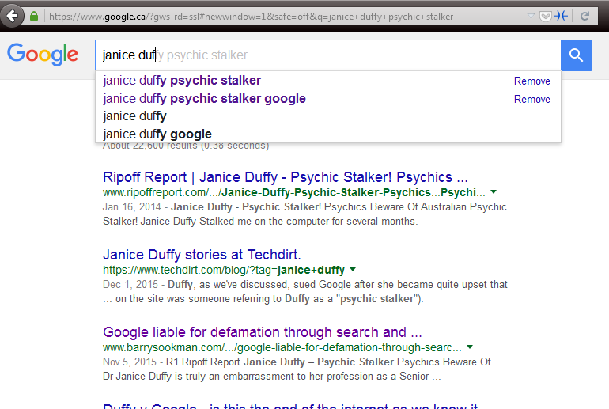
Third party liability – links+
Duffy v Google Inc. [2015] SASC 170
→ Secondary publication, Google liable!
Notes:
Defamatory “Snippets” of text from site on Google results → NOTE RIPOFF REPORT
publishing a hyperlink to defamatory material along with search results information made Google a secondary publisher of the information → importance was title of the result, which is a hyperlink → this cited Crookes which said “The Court held that merely creating a hyperlink without more did not amount to publication of the material on the external webpage”, here there was more
$115k damages awarded

Slide 8
Third party liability – links+
Duffy v Google Inc. [2017] SASCFC 130 (October 4, 2017)
→ upheld, Google is in fact a secondary publisher
“There is an important distinction between a pre-programmed automated system and passivity. It is the degree to which the automated programmers facilitate the production of defamatory material in a written and therefore comprehensible form which is important”
“Google participated in the publication of the paragraphs about Dr Duffy produced by its search engine because it intended its search engine to do what it programmed it to do”

Slide 9
Duffy (cont’d)
Duffy v Google LLC [2023] SASC 13 (February 3, 2023)
“the subject snippets did more than describe a story about a person; they described her as a furtive stalker in terms amounting to an imputation of criminal conduct… (Google’s) capacity to entice the reader to select the hyperlinks was enhanced by the preeminent ranking”
Snippets were defamatory – Google took down the links, but did not change auto-complete and were very aware of the problem thanks to all the court cases!
Future hearing on damages, still appeal coming…

Slide 10
Google Auto-Complete Policy
1. Sexually explicit predictions
We remove predictions that contain sexually explicit or vulgar language. Pornographic terms or terms that are closely associated with pornography are removed from predictions.
2. Hateful predictions against groups and individuals
We remove predictions that include language that denigrates or insults individuals or groups on the basis of race, ethnic origin, religion, disability, gender, age, nationality, veteran status, sexual orientation, or gender identity.
3. Violent predictions
We remove predictions that include graphic descriptions of violence or advocate violence generally.
4. Dangerous and harmful activity in predictions
We remove predictions promoting dangerous or criminal activities that would lead to real-world harm.

Slide 11
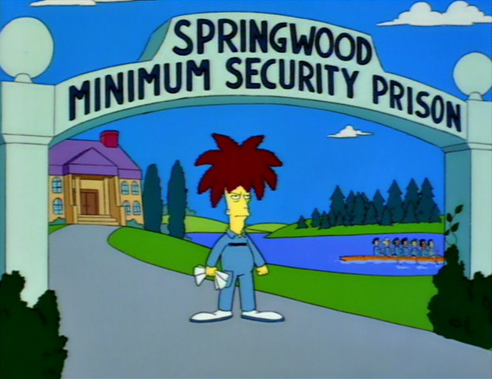
Defamation - criminal remedies?

Slide 12
Defamatory Libel
Criminal Code
298. (1) A defamatory libel is matter published, without lawful justification or excuse, that is likely to injure the reputation of any person by exposing him to hatred, contempt or ridicule, or that is designed to insult the person of or concerning whom it is published.
300. Every one who publishes a defamatory libel that he knows is false is guilty of an indictable offence and liable to imprisonment for a term not exceeding five years.
301. Every one who publishes a defamatory libel is guilty of an indictable offence and liable to imprisonment for a term not exceeding two years
Notes:
Very rare, rarely used
Criminal speech is problematic
300 upheld by SCC in R v Lucas 1998
301 is generally held unconstitutional by the courts (4 different provinces, not yet at SCC), violating freedom of expression and not saved by s. 1

Slide 13
Criminal Harassment
s. 264 Criminal Code
264 (1) No person shall, without lawful authority and knowing that another person is harassed or recklessly as to whether the other person is harassed, engage in conduct referred to in subsection (2) that causes that other person reasonably, in all the circumstances, to fear for their safety or the safety of anyone known to them.
(2) The conduct mentioned in subsection (1) consists of (…)
(b) repeatedly communicating with, either directly or indirectly, the other person or anyone known to them;

Slide 14
Criminal Harassment on Twitter?
Elliott v. R, 2016 ONCJ 35
@LadySnarksalot how fat is your ass
” The element that the fear be reasonable in all of the circumstances has not been established”
”I am not satisfied beyond a reasonable doubt that Mr. Elliott’s repeated communications caused Ms. Reilly to fear for her safety”
Notes:
Long conversations on Twitter with two women Guthrie et Reilly
Nasty tweets, women said they feared for their safety
E.g. @LadySnarksalot how fat is your ass
Judge cites freedom of expression

Slide 15
Caplan v. Atas
2021 ONSC 670
F: Atas made defamatory statements (on Reddit, Pinterest, Facebook, Lawyerratingz, Blogspot, and more!) about as many as 150 targets (lawyersover several decades
Note: 4 different causes of action ruled on together
Factual holding: “On the totality of the evidence I find that Nadire Atas has long used anonymous and pseudonymous communications to respond to grievances she has – or believes she has – against other people.”

Slide 16
Criminal AND / OR Civil Remedy?
“Atas has engaged in a vile campaign of cyber-stalking against the plaintiffs in the four actions, the goal of which has been retribution for longstanding grievances. As argued by the plaintiffs, the conduct falls in the area where the civil and criminal law intersect.”

Slide 17
Freedom of speech and the internet
“Freedom of speech and the law of defamation have developed over centuries to balance the importance of preserving open public discourse, advancing the search for truth (which must allow for unpopular and even incorrect speech), protecting personal reputations, promoting free democratic debate, and enforcing personal responsibility for statements made about others. The value of freedom of speech, and the need for some limits on that freedom, have long been recognised as central to a vibrant and healthy democracy and, frankly, any decent society.
The internet has cast that balance into disarray.”
“Atas has engaged in a vile campaign of cyber-stalking against the plaintiffs in the four actions, the goal of which has been retribution for longstanding grievances. As argued by the plaintiffs, the conduct falls in the area where the civil and criminal law intersect. ….

Slide 18
Caplan v. Atas – The Problem
“The law should respond to this conduct to compensate victims, to express the law’s disgust and firm rejection of the conduct, to punish for wrongful conduct, to deter Atas and others from this sort of conduct in future, and to bring Atas’ wrongful conduct to an end.
The law’s response, thus far, has failed to respond adequately to Atas’ conduct.”
“The law of defamation provides some recourse for the targets of this kind of conduct, but that recourse is not sufficient to bring the conduct to an end or to control the behaviour of the wrongdoer.”

Slide 19
Caplan v. Atas – The Solution
‘..this court’s conclusion that the common law tort of harassment should be recognized in Ontario. “Harassment” describes what Atas has been doing, and ordering Atas to stop harassment provides remedial breadth not available in the law of defamation.’
“In my view, the tort of internet harassment should be recognized in these cases because Atas’ online conduct and publications seek not so much to defame the victims but to harass them”

Slide 20
Internet Harassment – The Test
“…the following test for the tort of harassment in internet communications: where the defendant maliciously or recklessly engages in communications conduct so outrageous in character, duration, and extreme in degree, so as to go beyond all possible bounds of decency and tolerance, with the intent to cause fear, anxiety, emotional upset or to impugn the dignity of the plaintiff, and the plaintiff suffers such harm.
The facts of these cases clearly meet this stringent test.”

Slide 21
Caplan v. Atas – The Remedies
Removal of all the harassing content
Injunctions to stop harassing people – plaintiffs and non-plaintiffs (even dead people!) alike
“the court is entitled to order Atas to desist from defaming and harassing non-parties where that conduct is part of a campaign of harassment directed against parties to these cases”
NOT ordered:
Damages because Atas has no $
Apology because Atas did all this anonymously and she is not famous or well-regarded so not effective (& other reasons)

Slide 22
Some foreshadowing…
‘[these facts] are much closer to the situation in which the Court of Appeal recognized the tort of intrusion on seclusion, Jones v. Tsige, in which Sharpe J.A. stated: “we are presented in this case with facts that cry out for a remedy“’

Slide 23
Some more foreshadowing (the RTBF)
One of the 150 victims who came forwarded and commented in the media:
“I just want to make sure people know it's not true and how easily people can be tarnished by somebody they don't even know just by posting something online,” Alkins said, referring to how he and others are labelled as pedophiles and whatever else that might embarrass them. “And you can't get it removed.”
(Travis Alkins was targeted because his wife Melanie has an aunt who worked for a law firm that was hired to repossess property Atas lost as she went bankrupt)

Slide 24
Rights to your image and reputation (in image form) online
Notes:
Reputation – in visual form! Defamation we just looked at was about words

Slide 25
Personality Rights Publication Rights
Right to your image
Right to your likeness
Right to your voice
Right to your name
Others? Email addy? Twitter /X username?
→ Your persona
Notes:
Others? i.e. enough PI to identify you, like email, Twitter user account name

Slide 26
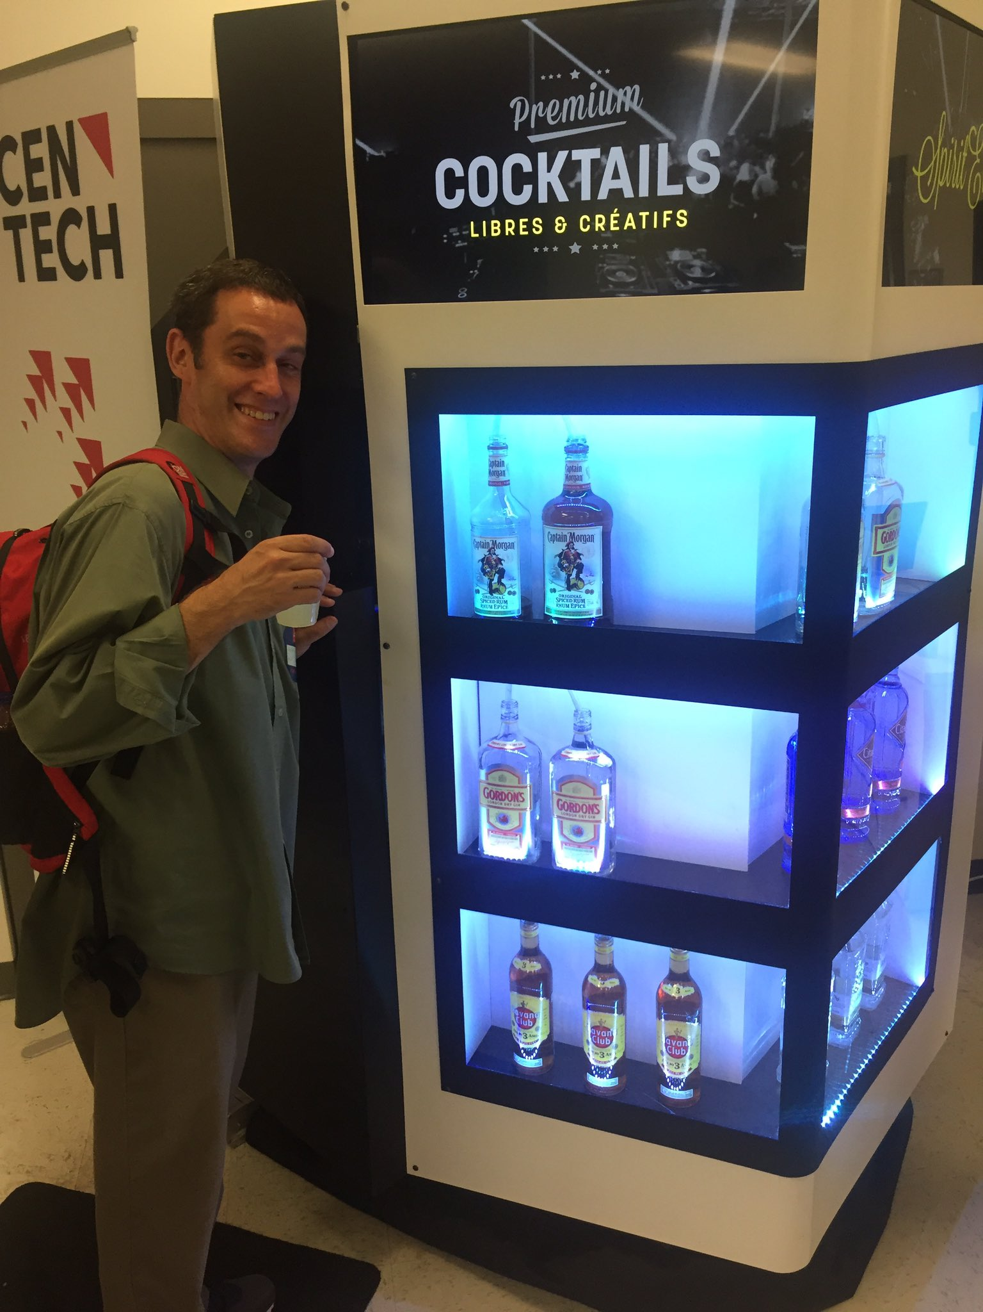
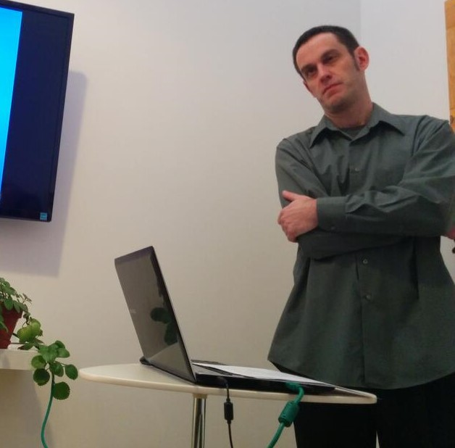
Personality Rights in play when…
$$$$$$$$$$$$$
Reputation / defamation
Notes:
Company making money of me by putting that on their blog?

Slide 27
Personality Rights in play when…
$$$$$$$$$$$$$
Reputation / defamation
Recall Douez v. Facebook Class 3 – territorial jurisdiction
BUT underlying privacy rights case → Mrs. Douez’ (and potential class) photo and name used in FB advertisement
A.B. v Bragg Communications
2012 SCC 46 ( a couple of weeks from now)
→ Fake FB profile with picture of A.B. and similar name, along with unflattering comments, sexual references
Notes:
AB Bragg – discussion in a few weeks

Slide 28
Personality Rights – Common Law
Specific references in Privacy Acts of British Columbia, Manitoba, Newfoundland, and Saskatchewan (see next slide)
Other common law provinces – tort of “appropriation of personality” or “wrongful appropriation of personality”

Slide 29
Common Law Statutes
MB, NL, SK
British Columbia
Personality rights are a subset of the right to privacy
Name, likeness, voice
No proof of damages required
Personality rights violations are a tort in and of themselves
Name and likeness only
No proof of damages required

Slide 30
e.g. Manitoba The Privacy Act
2. A person who substantially, unreasonably, and without claim of right, violates the privacy of another person, commits a tort against that other person.
3. Without limiting the generality of section 2, privacy of a person may be violated
(…)
(c) by the unauthorized use of the name or likeness or voice of that person for the purposes of advertising or promoting the sale of, or any other trading in, any property or services, or for any other purposes of gain to the user if, in the course of the use, that person is identified or identifiable and the user intended to exploit the name or likeness or voice of that person

Slide 31
British Columbia – The Privacy Act
3. (1) In this section, “portrait” means a likeness, still or moving, and includes
(a) a likeness of another deliberately disguised to resemble the plaintiff, and
(b) a caricature.
(2) It is a tort, actionable without proof of damage, for a person to use the name or portrait of another for the purpose of advertising or promoting the sale of, or other trading in, property or services, unless that other, or a person entitled to consent on his or her behalf, consents to the use for that purpose.

Slide 32
Forget Me Not? – the Right to Be Forgotten in Europe (and Canada?) and Introduction to European Data Protection

Slide 33
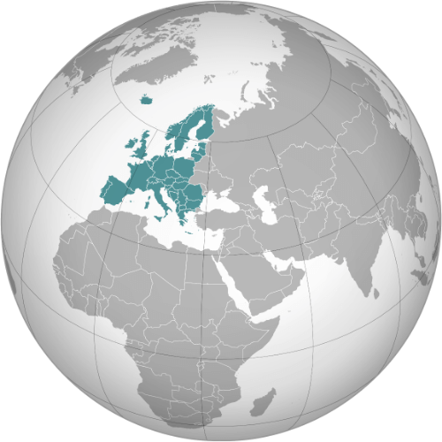
EUROPE!
Notes:
Happy to have Europeans!
Why important will become clear
Pay attention, all presentations are related

Slide 34
Charter of Fundamental Rights Of the European Union
Article 7
Everyone has the right to respect for his or her private and family life, home and communications.
Article 8
1. Everyone has the right to the protection of personal data concerning him or her.
2. Such data must be processed fairly for specified purposes and on the basis of the consent of the person concerned or some other legitimate basis laid down by law. Everyone has the right of access to data which has been collected concerning him or her, and the right to have it rectified.
3. Compliance with these rules shall be subject to control by an independent authority.
Notes:
Quality charter!
New, made binding by the Treaty of Lisbon in force 2009

Slide 35
T.V. Time!
https://www.cbc.ca/news/thenational/right-to-be-forgotten-should-past-wrongs-stay-public-forever-1.4642607

Slide 36
SO WHAT IS THIS RIGHT TO BE FORGOTTEN I KEEP HEARING ABOUT on tv?

Slide 37
Google v. AEPD and Gonzalez
Chloe Hughes-Legare & Emma Peress

Slide 38
WHY IN CANADA (OR ANYWHERE ELSE) SHOULD WE CARE ABOUT EU DATA PROTECTION LAW?

Slide 39
The GDPR
Isabela Vecchi & Leah Ramsay

Slide 40
Data Protection Commissioner v. Facebook Ireland Ltd, Maximillian Schrems
aka Schrems 2 or Schrems II: Privacy Boogaloo
Julien Bérubé & Divine Tatchinda

