Slide 1


LAWG 536 INTERNET LAW
Class 1 - SEPTEMBER 9, 2024
A series of tubes

Slide 2
https://x.com/almendelsohn
@almendelsohn

Slide 3
ME! Me! Me!

Slide 4
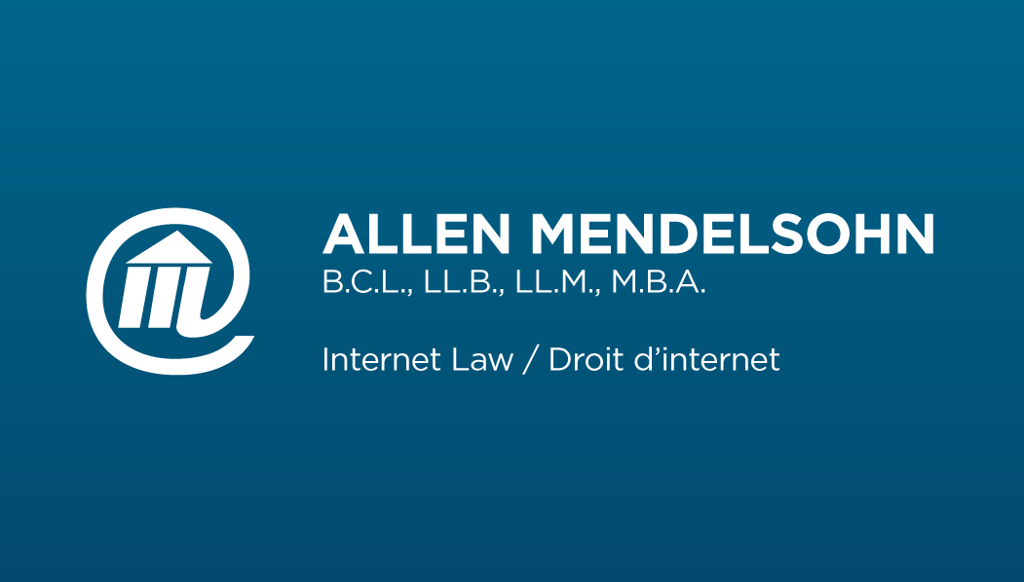
WTF?????

Slide 5
#AMPL/AMPD

Slide 6
#admin_crap
Syllabus

Slide 7
A SERIES OF TUBES

Slide 8
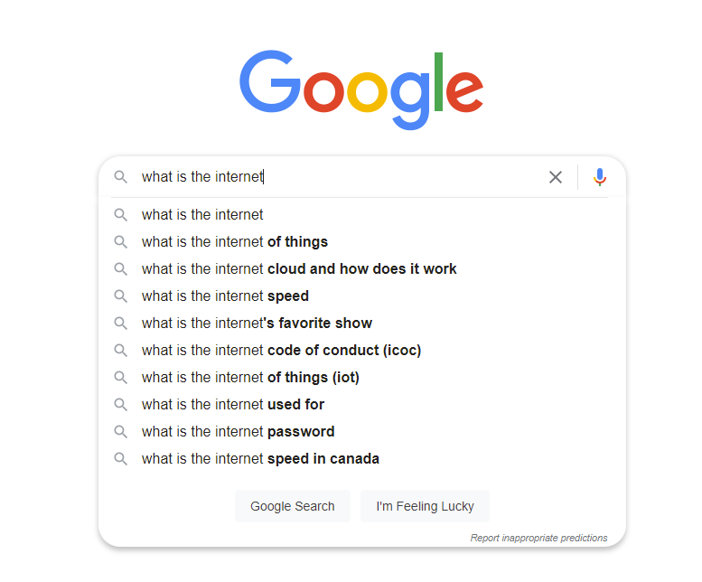
WHAT IS THE INTERNET?

Slide 9
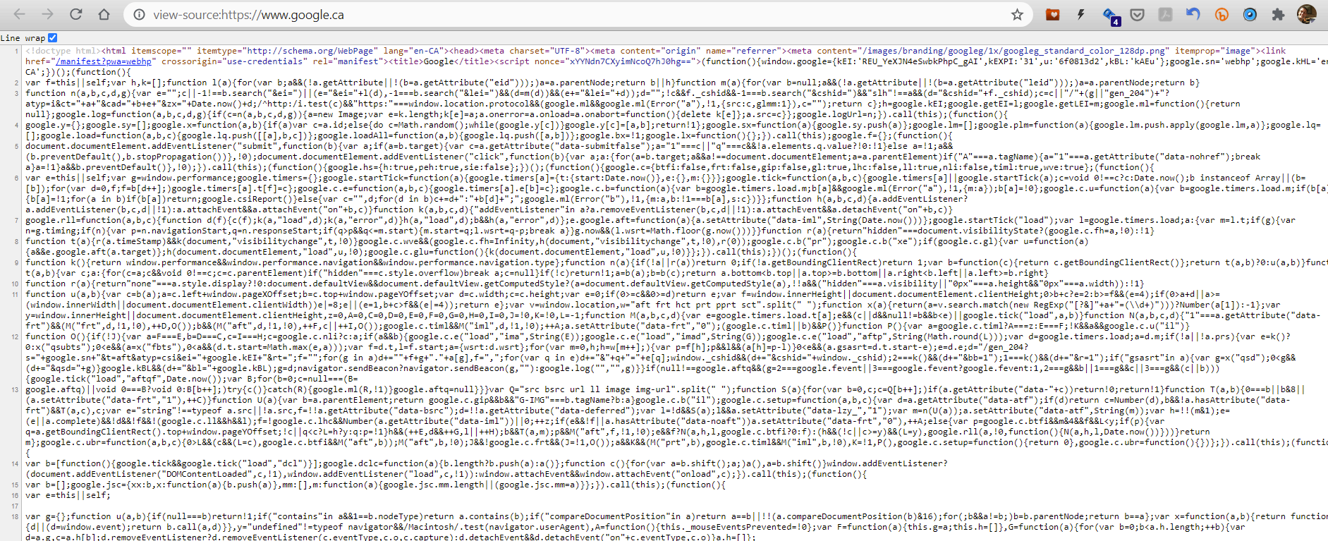
THIS IS teh GOOGLE

Slide 10
“code”

Slide 11
Where is that code (+ other stuff)?

Slide 12
The “server”

Slide 13
How does that code (+ other stuff) get to me from the server?

Slide 14
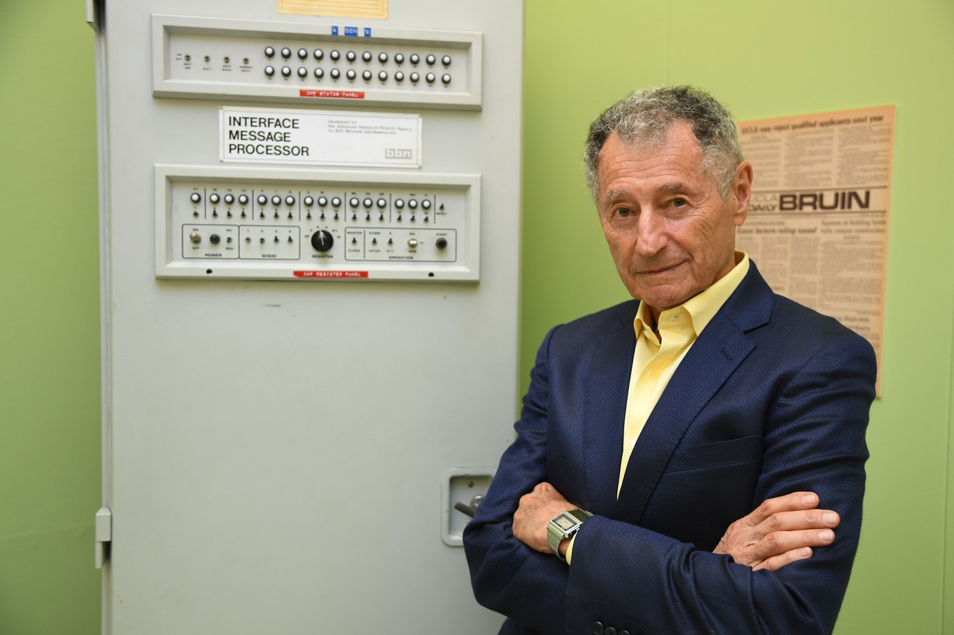
October 29, 1969
Notes:
Leonard Kleinrock UCLA October 29, 1969

Slide 15
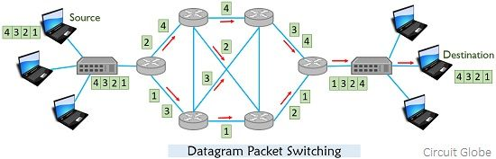
PACKET SWITCHING

Slide 16
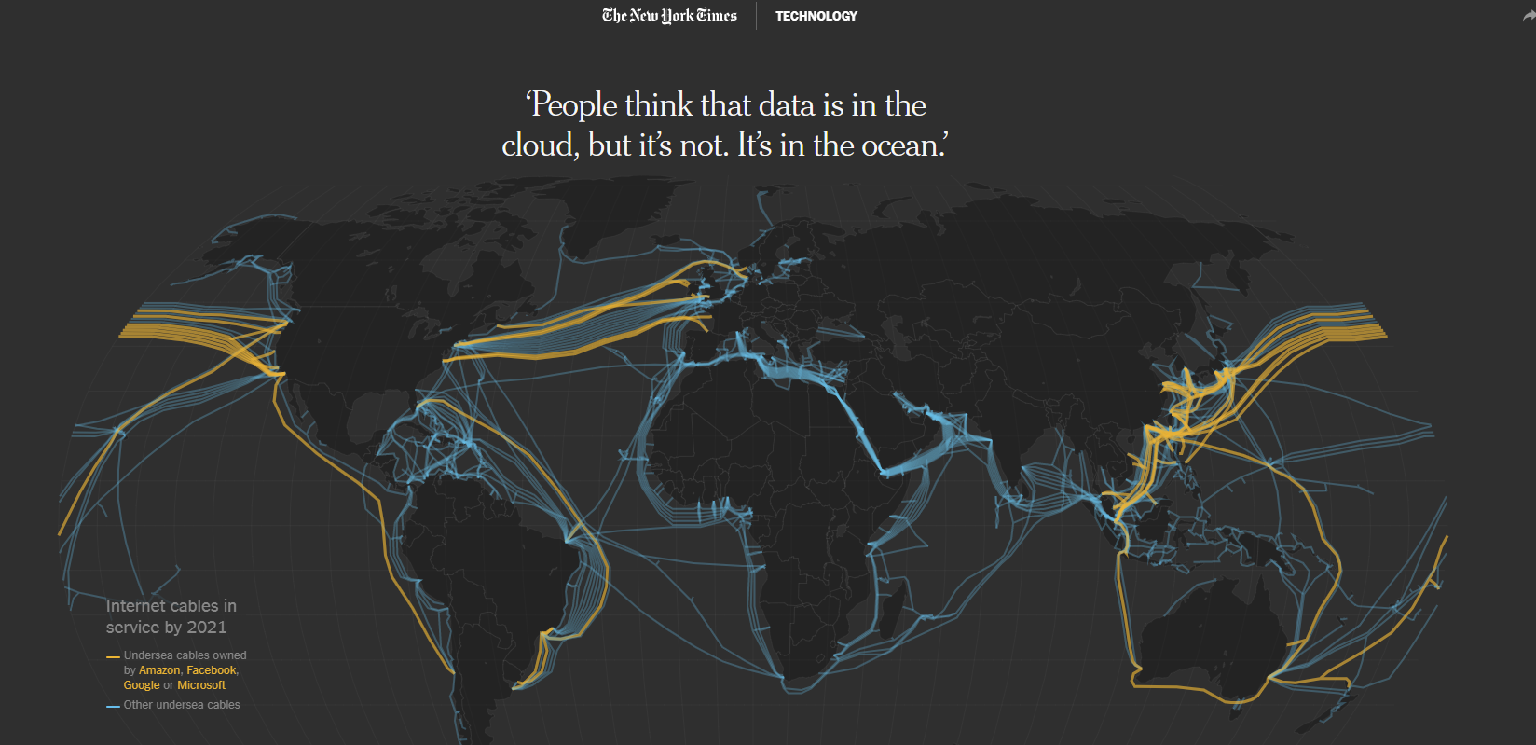
THE SERIES OF TUBES

Slide 17
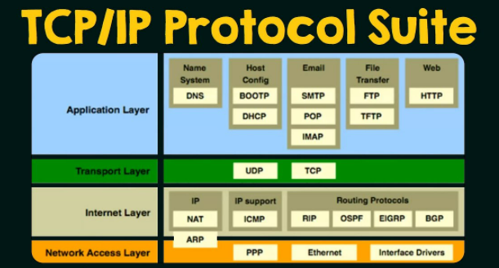
Transmission control Protocol /
Internet Protocol

Slide 18
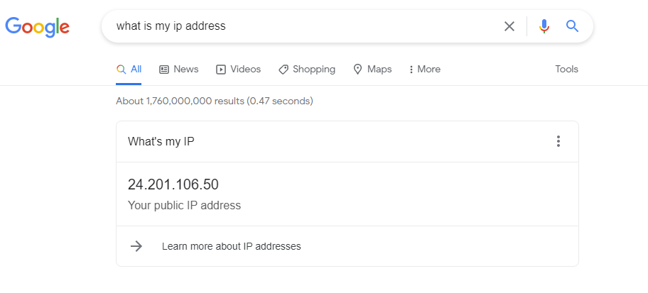
I.p. address

Slide 19
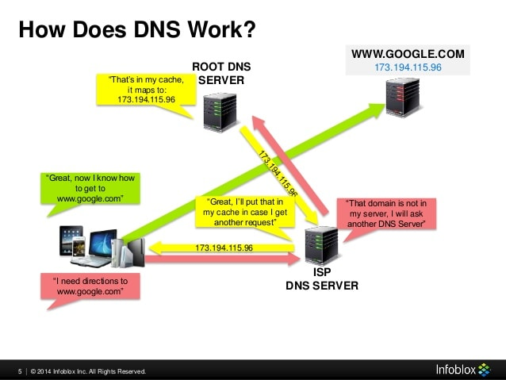
Dns (domain name system)

Slide 20
See you next week
Let’s do this thing!
allenmendelsohn.com/mcgill
allen@allenmendelsohn.com

