Slide 1
Digital Millennium Copyright Act - 17 U.S. Code § 512
Rita Chiboub & Juliette Croce

Slide 2
Do these pictures look familiar?

Slide 3
Outline
I. Introduction
II. Threshold Requirements
Qualifying Repeat Infringer Policy
Accommodating Standard Technical Measures
III. Qualifying OSPs: Limited Liability
Transitory Digital Network ("Mere Conduit")
Notice & Takedown:
Caching
Hosting
Linking
IV. Other Sections
V. Current State

Slide 4
Context of DMCA 15
Federal US law passed in 1998
Created a conditional safe harbor for online service providers (OSPs) by shielding them from potential secondary liability for copyright infringing acts of others
I. Introduction

Slide 5
Striking the balance
OSPs' wish to allow users to post content and communications without being liable for infringing acts of said users
Copyright owners’ fear of large-scale copyright infringement with the rise of user-submitted content
U.S. implementation of the 1996 World Intellectual Property Organization Copyright Treaty (WIPO Copyright Treaty) directive to “maintain a balance between the rights of authors and the larger public interest, particularly education, research, and access to information.”
I. Introduction

Slide 6
II. Threshold Requirements

Slide 7
Repeat Infringer Policy §512(i)(1)(A)
Must adopt, reasonably implement, and inform subscribers/account holders of policy
Goal: Deter potential infringers by showing there is a realistic threat of losing access
Does not require an affirmative duty to monitor (§512 (m)(1))
Goal: Balance copyright owners' interest with privacy interest of users
II. Threshold Requirements

Slide 8
Repeat Infringer Policy §512(i)(1)(A)
Unclear definition of "adopted," "reasonably implemented," and "repeat infringement"
Differing tests applied in courts
Criticisms:
Lax standard for OSPs and burden on the rightsholder (but note BMG Rights Mgmt. [2018] & UMG Recordings [2019] favorable towards copyright owners)
Demand for clearer obligations of OSPs
Terminating account access = Excessively punitive?
II. Threshold Requirements

Slide 9
Repeat Infringer Policy §512(i)(1)(A)
Copyright Office Report Clarifications
Repeat Infringer:
Case-by-case basis depending on type of infringement and type of OSP = malleable
Repeat alleged infringer; not repeat adjudicated infringer
Policy re: circumstances of termination: Not based off of what users do but if the OSP was reasonable in adopting the standard (Court interpretation)
Minimum requirements for implementation:
Does not require perfect implementation
OSP: a) encouraged infringement b) failed to maintain system of notices c) no policy
OSP's must be more stringent on terminating accounts
II. Threshold Requirements

Slide 10
Standard Technical Measures §512(i)(1)(B)
Must accommodate and not interfere with standard technical measures
Measures used by copyright owners to identify / protect their work that have:
Broad consensus they are open, fair, voluntary, and cross multiple industries
Available to any person on terms that are reasonable and nondiscriminatory
Don't impose substantial costs / burdens on OSPs or their systems
II. Threshold Requirements

Slide 11
Standard Technical Measures §512(i)(1)(B)
Do these exist? Not really.
No standard technical measures identified
Doesn't require agreement by all stakeholders for a given STM
Foster cooperation among stakeholders to develop multi-industry process ("More questions than consensus")
II. Threshold Requirements

Slide 12
III. Qualifying OSPs: Limited Liability

Slide 13
Transitory Digital Networks
OSPs that act as mere conduits for the routing of messages across the internet will not be liable for material transmitted through their controlled networks if:
Transmission is not initiated by the OSP
Transmission is not through an automated technical process i.e. OSP did not select the material
OSP did not select the recipients of the material
No copy maintained on system / network is made available to others other than the recipient
Transmission did not modify the content of the material
III. Qualifying OSPs: Limited Liability

Slide 14
Notice & Takedown
The remaining three types of OSPs must comply with the notice-and-takedown system to qualify for the safe harbor provision.
Allows copyright owners to send a notification to the OSP regarding infringing material that appears on the service provider’s system.
Prescribed form, includes identification of the infringing material and a statement attesting to the sender's good faith belief of infringement
Once the OSP receives a compliant notice, it must expeditiously remove or disable access to the infringing material.
The OSP must then promptly notify the user that the originally uploaded material has been removed
III. Qualifying OSPs: Limited Liability

Slide 15
Notice & Takedown​ - ct.
If the user believes their content was removed as the result of a mistake or misidentification of the material, the user may submit a counter-notice requesting the reinstatement of the material.
Following receipt of a compliant counter-notice, the OSP must restore access to the material after no less than and no more than fourteen business days, unless the original notice sender informs the OSP that it has filed a court action against the user.
III. Qualifying OSPs: Limited Liability

Slide 16
Caching safe harbor: §512(b)(1)
“A service provider shall not be liable … for infringement of copyright by reason of the intermediate and temporary storage of material on a system or network controlled or operated by or for the service provider…”
What’s caching? Creation of copies of material for faster access.
III. Qualifying OSPs: Limited Liability

Slide 17
Caching safe harbor – eligibility conditions: § 512(b)(2)
Compliance with the Notice & Takedown system
Someone other than the OSP makes the allegedly infringing material available online
The OSP transmits the material through its system or network at the direction of a third party (eg: an end-user who calls up the original website or online source)
The material is stored through an automated process for the purpose of making it available to other requesting users:
Transmission without modification
The OSP does not allow access to the material without passwords or fees if they were required by the original site
III. Qualifying OSPs: Limited Liability

Slide 18
Online storage/hosting safe harbor: §512(c)(1)
The storage safe harbor protects the OSP against copyright liability “by reason of the storage at the direction of a user of material that resides on a system or network controlled or operated by or for the service provider …”
The key point is that a user, not the OSP, is responsible for the presence of the allegedly infringing material on the OSP’s system.
Eg: YouTube or Spotify, where users are responsible for uploading content
III. Qualifying OSPs: Limited Liability

Slide 19
Hosting safe harbor – eligibility conditions: §512(c)(2)​
Compliance with the Notice & Takedown system
Lack of knowledge: the OSP must not have actual knowledge that it is hosting infringing material or be aware of facts or circumstances from which infringing activity is apparent. Although no duty to monitor, the OSP can be put on notice of infringing material through: a) a notice and take down, or b) the existence of “red flags”
Red flag test has a subjective and objective component:
Subjective: OSP must have knowledge that the material resides on its system
Objective: the “infringing activity would have been apparent to a reasonable person operating under the same or similar circumstances”
III. Qualifying OSPs: Limited Liability

Slide 20
Hosting safe harbor – eligibility conditions: §512(c)(2)​ - ct.
Designate an agent for receipt of copyright claims both on the OSP’s website and in an online US Copyright Office filing
Not derive direct financial benefit from infringement in circumstances where the OSP has the right and ability to control the infringing activity
In A&M Records, Inc. v. Napster, Inc., 239 F.3d 1004 (9th Cir. 2001), the court held that copyrighted material on Napster's system created a "draw" for customers which resulted in a direct financial benefit because Napster's future revenue was directly dependent on increases in user-base.
Conversely, in Ellison v. Robertson, 357 F.3d 1072 (9th Cir. 2004), the court held that AOL did not receive a direct financial benefit when a user stored infringing material on its server because the copyrighted work did not "draw" new customers. AOL neither "attracted [nor] retained…[nor] lost…subscriptions" as a result of the infringing material.
III. Qualifying OSPs: Limited Liability

Slide 21
Linking safe harbor: §512(d)
“A service provider shall not be liable … for infringement of copyright by reason of the provider referring or linking users to an online location containing infringing material or infringing activity, by using information location tools, including a directory, index, reference, pointer, or hypertext link …”
In other words, no liability for providing a search engine that leads to infringing matter
Eg: search engine (Google, Yahoo, Bing, etc.)
III. Qualifying OSPs: Limited Liability

Slide 22
Linking safe harbor – eligibility conditions: §512(d)(1-3)​
Compliance with the Notice & Takedown system
Lack of knowledge or awareness and prompt takedown upon knowledge or awareness
No direct financial benefit
III. Qualifying OSPs: Limited Liability

Slide 23
IV. Other Sections

Slide 24
Other sections (e-h)
§512(e): protects nonprofit educational institutions from liability for the actions of faculty and graduate student employees who place infringing material online
For the immunity to apply, the materials must not be course materials for a course taught by the faculty or graduate student employee, and the institution must not have received more than two infringement notifications about the same individual during the preceding 3 years. The institution must also distribute informational materials about US copyright laws to all the users of its network.
§512(f): deters false claims of infringement by imposing liability on anyone making such claims for the damages suffered by other parties as a result of the OSP’s reliance on the false claim, and associated legal fees
§512(h): identity infringers: allows a copyright owner to force an OSP to reveal identifying information about the user through the use of a subpoena issued by a federal court at the owner’s request
IV. Other Sections

Slide 25
Other sections (j, l & n)
§512(j): injunctions: OSPs may be compelled by copyright holders to stop providing access to infringing material or to terminate the account of a particular infringer
§512(l): ineligibility for a safe harbor does not affect the validity of other defenses
§512(n): an OSP may qualify for more than one safe harbor exemption.
III. Qualifying OSPs: Limited Liability

Slide 26
IV. Current State

Slide 27
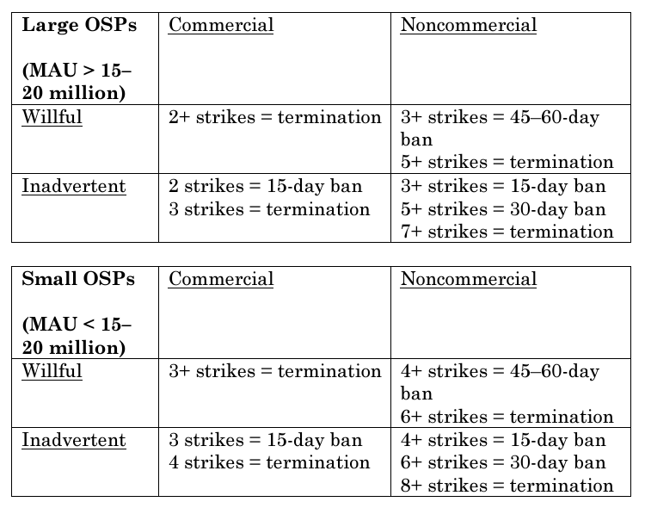
Ambiguities of repeat infringer policy
V. Current State

Slide 28
Notice-and-takedown critiques
V. Current State

Slide 29
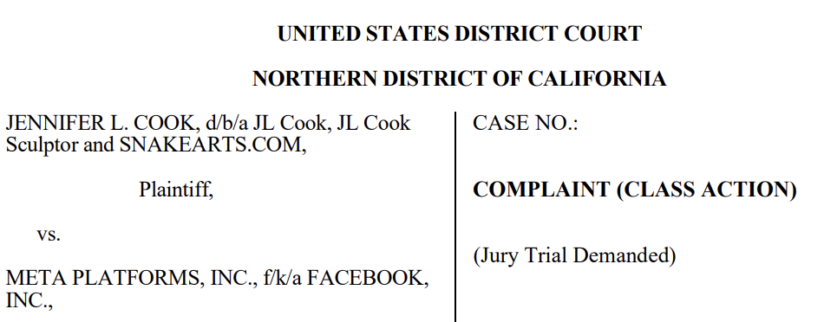
Liabilities for counterfeited ads?
V. Current State

Slide 30
Sources
17 U.S. Code § 512 - Limitations on liability relating to material online.
US Copyright Office, "Section 512 of Title 17: Resources on Online Service Provider Safe Harbors and Notice-and-Takedown System," online.
US Copyright Office, "Section 512 of Title 17 - A Report of the Register of Copyrights," (May 2020), online.
"The US Copyright Office Section 512 Study: Why the Entertainment Industry Is Claiming Victory," Wolters Kluwer (15 May 2020), online.
Fenwick & West, "Your DMCA Safe Harbor Questions Answered," (2017), online.
Cook v Meta Platforms, Inc (ND Cal 2024).
Blake Brittain, "Meta must face U.S. copyright lawsuit over Facebook ads," Reuters (5 Jan 2024), online.
Juan Londoño, Jaci McDole, & Daniel Castro, "IP and the Metaverse: The Digital Millennium Copyright Act Will Face Serious Challenges in the Metaverse" (19 Sept 2024), online.
Hunter McGhee, "Reinterpreting Repeat Infringement in the Digital Millennium Copyright Act" (2023) 25:3 Vanderbilt J Entertainment & Technology L 483.

