Slide 1
News Item Presentation
Jiamei Wang
(pronounced Jamaica without the –ca…!)

Slide 2
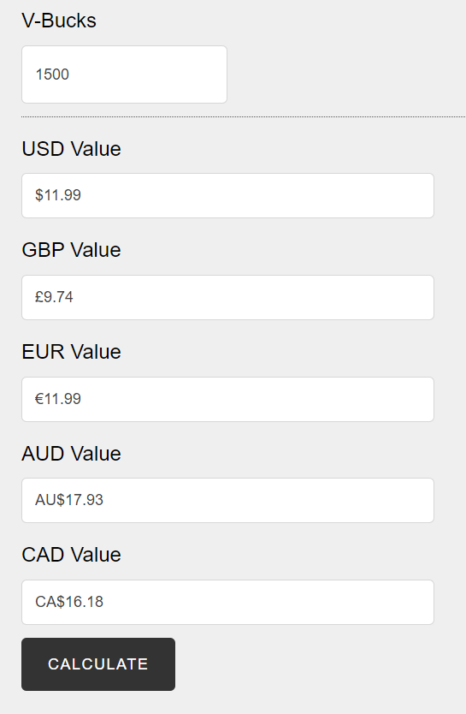
About 1 CAD = 100 V-Bucks
Like come on tell me you wouldn’t buy this
Pretty highly rated…

Slide 3
Not sure about this one though… eek

Slide 4
(FYI, this is the “IDK” “shrug” emote for 200 V-Bucks)
Seems pretty fun… so what’s the problem here?

Slide 5
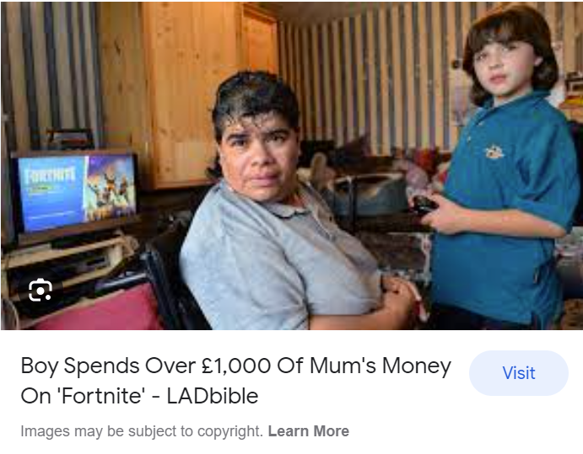
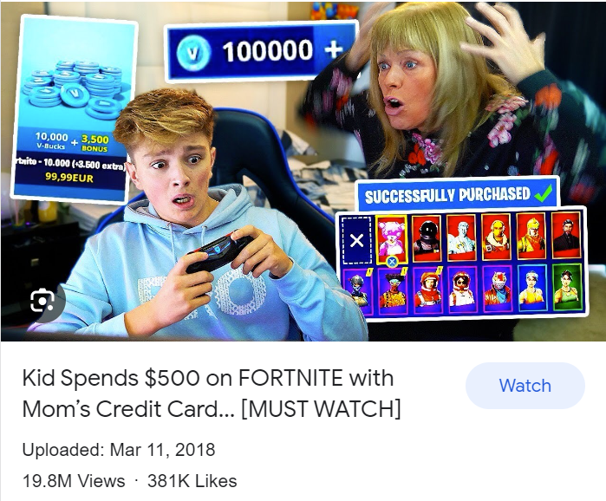
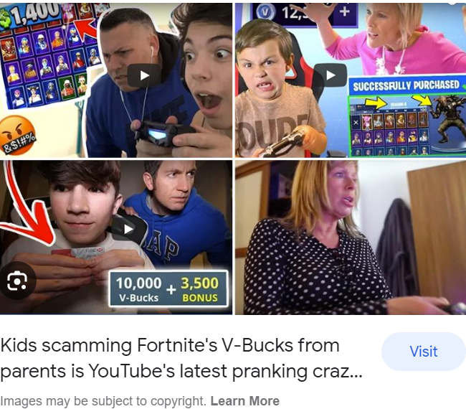
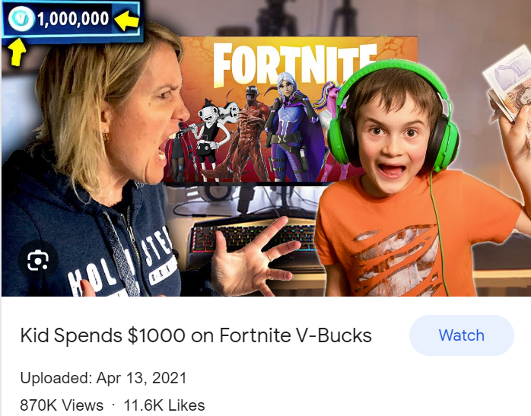
Um… so here’s the issue:

Slide 6
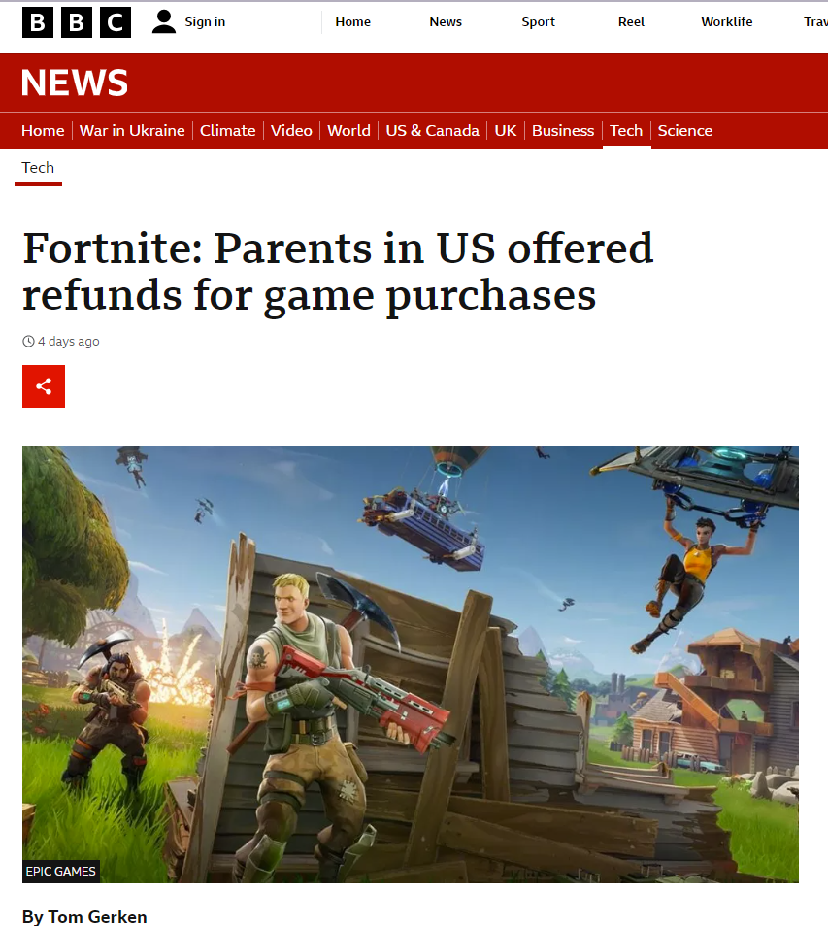
Today’s news article

Slide 7
So… potential legal issues?
(This is the “waterworks” emote, thank you Epic Games very epic)
(Feel free to add more I am nervous and lonely up here)
- Informed consent? Terms and Conditions for children??? Is it Epic Games’ responsibility to “child-proof” certain in-game mechanisms?
- Privacy??? Siphoning children’s data? In game voice/text communication?
- Children on the Internet/online games: are they independent actors or in the shadow of their parents?
- Parental controls for purchasing payments, adding/removing friends, etc?
- Gray area: are kids’ unauthorized charges fraud? Who’s responsible, the bank, you, or Epic Games?
- Dark patterns? Deceptive techniques to keep players hooked? Manipulation literacy? $222 billion industry, popularized in part by giving illusory and dangerous impression of user control: who’s actually in control? Do child users really understand what’s happening?

Slide 8
Thank you ☺

