Slide 1
Class 8 – November 1 1. Finishing Defamation in the internet Age 2. My Image is My Own – Rights to your image and reputation online and “revenge porn”

Slide 2
Admin Crap
News presentations / comments → approval of topics by email or in person just reminding you but you are doing great!
Guest speaker next week
Essays:
Still a couple of missing topics
Don’t worry about adjusting / changing your topic after deadline for topic submission
Adjusting is fine (but maybe you might want to talk to me about it?)
Changing needs actual approval
Notes and tips about actual writing next week

Slide 3
Other announcements
Tech Law McGill - The Artificial Intelligence and Data Act: A conversation with Surdas Mohit
Wednesday Nov 2 (tomorrow!), 16h00, NCDH 102
Tech Law McGill and the Privacy and A.I. Governance Research Lab at McGill invite you to join a conversation on Canada’s Artificial Intelligence and Data Act, a proposed federal law introduced earlier this year as part of Bill C-27. Surdas Mohit, the Acting Director of Artificial Intelligence and Data Policy at Innovation, Science and Economic Development Canada will be joining us for a presentation of the Act followed by an open Q&A.
Notes:
Ask Katherine (Beaulieu) if she wants to add

Slide 4
News Item 1
Kazumi Moore presentation

Slide 5
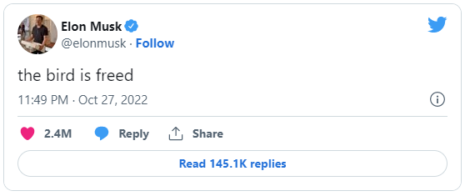
In the News
1. Elon Musk now in charge of Twitter, CEO and CFO have left, sources say (CNBC.com Friday)
2. Musk floats paid Twitter verification, fires board (CTV yesterday)

Slide 6
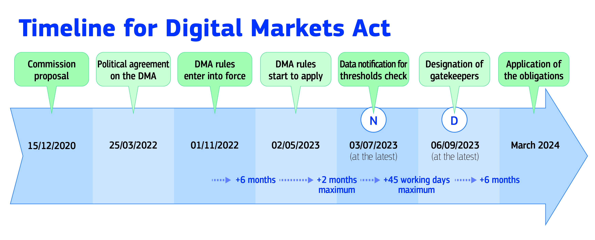
In the News 2
EU’s Digital Markets Act in force today!
Also Digital Services Act early next year
Notes:
“Gatekeeper companies” have to be interoperable
→ Gazal will do this for her news presentation

Slide 7
Now where were we…

Slide 8
Recall: defamation basics from (1) grant v. Torstar; (2) 1457 ccq
Notes:
Grant – words defamatory, refer to plaintiff, and were published
1457 – F + C + I, truth not a defense

Slide 9
“Innocent” third party liability
Notes:
Issue: are the platforms liable for defamation by their users

Slide 10
Canoë Inc. c. Corriveau QCCA takeaway
« Dans les circonstances, la juge de première instance était justifiée de conclure que l'appelante [ed. – Canoë] connaissait les conséquences probables de son inaction à cet égard. »
Notes:
Showed you this last week

Slide 11
Third party liability – removal (or failing to)
Message board: Baglow v. Smith, 2015 ONSC 1175
National Post comment section:
Weaver v. Corcoran, 2015 BCSC 165
Notes:
Showed you this last week
Baglow – Defendants operated a message board, failed to remove defamatory content, liable
Weaver – National post comments section did remove once they became aware, not liable

Slide 12
Third-party liability- USA
Section 230 Communications Decency Act (1996)
§ 230 (c) (1) No provider or user of an interactive computer service shall be treated as the publisher or speaker of any information provided by another information content provider.
“Section 230 marks a departure from the common-law rule that allocates liability to publishers or distributors of tortious material written or prepared by others”
(Jones case, coming up in a few slides)
Notes:
That was all in Canada! Very few big hosts of user content in Canada
Brought this up in class 2
230 is reaction to Stratton Oakmont case, held that at common law the provider of an electronic message-board service was potentially liable for its user’s defamatory message
IF THERER ARE TWO AMERCIAN LAWS YOU MUST TALE FROM THIS CLASS, IT’S THIS AND SECTION 512 DMCA RE COPYRIGHT (Notice and takedown)

Slide 13
230 CDA Cont.
(c) (2) Civil Liability. No provider or user of an interactive computer service shall be held liable on account of—
(A)any action voluntarily taken in good faith to restrict access to or availability of material that the provider or user considers to be obscene, lewd, lascivious, filthy, excessively violent, harassing, or otherwise objectionable, whether or not such material is constitutionally protected
Notes:
Important 2nd part that no one knows!
Called the “Good Samaritan” portion of the law

Slide 14
The “innocent” 3rd parties - USA
Zeran v. AOL 129 F.3d 327 (4th Cir. 1997)
F – Posting of “Naughty Oklahoma T-Shirts” on AOL message board with Zeran’s phone # which repeated even after Zeran told AOL and AOL took them down
Issue – AOL liable?
Held: No
“AOL falls squarely within this traditional definition of a publisher and, therefore, is clearly protected by § 230's immunity.”
“Section 230 creates a federal immunity to any cause of action that would make service providers liable for information originating with a third-party user of the service”

Slide 15
Zeran v. AOL (cont.)
→ Publisher vs. distributor liability in the USA
Distributor must remove content upon receiving notice
“liability upon notice has a chilling effect on the freedom of Internet speech”
“notice-based liability for interactive computer service providers would provide third parties with a no-cost means to create the basis for future lawsuits”
Notes:
Distributor liability → get a notice don’t remove, you are liable

Slide 16
Future of s. 230 CDA Recall In the News October 5th
Supreme Court to hear cases that could decide future of internet speech and social media (CNN.com yesterday)
One case, Gonzalez v. Google, is set to consider whether tech platforms’ recommendation algorithms are protected from lawsuits under a commonly invoked legal shield tech companies have used to nip other types of content-moderation suits in the bud [ed. – section 230 CDA].
The second case, Twitter v. Taamneh, will decide whether social media companies can be sued for allegedly aiding and abetting an act of terrorism, when the platforms have hosted unrelated user content that generally expresses support for the group behind the violence.

Slide 17
Future of s. 230 CDA - More generally
Texas HB 20 headed to SCOTUS after 5th Cir. upheld it
→ HB 20 aims to expose social media platforms including Meta, YouTube and Twitter to new private lawsuits, as well as suits by the state’s attorney general, over the companies’ decisions to remove or reduce the visibility of user content they deem objectionable.
Florida SB 7072 wants to go to SCOTUS
→ allows political candidates to sue social media companies if they are blocked or removed from the platforms for more than 14 days; imposes other moderation requirements
(11th Cir. Ruled it was probably unconstitutional, big tech co’s have first amendment rights; are not “common carriers”)

Slide 18
Hiding behind s. 230 CDA and freedom of expression
thedirty.com
ripoffreport.com
Jones v. Dirty World Entm’t Recordings, et al, 755 F.3d 398 (6th Cir. 2014) , US Ct. App.
“Section 230(c)(1) therefore bars Jones’s claims”
Notes:
Jones – lower court denied s. 230 immunity, CA overturned
Ripoff report – VIP Arbitration costs you $2000, then an extra $250 for each comment!

Slide 19
But Freedom of Expression a factor even in Quebec
Gagné c. Fortin, 2018 QCCQ 4470
F: Alleged defamotary comments on Company’s Facebook page
« De l’avis du Tribunal, les propos tenus par messieurs Fortin et Nadeau constituent un exercice légitime de leur liberté d’expression. Ils n’ont pas franchi la limite de cette liberté d’expression de manière à entacher aux yeux d’une personne raisonnable, c’est-à-dire avisée, diligente et attentive aux droits d’autrui, la réputation de monsieur Gagné.
La preuve démontre que la qualification des propos litigieux par monsieur Gagné ne relève que de sa perception purement subjective. Ainsi, les sentiments qu’il a vécus même justifiés ne peuvent servir de fondement à un recours en diffamation. »
Notes:
In Canoe v Corriveau freedom of X was not enough, here it was, objectively not defamation

Slide 20
Third-Party liability - links
Crookes v. Newton, 2011 SCC 47
“a hyperlink, by itself, should never be seen as ‘publication’ of the content to which it refers” (Abella J.)
(concurring, McLachlin and Fish JJ.) “Publication of a defamatory statement via a hyperlink should be found if the text indicates adoption or endorsement of the content of the hyperlinked text. “
Notes:
F – links from a website to defamatory content. Newton runs website, published links to defamatory content
Concurring opinion (Fish and McLachlan) – reaction to Abella’s test which was you have to REPEAT the defamatory content

Slide 21
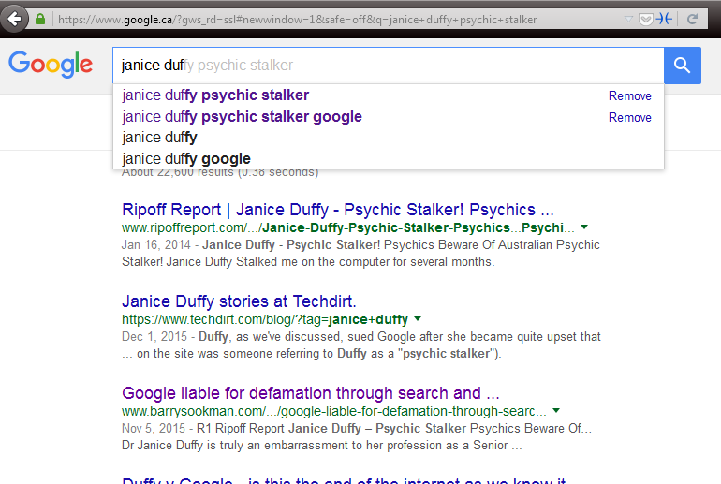
Third party liability – links+
Duffy v Google Inc. [2015] SASC 170
→ Secondary publication (notice is important)
Notes:
Defamatory “Snippets” of text from site on Google results → NOTE RIPOFF REPORT
publishing a hyperlink to defamatory material along with search results information made Google a secondary publisher of the information → importance was title of the result, which is a hyperlink → this cited Crookes which said “The Court held that merely creating a hyperlink without more did not amount to publication of the material on the external webpage”, here there was more
$115k damages awarded

Slide 22
Third party liability – links+
Duffy v Google Inc. [2017] SASCFC 130 (October 4, 2017)
→ upheld, Google is in fact a secondary publisher
“There is an important distinction between a pre-programmed automated system and passivity. It is the degree to which the automated programmers facilitate the production of defamatory material in a written and therefore comprehensible form which is important”
“Google participated in the publication of the paragraphs about Dr Duffy produced by its search engine because it intended its search engine to do what it programmed it to do”

Slide 23
Google Auto-Complete Policy
1. Sexually explicit predictions
We remove predictions that contain sexually explicit or vulgar language. Pornographic terms or terms that are closely associated with pornography are removed from predictions.
2. Hateful predictions against groups and individuals
We remove predictions that include language that denigrates or insults individuals or groups on the basis of race, ethnic origin, religion, disability, gender, age, nationality, veteran status, sexual orientation, or gender identity.
3. Violent predictions
We remove predictions that include graphic descriptions of violence or advocate violence generally.
4. Dangerous and harmful activity in predictions
We remove predictions promoting dangerous or criminal activities that would lead to real-world harm.

Slide 24
More Google
Trkulja v Google LLC [2018] HCA 25
F: Autcomplete – Michael Trk… becomes Michael Trkulja criminal, also publication of images in G Images search
Issue: Google a publisher?
Held: Yes!
“Google’s intentional participation in the communication of the allegedly defamatory results to Google search engine users supports a finding that Google published the allegedly defamatory results”
(note Google did not file defense, this was preliminary, seems to have died out, may have been settled)
Notes:
Australia – no CDA protection, can be publisher

Slide 25
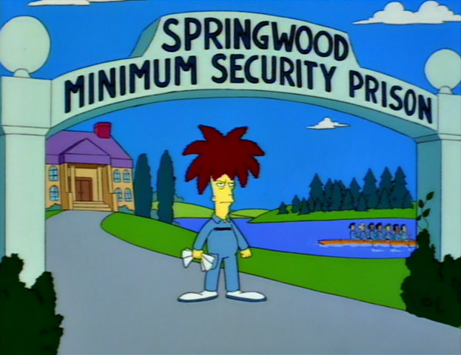
Defamation - criminal remedies?

Slide 26
Defamatory Libel
Criminal Code
298. (1) A defamatory libel is matter published, without lawful justification or excuse, that is likely to injure the reputation of any person by exposing him to hatred, contempt or ridicule, or that is designed to insult the person of or concerning whom it is published.
300. Every one who publishes a defamatory libel that he knows is false is guilty of an indictable offence and liable to imprisonment for a term not exceeding five years.
301. Every one who publishes a defamatory libel is guilty of an indictable offence and liable to imprisonment for a term not exceeding two years
Notes:
Very rare, rarely used
Criminal speech is problematic
301 is generally held unconstitutional by the courts (4 different provinces, not yet at SCC), violating freedom of expression and not saved by s. 1

Slide 27
Criminal Harassment
s. 264 Criminal Code
264 (1) No person shall, without lawful authority and knowing that another person is harassed or recklessly as to whether the other person is harassed, engage in conduct referred to in subsection (2) that causes that other person reasonably, in all the circumstances, to fear for their safety or the safety of anyone known to them.
(2) The conduct mentioned in subsection (1) consists of (…)
(b) repeatedly communicating with, either directly or indirectly, the other person or anyone known to them;

Slide 28
Criminal Harassment on Twitter?
Elliott v. R, 2016 ONCJ 35
@LadySnarksalot how fat is your ass
” The element that the fear be reasonable in all of the circumstances has not been established”
”I am not satisfied beyond a reasonable doubt that Mr. Elliott’s repeated communications caused Ms. Reilly to fear for her safety”
Notes:
Long conversations on Twitter with two women Guthrie et Reilly
Nasty tweets, women said they feared for their safety
E.g. @LadySnarksalot how fat is your ass
Judge cites freedom of expression

Slide 29
On the other hand
R. v Gardner, 2018 CanLII 72609 (NL PC)
“I’m just in the mood to break your fucking pig face Terry Murphy. Get the money or I’ll beat your ugly head out your own asshole. You got 1 day bitch. Or you’re fucked…test me you piece of shit” (and this went on and on and on…)
Indeed guilty of criminal harassment on FB
“In order to determine the appropriate sentence for Mr. Gardner, I reviewed cases from across the country that dealt with threats or criminal harassment perpetrated through Facebook or other electronic means to ascertain what “similar offenders in similar circumstances” have received as a sentence.”
(up to 6 months incarceration for criminal harassment, Gardner got 90 days)

Slide 30
Criminal AND / OR Civil Remedy?
Caplan v. Atas 2021 ONSC 670
“Atas has engaged in a vile campaign of cyber-stalking against the plaintiffs in the four actions, the goal of which has been retribution for longstanding grievances. As argued by the plaintiffs, the conduct falls in the area where the civil and criminal law intersect.”
Notes:
Facts way too complicated, many parties, many campaigs of cyberstalking and cyberbullying

Slide 31
Caplan v. Atas
“Freedom of speech and the law of defamation have developed over centuries to balance the importance of preserving open public discourse, advancing the search for truth (which must allow for unpopular and even incorrect speech), protecting personal reputations, promoting free democratic debate, and enforcing personal responsibility for statements made about others. The value of freedom of speech, and the need for some limits on that freedom, have long been recognised as central to a vibrant and healthy democracy and, frankly, any decent society.
The internet has cast that balance into disarray.”
“Atas has engaged in a vile campaign of cyber-stalking against the plaintiffs in the four actions, the goal of which has been retribution for longstanding grievances. As argued by the plaintiffs, the conduct falls in the area where the civil and criminal law intersect. ….

Slide 32
Caplan v. Atas
“The law should respond to this conduct to compensate victims, to express the law’s disgust and firm rejection of the conduct, to punish for wrongful conduct, to deter Atas and others from this sort of conduct in future, and to bring Atas’ wrongful conduct to an end.
The law’s response, thus far, has failed to respond adequately to Atas’ conduct.”
→ New common law tort of “online harassment”, and a crapload of remedies (injunctions, removal, no damages because Atas bankrupt)

Slide 33
In (Defamation) Conclusion…
Lavallee et al. v. Isak, 2021 ONSC 6661
→ Class 12 fun exercise! Fabulous prizes!
Notes:
Racism, death threats, defamation, social media networks, possible criminality → the case has it all!

Slide 34
Rights to your image and reputation online
Notes:
Reputation – in visual form! Defamation we just looked at was about words

Slide 35
Personality Rights Publication Rights
Right to your image
Right to your likeness
Right to your voice
Right to your name
Others? Email addy? Twitter username?
→ Your persona
Notes:
Others? i.e. enough PI to identify you, like email, Twitter user account name

Slide 36
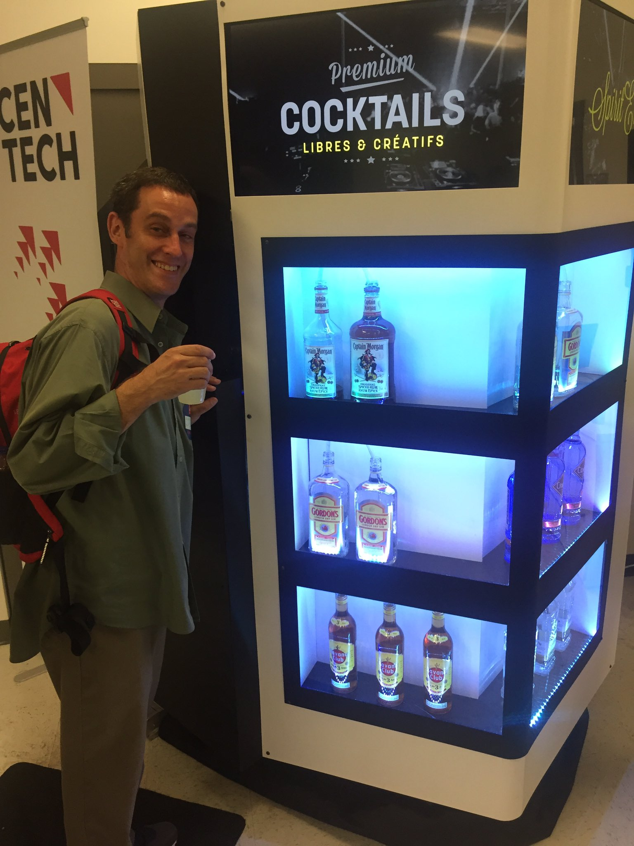
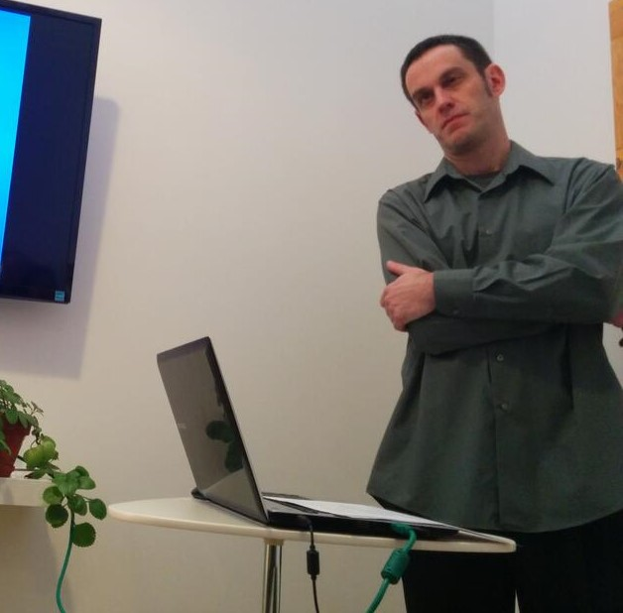
Personality Rights in play when…
$$$$$$$$$$$$$
Reputation / defamation
Notes:
Company making money of me by putting that on their blog?

Slide 37
Personality Rights in play when…
$$$$$$$$$$$$$
Reputation / defamation
Recall Douez v. Facebook Class 3 – territorial jurisdiction
BUT underlying privacy rights case → Mrs. Douez’ (and potential class) photo and name used in FB advertisement
A.B. v Bragg Communications
2012 SCC 46 (next class)
→ Fake FB profile with picture of A.B. and similar name, along with unflattering comments, sexual references
Notes:
AB Bragg – Michell presenting next week

Slide 38
Personality Rights – Common Law
Specific references in Privacy Acts of British Columbia, Manitoba, Newfoundland, and Saskatchewan (next slide)
Other common law provinces – tort of “appropriation of personality” or “wrongful appropriation of personality”

Slide 39
Common Law Statutes
MB, NL, SK
British Columbia
Personality rights are a subset of the right to privacy
Name, likeness, voice
No proof of damages required
Personality rights violations are a tort in and of themselves
Name and likeness only
No proof of damages required

Slide 40
e.g. Manitoba The Privacy Act
2. A person who substantially, unreasonably, and without claim of right, violates the privacy of another person, commits a tort against that other person.
3. Without limiting the generality of section 2, privacy of a person may be violated
(…)
(c) by the unauthorized use of the name or likeness or voice of that person for the purposes of advertising or promoting the sale of, or any other trading in, any property or services, or for any other purposes of gain to the user if, in the course of the use, that person is identified or identifiable and the user intended to exploit the name or likeness or voice of that person

Slide 41
British Columbia – The Privacy Act
3. (1) In this section, “portrait” means a likeness, still or moving, and includes
(a) a likeness of another deliberately disguised to resemble the plaintiff, and
(b) a caricature.
(2) It is a tort, actionable without proof of damage, for a person to use the name or portrait of another for the purpose of advertising or promoting the sale of, or other trading in, property or services, unless that other, or a person entitled to consent on his or her behalf, consents to the use for that purpose.

Slide 42
Common law tort
Krouse v. Chrysler Canada Ltd. et al.
(1974), 1 O.R. (2d) 225 (Ont. CA)
F – pictures of a football game, player with numbers on jerseys used in car ad, faces not visible
“…there may well be circumstances in which the Courts would be justified in holding a defendant liable in damages for appropriation of a plaintiff's personality, amounting to an invasion of his right to exploit his personality by the use of his image, voice or otherwise with damage to the plaintiff, but…” [ed: facts in this case say no…]
→ Player was jus incidental, car was focus of ad

Slide 43
Common Law Developments
Jones v. Tsige, 2012 ONCA 32
F: “appellant, Sandra Jones, discovered that the respondent, Winnie Tsige, had been surreptitiously looking at Jones' banking records. Tsige and Jones did not know each other despite the fact that they both worked for the same bank and Tsige had formed a common-law relationship with Jones' former husband. As a bank employee, Tsige had full access to Jones' banking information and, contrary to the bank's policy, looked into Jones' banking records at least 174 times over a period of four years.”
Notes:
Tsige = Siggee pronouncement joke…

Slide 44
Jones v. Tsige
Issue: Does Ontario law recognize a right to bring a civil action for damages for the invasion of personal privacy?
Held: It does now!
Ratio
Prosser’s torts (USA) – 4 invasion of privacy torts:
Intrusion upon the plaintiff's seclusion or solitude, or into his private affairs. (“Intrusion upon seclusion”)
Public disclosure of embarrassing private facts about the plaintiff (“Public disclosure of private facts”)
(2 more, ignore them)
Notes:
#2 tort will come up later!

Slide 45
Jones v. Tsige
Ratio
“we are presented in this case with facts that cry out for a remedy. While Tsige is apologetic and contrite, her actions were deliberate, prolonged and shocking”
“In my view, it is appropriate for this court to confirm the existence of a right of action for INTRUSION UPON SECLUSION. Recognition of such a cause of action would amount to an incremental step that is consistent with the role of this court to develop the common law in a manner consistent with the changing needs of society.

Slide 46
Jones v. Tsige
Ratio
“The case law, while certainly far from conclusive, supports the existence of such a cause of action. Privacy has long been recognized as an important underlying and animating value of various traditional causes of action to protect personal and territorial privacy. Charter jurisprudence recognizes privacy as a fundamental value in our law and specifically identifies, as worthy of protection, A RIGHT TO INFORMATIONAL PRIVACY THAT IS DISTINCT FROM PERSONAL AND TERRITORIAL PRIVACY. The right to informational privacy closely tracks the same interest that would be protected by a cause of action for intrusion upon seclusion.”
“I would essentially adopt as the elements of the action for intrusion upon seclusion the Restatement (Second) of Torts (2010) formulation which, for the sake of convenience, I repeat here:
One who intentionally intrudes, physically or otherwise, upon the seclusion of another or his private affairs or concerns, is subject to liability to the other for invasion of his privacy, if the invasion would be highly offensive to a reasonable person.”
Notes:
INFORMATIONAL PRIVACY → R v. Spencer

Slide 47
Srsly prof. mendelsohn, Why SHOULD I care about Jones v. Tsige?
Notes:
Facts are about bank records dammit!

Slide 48
Why do we care about Jones v. Tsige?
Vanderveen v Waterbridge Media Inc., 2017 CanLII 77435 (ON SCSM)
F: Filming of person jogging while trying to lose post-partum weight, video used to promote condo community without her consent
“I have no hesitation in concluding that in capturing the image of Mme Vanderveen and publishing it in a commercial video for Bridgeport, the defendant committed the tort of intrusion upon seclusion”
“While Jones v. Tsige dealt with the examination of Jones’ bank account by Tsige on 174 occasions over a 4 year period, I am satisfied that the elements of intrusion upon seclusion mentioned above apply to capturing the persona or likeness of an individual and using it for commercial purposes without consent.”
Notes:
SUPERIOR COURT OF JUSTICE
SMALL CLAIMS COURT

Slide 49
Various defenses at common law re images
Consent
Public interest
Fair comment
Not recognizable
Group picture unless identified
Non-intentional
Incidental to another legal act
Law enforcement images

Slide 50
Personality Rights in Quebec
Quebec Charter
4. dignity, honour and reputation; and 5.respect for private life
C.C.Q.
35. Every person has a right to the respect of his reputation and privacy.
36. The following acts, in particular, may be considered as invasions of the privacy of a person (...)
(3) appropriating or using his image or voice while he is in private premises; (…)
(5) using his name, image, likeness or voice for a purpose other than the legitimate information of the public;

Slide 51
Personality Rights in Quebec
Aubry c. Éditions Vice-Versa inc. [1998] 1 SCR 591
F – Aubry (17 years old) had her photo taken in a public place, sitting on some steps, and published in an arts magazine without her consent
Issue – Does publication of photograph without permission lead to liability?
Held: Yes!

Slide 52
Aubry c. Éditions Vice-Versa inc (cont.)
“Since the right to one’s image is included in the right to respect for one’s private life, it is axiomatic that every person possesses a protected right to his or her image. This right arises when the subject is recognizable. There is, thus, an infringement of the person’s right to his or her image, and therefore fault, as soon as the image is published without consent and enables the person to be identified.”
“Since every person is entitled to protection of his or her privacy, and since the person’s image is protected accordingly, it is possible for the rights inherent in the protection of privacy to be infringed even though the published image is in no way reprehensible and has in no way injured the person’s reputation.”

Slide 53
Aubry c. Éditions Vice-Versa inc (cont.)
“The public’s right to information, supported by freedom of expression, places limits on the right to respect for one’s private life in certain circumstances. This is because the expectation of privacy is reduced in certain cases.”
Depends on context, e.g. public interest. So here…
“In our view, the artistic expression of the photograph, which was alleged to have served to illustrate contemporary urban life, cannot justify the infringement of the right to privacy it entails. It has not been shown that the public’s interest in seeing this photograph is predominant.”

Slide 54
Aubry c. Éditions Vice-Versa inc (cont.)
“The appellants argued that there was no causal connection between the publication of the photograph and the damages. In our view, no particular problem arises here since the damages are the logical, direct and immediate consequence of the fault. A teenager’s sensitivity and the possibility of being teased by her friends are eminently foreseeable.”
“In this regard, the respondent is correct in stating that the magazine does not cease to be “commercial” merely because it has an artistic content. In the case at bar, the photograph was used for commercial purposes, in particular to sell the magazine.”

Slide 55
Aubry c. Éditions Vice-Versa inc (cont.)
Notes:
Case facts from 1989, CCLC applies, does not have specific CCQ right to image; case decided under s. 5 of Quebec Charter → right to image held to be included in right to privacy
dissent → no damages here! Some classmates laughing at her is not enough; Aubry never said she felt humiliated

Slide 56
Bring it all home
“I note that the legal principles discussed, the societal values protected and the determination of the quantum of damages in Jones v. Tsige are entirely consistent with the decision of the Supreme Court of Canada in Aubry v. Les Editions Vice-Versa, a case grounded in the Civil Code of Quebec and the Charter of Human Rights and Freedoms rather than the common law in Ontario.”
(Vanderveen)
Notes:
NOTE: adopting Aubry into common law???

Slide 57
Special case? - Children

Slide 58
Non-consensual “pornography” (a.k.A. Revenge porn?)
Notes:
In quotes for a good reason. Coming next slide.

Slide 59
Non-consensual “pornography”
The distribution of sexual or pornographic images of individuals without their consent
No revenge motive per se
Also called non-consensual distribution of intimate images (“the only people who perceive intimate images shared without consent as pornography are the abusers” – Human Rights Watch, Women’s Division)
images originally obtained without consent (e.g. using hidden cameras, hacking phones, or recording sexual assaults)
images consensually obtained within the context of an intimate relationship, then distributed without consent

Slide 60
e.g. B.C. Privacy Act
L.A.M. v. J.E.L.I., 2008 BCSC 1147
F – D videotaped nude P and her young daughter in the bathroom
(D also convicted for child pornography)
Held - $60k total damages (including $35k punitive) for violating BC Privacy Act
Note – no distribution here, but privacy violation
Notes:
Circles back to rights to image in Privacy Act

Slide 61
e.g. B.C. Privacy Act
T.K.L. v. T.M.P., 2016 BCSC 789
F – D videotaped nude P (his stepdaughter) in bedroom and bathroom / shower, said he did it for humiliation and revenge
Held - ~ $94k total damages for violating BC Privacy Act

Slide 62
What if there is no Privacy Act?
Doe 464533 v. N.D., 2016 ONSC 541
Sierra Eeet presentation

