Slide 1
3510395 Canada Inc v Canada (Attorney General), 2020 FCA 103
Thomas Power
November 22, 2022

Slide 2
Background
An Act to promote the efficiency and adaptability of the Canadian economy by regulating certain activities that discourage reliance on electronic means of carrying out commercial activities, and to amend the Canadian Radio-television and Telecommunications Commission Act, the Competition Act, the Personal Information Protection and Electronic Documents Act and the Telecommunications Act, SC 2010, c 23
Canada's Anti-Spam Legislation (CASL)
Enacted 2010, relevant provisions in force July 1, 2014
Regulation on sending “commercial electronic messages” (CEM)
Ss. 6-13 CASL
Administrative monetary penalties (AMP) regime
Ss. 14-40 CASL

Slide 3
Background [cont.]
Unsolicited electronic messages
6 (1) It is prohibited to send or cause or permit to be sent to an electronic address a commercial electronic message unless
(a) the person to whom the message is sent has consented to receiving it, whether the consent is express or implied; and
(b) the message complies with subsection (2).
Contents of message
(2) The message must be in a form that conforms to the prescribed requirements and must
(a) set out prescribed information that identifies the person who sent the message and the person — if different — on whose behalf it is sent;
(b) set out information enabling the person to whom the message is sent to readily contact one of the persons referred to in paragraph (a); and
(c) set out an unsubscribe mechanism in accordance with subsection 11(1).
Meaning of commercial electronic message
(2) For the purposes of this Act, a commercial electronic message is an electronic message that, having regard to the content of the message, the hyperlinks in the message to content on a website or other database, or the contact information contained in the message, it would be reasonable to conclude has as its purpose, or one of its purposes, to encourage participation in a commercial activity, including an electronic message that
(a) offers to purchase, sell, barter or lease a product, goods, a service, land or an interest or right in land;
(b) offers to provide a business, investment or gaming opportunity;
(c) advertises or promotes anything referred to in paragraph (a) or (b); or
(d) promotes a person, including the public image of a person, as being a person who does anything referred to in any of paragraphs (a) to (c), or who intends to do so.

Slide 4
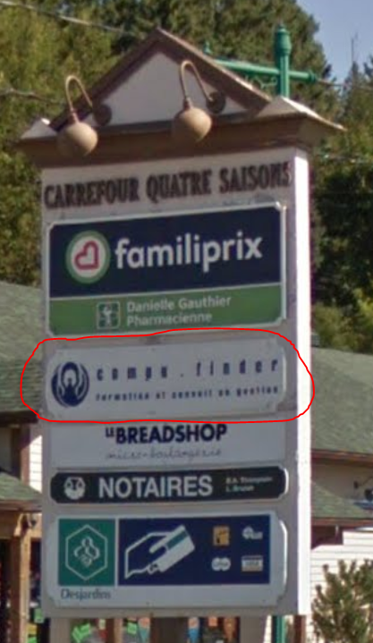
Background [cont.]
3510395 Canada Inc. (dba CompuFinder) was professional training company in Morin Heights, QC
Conducted 3 email marketing campaigns between July and September 2014
Resulted in large number of complaints to CRTC’s spam reporting centre

Slide 5
Procedural history
Notice to produce from CRTC in September 2014 under s. 17 CASL
CRTC issued Notice of Violation to CompuFinder in March 2015
4 violations of CASL, proposed penalty of $1.1m
CompuFinder made representations contesting constitutionality of CASL and CRTC’s interpretation of provisions
CRTC issued decisions on constitutional issues (CRTC 2017-367) and violations (CRTC 2017-368) in October 2017
CompuFinder appealed CRTC decision to Federal Court of Appeal

Slide 6
Issues
Constitutional Challenge
Is CASL ultra vires Parliament?
Is CASL’s violation of section 2(b) of the Charter justified under section 1?
Does CASL violate section 11 of the Charter?
Does CASL violate sections 7 or 8 of the Charter?
Notice of Violation
Did the CRTC err in its interpretation and application of the business-to-business exemption?
Did the CRTC err in its interpretation and application of CASL’s implied consent requirements regarding conspicuous publication?
Did the CRTC err in its interpretation and application of CASL’s requirements regarding unsubscribe mechanisms?

Slide 7
Division of powers [76-129]
CompuFinder argued CASL provisions were outside federal jurisdiction; CRTC found they were made under trade and commerce power in s. 91(2) Constitution Act, 1867
Pith and substance: “the main thrust of the impugned scheme is to regulate the public’s ability to send unsolicited CEMs in order to guard against the threats that such messages can pose to Canada’s e-economy” [110]
Purpose: “to regulate unsolicited CEMs in order to combat spam and associated online threats in the interests of privacy and security in order to promote a healthy e-economy” [95]
Effects
Direct effect: “establishment of a federal regulatory scheme for unsolicited CEMs applicable to all provinces” [98]
Practical effect of regulating messages only in one province is incidental to main goal of regulating national ones

Slide 8
Division of powers [76-129] [cont.]
CASL provisions meet all 5 indicia in the General Motors test
part of a regulatory scheme
monitored by the continuing oversight of a regulatory agency
concerned with trade as a whole rather than with a particular industry
of a nature that provinces jointly or severally would be constitutionally incapable of enacting
failure to include one or more provinces or localities in a legislative scheme would jeopardize the successful operation of the scheme
CASL provisions validly made under federal general trade and commerce power in s. 91(2)

Slide 9
S. 2(b) of the Charter [130-202]
AGC conceded that the CEM provisions violate s. 2(b), but argues saved under s. 1
CASL provisions sufficiently precise
CF argued certain definitions and coverage of certain actions too vague
Objective to “stymie certain negative effects to which unsolicited CEMs give rise” [159] is pressing and substantial
CASL’s limited regulation of CEMs and exceptions are rationally connected to objective
CASL model is minimally impairing
Opt-out model and other alternatives would not achieve objective
CASL has notable practical benefits, these outweigh limited deleterious effects
CASL provisions justified under s. 1

Slide 10
S. 11(d) of the Charter [203-25]
Presumption of innocence
CASL AMP program not criminal in nature
Penalties under CASL AMP program not true penal consequence
Not palpable and overriding error for CRTC to have found AMP imposed on CompuFinder was not true penal consequence

Slide 11
S. 7 of the Charter [226-29]
S. 7 only available to individuals
Because provisions not penal, Big M Drug Mart exception for corporations not applicable
No violation

Slide 12
S. 8 of the Charter [230-33]
Relates to CRTC’s notice to produce during investigation where CompuFinder had to provide certain documents
Low expectation of privacy for business records in regulated industry
Regulatory inspection here was reasonable search
No violation

Slide 13
Business-to-business exemption [235-45]
S. 3(a)(ii) of the Electronic Commerce Protection Regulations, SOR/2013-221 provides an exception for certain communications between businesses
“This exemption applies where three conditions are met:
(i) a CEM is sent by an employee of one organization to an employee of another organization;
(ii) those organizations have a relationship; and
(iii) the CEM concerns the activities of the receiving organization.” [235]
CRTC did not commit error in finding CompuFinder’s relationships too weak to qualify
CRTC interpreted relevance criteria too restrictively, but exception still does not apply to CompuFinder

Slide 14
Implied consent [246-55]
“Paragraph 10(9)(b) thus permits the sending of CEMs where the following three conditions are met:
The recipient has conspicuously published or caused to be conspicuously published their electronic address;
The publication is not accompanied by a statement that the recipient does not wish to receive CEMs; and
The CEM is relevant to the business, role, functions or duties of the recipient individual or organization. “ [246]
No error in finding information CompuFinder provided did not satisfy these criteria

Slide 15
Unsubscribe mechanisms [256-59]
S. 3 of the Electronic Commerce Protection Regulations (CRTC), SOR/2012-36 requires unsubscribe mechanisms to be “set out clearly and prominently” and “able to be readily performed”
CompuFinder’s emails contained two unsubscribe links, of which only one worked
Not an error for CRTC to find that these were not clear/prominent and hindered performance

Slide 16
Conclusion [260]
FCA decides all issues in favour of CRTC
Appeal dismissed

Slide 17
Later developments
Leave to appeal to SCC denied
3510395 Canada Inc v Canada (AG), 2021 CanLII 15598 (SCC)
CompuFinder appears no longer to be operating

