Slide 2
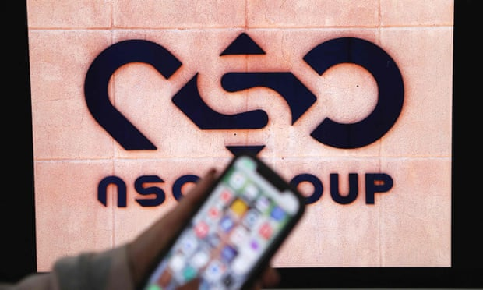
The Regulation of Cyber-surveillance Technology
The Case of the Pegasus Spyware

Slide 3
What are Cyber-surveillance technologies?
Cyber-Surveillance
Spyware (cyber-surveillance technologies): A malicious software
Dual-Use Cyber-Surveillance Technology: used for both “civilian” and “military” purposes
Increasing widespread use of these technologies by governments

Slide 4
News Item: Pegasus Spyware
NSO: “help [governments] fight terrorism and serious crime.”
The Pegasus Spyware Attack Methodology:
hacking into a victim’s device through a ‘zero-click’ technique that turns a device into a a 24-hour surveillance device.
Governments Targeting Members of Civil Society around the world
The technology is exported to authoritarian regimes
The killing of journalist Jamal Khashoggi

Slide 5
News Item: Pegasus Spyware
More Recent Revelations:
Mexico: Human rights investigators (Reported: Oct. 2 2022)
Indonesia: Senior Indonesian Officials (Reported: Sept. 30th 2022)
Thailand: Thai Democracy activists (Reported: July 17th 2022)
Pegasus used by at least 5 EU countries including: Poland and Hungary and Spain: using it against their own dissidents (Reported: June. 21st 2022)
Even European Commission officials were targeted (Reported April 2022)

Slide 6
Issues arising from the Case of Pegasus Spyware
Governments are using this software under the guise of state security
“Democratic states” are exporting this technology to states that abuse it, Proliferating authoritarian trends
Undermining Freedom of expression and association, Privacy rights, the right to security of the Person
→ Suppressing the voice of journalists and human rights activists.
The market for the spyware industry is increasingly privatized and unregulated
States are prioritizing “security” and governmental control before civilian rights

Slide 7
Beyond Pegasus
Other ”democratic countries” export similar Cyber-surveillance technology
United Kingdom: licenses Gamma Group exports
Germany: exports FinFisher products,
Spain: exports Mollitiam Industries technologies.
Italy: exports Tykelab (inside and outside of the EU)
These trends undermine the conditions that legitimize democratic systems

Slide 8
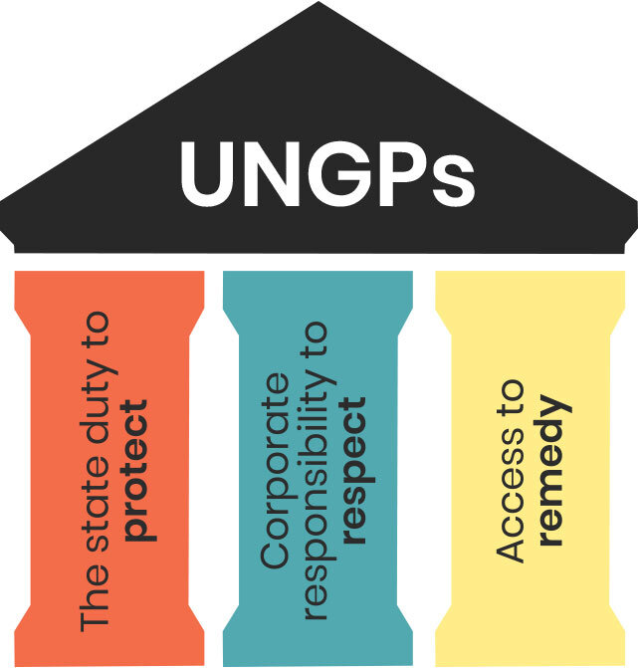
The Scope of Regulatory Measures
National Level
Israeli Defence Export Control Law 2007
Ministry of Economy
International Level
Wassenaar Arrangement on Export Controls Conventional Arms and Dual-Use Goods and Technologies
United Nations Guiding Principles on Business and Human Rights

Slide 9
The Gaps in the Regulation of This Issue
Portable nature of cyber-surveillance technology
Wassenaar Arrangement ineffective in restricting intangible surveillance tools
The structure of the Wassenaar Arrangement
Lack of enforceable international treaty
Israeli National Laws do not provide legal recourse for victims

Slide 10
Calling for Reform
"In privacy-threatening technologies, it's hard to put the genie back in the bottle. Once a technology is out in the world, it's tough to undo that development. It's much easier to put protections in place at the development stage.”
Calli Schroeder, global privacy counsel, Electronic Privacy Information Center (EPIC)

Slide 11
Proposing Reform
Implementing a Transnational regulatory treaty
Procedure to ensure more rigorous oversight
Holding parties like the Ministry of Defense accountable for its risk assessment
UN member states to enforce a moratorium on the sale and use of cyber-surveillance technology
Ensuring government compliance by imposing sanctions and penalties

