Slide 1
Cyberattacks & Ransomware
Case study of canada’s largest telecommunication company Bell
And their 15.09.2022 cyberattack

Slide 2
They are two types of computer programs:
those that were hacked and those that will be hacked

Slide 3
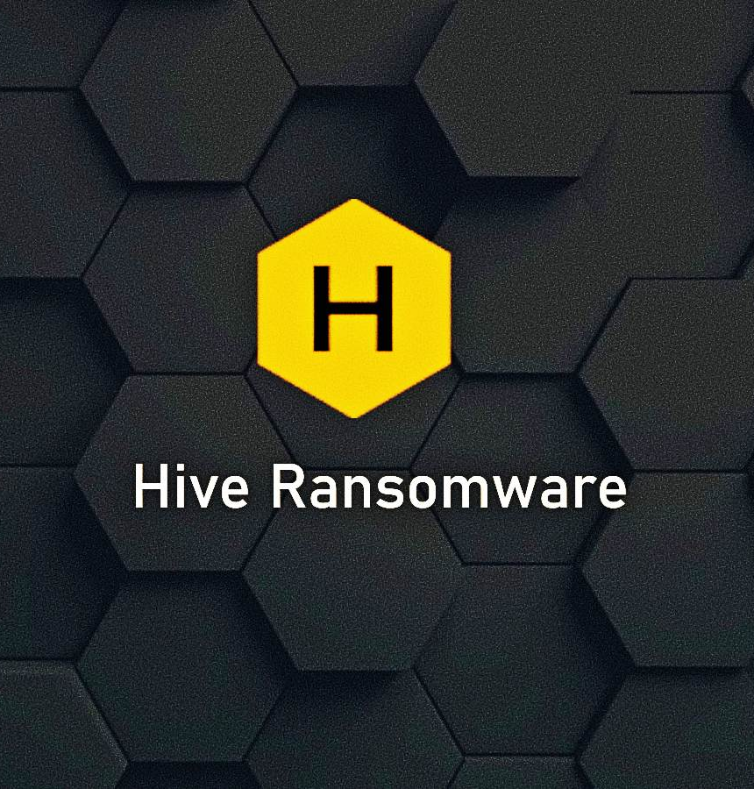
To hack or to be hacked
Summary of the September 15, 2022 Attack.
Bell Technical Solutions (BTS) installs phone, tv and internet for residential and professional clients.
Hive Leaks, a cyberattack group, managed to get into Bell’s servers and steal employees’ and consumers’ data.
To release said data, they have demanded a large sum of money, to be paid in cryptocurrency. (Unconfirmed by Bell)
Cyberattacks and Ransomwares - Internet law.

Slide 4
What is a ransomware?
A form of extorsion.
Hackers get access to your servers and encrypt your data. You no longer have access to the computer system. For them to restore it, you will have to pay a ransom.
Hackers will then deliver you a key to decrypt the data —most of the time, only partially though—.
A 2016 ransomware named ‘jigsaw’. Credit to emsisoft.

Slide 5
Ransomware in full swing
Small and medium businesses.
Schools
Cities
Saint-Johns’ network was frozen entirely. The CAD$ 17 millions ransom were not paid as they instead decided to rebuilt a new network from scratch for CAD$ 2,9 millions.
Hospitals
Newfoundland healthcare system in 2021 was paralyzed.
In Germany a woman died due to delayed healthcare procedures.
Global scale
Attack on Colonial Pipelines in 2021 paralyzed fuel supplies in the USA.
WannaCry in 2017, said to have cost hundreds of millions.
Cyberattacks and Ransomwares - Internet law.

Slide 6
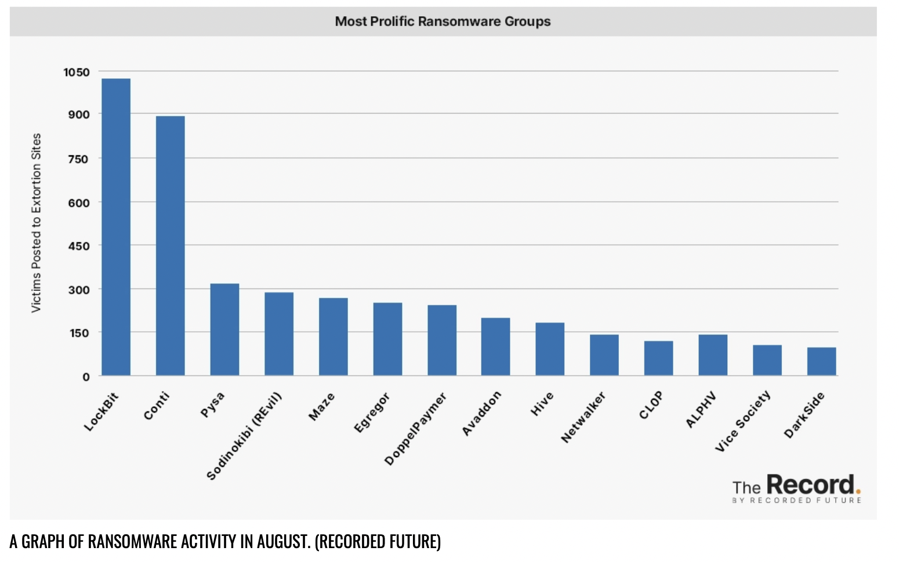
Ransomware in full swing, a few figures
39% of cybercrimes are committed by organized criminal groups. ‘Ransomware gangs’.
The most prolific one is Lockbit.
Besides direct cyberattacks, they also provide ‘Ransomware as a service’ (or RaaS). They rent out their ransomware program to third parties.
Cyberattacks and Ransomwares - Internet law.

Slide 7
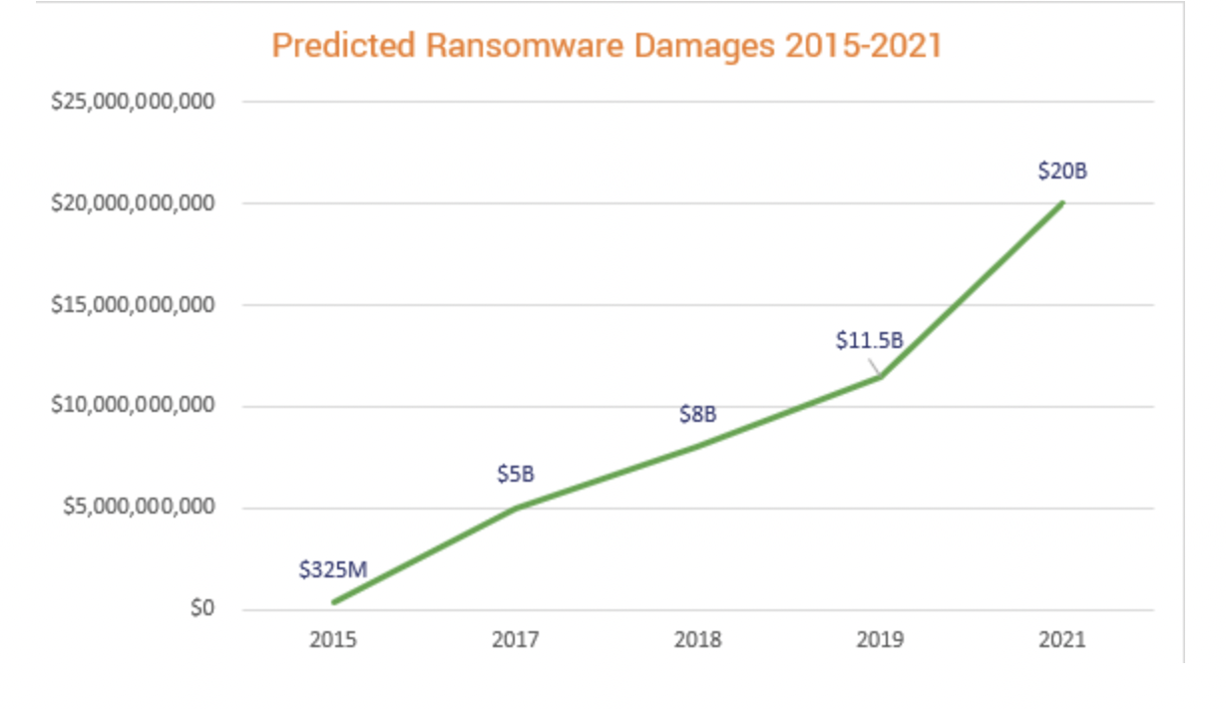
Ransomware in full swing, a few figures
37% of all businesses and organisations underwent ransomware attacks.
In 2021, ransomware cost USD$20 billions in the world. (Aka as much as Iceland’s GDP!)
According to experts, it will reach USD$265 billion in 2031.
Cyberattacks and Ransomwares - Internet law.

Slide 8
Legal solutions
Privacy law in canada
Personal Information Protection and Electronic Documents Act (PIPEDA) and its Quebecois equivalent: the Act respecting the Protection of Personal Information in the Private Sector.
PIPEDA:
“Organizations are responsible for personal information under their control […]” Sch 1, Art 4.1.
“Personal information must be protected by security safeguards appropriate to the sensitivity of the information” Sch 1, Art 4.7.
“Security safeguards must protect personal information against loss or theft, as well as unauthorized access, disclosure, copying, use or modification, regardless of the format in which it is held” Sch 1, Art 4.7.1.
“The nature of the safeguards will vary depending on the sensitivity of the information that has been collected, the amount, distribution, format of the information, and the method of storage. More sensitive information should be safeguarded by a higher level of protection” Sch 1, Article 4.7.2.
Cyberattacks and Ransomwares - Internet law.

Slide 9
Legal solutions
Canada’s criminal law code
s 430 (1.1): Mischief in relation to computer data (1.1) Everyone commits mischief who wilfully
(a) destroys or alters computer data;
(b) renders computer data meaningless, useless or ineffective;
(c) obstructs, interrupts or interferes with the lawful use of computer data; or
(d) obstructs, interrupts or interferes with a person in the lawful use of computer data or denies access to computer data to a person who is entitled to access to it.
s 342.2 (1): Possession of device to obtain unauthorized use of computer system or to commit mischief
Every person who, without lawful excuse, makes, possesses, sells, offers for sale, imports, obtains for use, distribuites or makes available a device that is designed or adapted primarily to commit an offence under section 342.1 or 430, knowing that the device has been used or is intended to be used to commit such an offence, is
(a) guilty of an indictable offence and liable to imprisonment for a term of not more than two years; or
(b) guilty of an offence punishable on summary conviction.
Cyberattacks and Ransomwares - Internet law.

Slide 10
Legal solutions
Canadian Law - groundbreaking case law.
R. v. Vachon-Desjardins, 2022 ONCJ 43.
Hacker was suspected of having received over USD$15 millions via ransomware attacks.
Found through his online activity, he was convicted on four grounds: mischief to data, (s. 430(5), unauthorized use of computer (s. 342.1(1)), extortion (s. 346(1.1)) and participation in the activities of a criminal organization) for a six year sentence.
Disgorgement: he had to reimburse the money the police was actually able to retrieve (including 719 bitcoins, worth at the time of the trial USD$20 millions (June 2022)).
Cyberattacks and Ransomwares - Internet law.

Slide 11
Legal solutions
Efforts for a much-needed international cooperation
The Budapest Convention on Cybercriminality 2001.
An initiative from the Council of Europe but signed now by more than 66 countries.
UN proposal 74/247 for an international treaty for the fight against cybercrime.
Drafted by Russia and China which led many countries opposing the project because of the risk of Internet censorship.
However, international cooperation does not always work. 23% of cyberattacks are led by countries.
Digital sovereignty and cyberdiplomacy
Cyberattacks and Ransomwares - Internet law.

Slide 12
Towards more cybersecurity
Policy proposals for a legal reinforcement of encryption standards.
Bill C-26, An Act Respecting Cyber Security (ARCS) (second reading phase).
Amend the Telecommunications Act to reinforce the security aspect.
Introduce the Critical Cyber Systems Protection Act (CCSPA).
Cyberattacks and Ransomwares - Internet law.

Slide 13
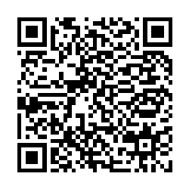
quizz!
Glory to be won and money to be made! (no)
Cyberattacks and Ransomwares - Internet law.

