Slide 1
Telecom Decision CRTC 2017-105
Zachary Bensemana
Prof. Mendelsohn

Slide 2
Background
Videotron launches an “Unlimited Music Program”
Some of higher paying plans can stream music from Videotron partnered music services without incurring data charges.
The data consumed by these streaming services would not count towards the data cap in their plan
Any eligible music streaming service that wanted to participate must be approved by Videotron

Slide 3
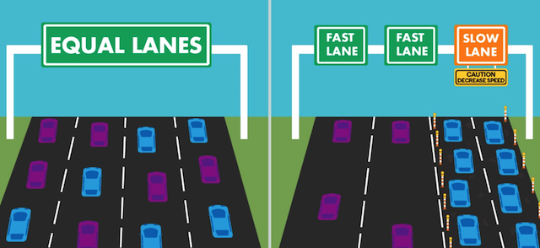
Proceeding
Parties raised concerns over Zero-rating practices
Saying they undermine Net Neutrality: the principle that ISP’s should treat all internet traffic equally
Commission saw that zero-rating and other differential pricing practices are likely to become common in Canada.
They decided to undertake a thorough analysis of these issues in this case and Telecom Regulatory Policy CRTC 2017-04
Doing this to ensure market certainty

Slide 4
s.27 (2) No Canadian carrier shall, in relation to the provision of a telecommunications service or the charging of a rate for it, unjustly discriminate or give an undue or unreasonable preference toward any person, including itself, or subject any person to an undue or unreasonable disadvantage.

Slide 5
Verdict
(a) Determination of Preference or Disadvantage and (b) the Undue or Unreasonable nature of the preference or disadvantage
Videotron has given an undue and unreasonable preference to:
its eligible subscribers who access the Unlimited Music program; and
the providers of the services included in that program.
Videotron has subjected to an undue and unreasonable disadvantage:
(a) its ineligible subscribers;
(b) its eligible subscribers who do not access the services in question;
(c) excluded content providers, either for difficulty of joining or ineligibility despite being substantially similar (internet radio stations)
Notes:
Users who are not eligible must use those services at a significantly higher cost
only the higher paying subscribers have access
Users who use services not covered by the program must access them at significantly higher cost
Subscribers are likely to opt for free content over other options
Harms people who don’t use the service, no rebate
Content providers not eligible (but substantially the same) can never access the program, and can expect to lose customers to those that do
Videotron says the service is open to all providers
They actively approached well-known providers to join
Negotiations times have averaged at 5.5 months
How do smaller less established services find out? How do they reach an agreement in time?
The exclusion of other kinds of services is arbitrary (internet radio stations)

Slide 6
Analysis
When consumers subscribe to a wireless data plan, they do so to gain access to all content available on the Internet.
the cost to the consumer of accessing the content included in Unlimited Music can be significantly different from the cost of accessing other Internet content.
Zero rating has a variety of negative effects:
Stunting development of new applications
Gatekeeping power to ISP’s
Mandates Videotron Compliance

Slide 7
Analysis under Telecom Regulatory Policy 2017-04
Agnostic Treatment of Data
Some data in this program is charged while the other isn’t
Exclusiveness of the Offering
Limited to certain high paying plans and music providers
Impact on Internet Openness and Innovation
Creates false incentives to use other products
Makes it difficult to launch new services, favours the established
Financial Compensation
None here, passed this criteria

