Slide 1
Corriveau c. Canoë inc., 2010 QCCS 3396

Slide 2
Facts
In response to the blog article, readers posted negative comments about Ms. Corriveau, ranging from perceived corruption in the court system to threats.
In September 2007, Ms. Corriveau found out about the comments through a judge she knew well.
Ms Corriveau sued Canoë.ca for moral damages, punitive damages and court fees.
In 2007, Suzanne Corriveau represented an accused who had been charged with sexually assaulting an 8-year-old child. Ms. Corriveau was heavily criticized by a Quebec judge for her cross examination of the victim, deemed too “severe”.
The judgement and the judge’s comments were widely reported on by the media across many news outlets in April 2007.
Among these news reports, Richard Martineau published a commentary on a blog, “Franc-parler” with a short leading question-style format, with the goal of generating discussion.

Slide 3
Comments like….
[Translation]
“I feel like punching her in the face!!!!” She’s an idiot, that one… if this “lady” missed a step, I wouldn’t be upset.”
“[…] Me Suzanne Corriveau, well-known in Québec for winning every time since she provides certain Superior Court judges with young prostitutes.”
“Suzan Corriveau is the daughter of Lawrence Corriveau, the lawyer of a notorious client who avoided accusations because of his death. Suzan’s brother Richard, also a lawyer, spent some time in prison for various offences involving fraud.”
+ more derogatory comments, generally treating her like an “idiot” (“belle tarte”).
Corriveau c. Canoe inc., 2010 QCCS 3396 (CanLII), pp 9-17, 19

Slide 4
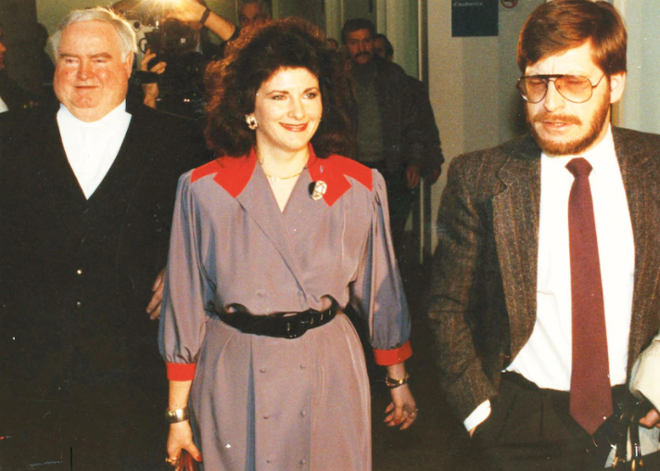
Background
Richard Martineau is a journalist who wrote a blog titled “Franc-parler”.
(Still blogs for Canoë via the Journal de Montréal)
Suzan Corriveau became well known owing to a highly publicized murder trial in the 1980s involving Benoît Proulx, a journalist
Illustrious career, enjoyed a good reputation, was well-respected by peers

Slide 5
Issues
Should the defendant be held liable for damages suffered by the complainant?
Did Ms. Corriveau suffer damages?
If yes, was it caused by the fault of the defendants?
If yes, how much in damages?

Slide 6
Issues
Should the defendant be held liable for damages suffered by the complainant? (Yes)
Did Ms. Corriveau suffer damages? (yes)
If yes, was it caused by the fault of the defendants? (yes)
If yes, how much in damages? (Enough to incite Canoë to take action to avoid similar comments being published in future blog posts)

Slide 7
Applicable law
Quebec Charter of Human Rights and Freedoms
3. Every person is the possessor of the fundamental freedoms, including […] freedom of opinion, freedom of expression […].
4. Every person has a right to the safeguard of his dignity, honour and reputation.

Slide 8
Applicable law
Civil Code of Quebec
3. Every person is the holder of personality rights, such as the right to […] the respect of his name, reputation and privacy […].
7. No right may be exercised with the intent of injuring another or in an excessive and unreasonable manner, and therefore contrary to the requirements of good faith.
35. Every person has a right to the respect of his reputation and privacy.
The privacy of a person may not be invaded without the consent of the person or without the invasion being authorized by law.
1457. Every person has a duty to abide by the rules of conduct incumbent on him, according to the circumstances, usage or law, so as not to cause injury to another.
Where he is endowed with reason and fails in this duty, he is liable for any injury he causes to another by such fault and is bound to make reparation for the injury, whether it be bodily, moral or material in nature.
He is also bound, in certain cases, to make reparation for injury caused to another by the act, omission or fault of another person or by the act of things in his custody.

Slide 9
Analysis
Must balance two competing interests:
Right to freedom of opinion and expression
Right to safeguard of his dignity, honour and reputation
Nothing particular in the laws of Quebec about defamation, so the court proceeded with a causality link between fault and prejudice.
Definition of defamation:
communication that results in negative feelings of oneself, lowered self-esteem, an attack on someone’s reputation through harmful things said, hate, or exposure to ridicule (Radio-Canada c. Radio Sept-Îles)
Defamation the result of two behaviours (Baudoin et Deslauriers):
The defendant seeks to do harm through ridicule, humiliation, exposure to hate
The defendant, through negligence, exposes the victim to ridicule or humiliation

Slide 10
Analysis
Determining whether there is defamation:
Reasonable person standard: would an ordinary person think less of someone else based on the defamatory statements?
Yes– the comments attempting to link Ms. Corriveau to corruption in the justice system and criminality are very serious for someone working in criminal law
(Also the fact that a judge that Ms. Corriveau knew well brought the comments to her is significant)
Was there harm?
Ms. Corriveau’s daughter and partner both observed how the comments had a profound effect on her (harm was caused)
Once Ms. Corriveau became aware of the defamatory statements, she suffered humiliation and feared repercussions on her professional life
The importance of a lawyer’s reputation:
A lawyer’s entire profession is based on their professional integrity (Hill). The fact that the complainant had been practicing law since 1980 is significant
Damages are determined based on how much harm is caused and how many people witnessed the defamatory statements.

Slide 11
Analysis (continued)
Was the harm caused by the defendents?
Defamation on the Internet is still defamation; the Internet is a powerful broadcasting tool, and those who write or broadcast on the internet must recognize the importance of the right to respect one’s dignity and reputation (Graf c. Duhaime)
Where the individual author cannot be found, the website itself is considered the editor -- website has editorial control over the content that is posted (Stratton Oakmont Inc. v. Prodigy Services Co.)
Canoë provides access to news articles through various mediums, and has the ability to control what remains visible and what is removed (has editorial control)
Canoë is considered to be a reputable, high traffic news source, and left the comments posted for 6 months
Canoë found to have been grossly negligent for not having checked for defamatory comments, despite having invited them, making it highly probably that the comments would be published and visible to others

Slide 12
Analysis (continued)
Damages should be significant enough to compensate Ms. Corriveau for the harm and suffering caused, and to ensure Canoë takes steps to avoid this situation from reoccurring
Canoë ordered to pay $50,000 in damages + $50,000 punitive damages
+ $7,000 in court costs

Slide 13
Key takeaway
News websites have editorial control over content posted and can be sued for negligence for the failure to prevent defamatory comments posted by third parties
+ Bonus takeaway for law students:
[Translation] “a lawyer’s career is built around their reputation and professional integrity. […] no other profession requires a higher degree of honesty and integrity.”

Slide 14
Thank you!
Also Peanut says hi and thanks for keeping her human busy while she steals socks

