Slide 1
Class 6 – October 10 My Image is My Own – Rights to your image and reputation online and “revenge porn”

Slide 2
Admin Crap / Announcements
http://allenmendelsohn.com/mcgill/
Office hours today CANCELLED
Office hours next week – TBD, will email
Essay topics → week of October 24 (see next slide)
October 16 18h00 McConnell Engineering: Roger Dingledine - President and co-founder of The Tor Project – “Tor: Internet privacy in the age of big surveillance”

Slide 3
Essay topics “guidelines”
Do what you want!
Do not necessarily limit yourself to the class topics
“Internet” = web, mobile, “things”
Focus!
4000-5000 words is really not a lot
Have a specific topic
Good to use specific examples and analyse
Notes:
Focus – do you think it would make a good book? It’s too broad!

Slide 4
News Item 2
Renee Tousignant presentation

Slide 5
In the News
Disqus data breach from 2012 → 17.5 million email addresses, usernames, sign-up dates, and encrypted passwords
Recall from mandatory data breach notifications:
“significant harm” includes bodily harm, humiliation, damage to reputation or relationships, loss of employment, business or professional opportunities, financial loss, identity theft, negative effects on the credit record and damage to or loss of property

Slide 6
In the News
Death of AIM (AOL Instant Messenger)
2001, FCC approved AOL merger with Time Warner
Condition of the merger that AOL make AIM interoperable with other services, to prevent a monopoly
AOL had 140 million users
___ has 2 billion users

Slide 7
Class 5 finish

Slide 8
Rights to your image
Notes:
“Subset” of right to privacy?
Mixed up with reputation? → see class title
If reputation damaged, what law do you think of? Defamation!
Also, OFFLINE law yada yada…

Slide 9
Personality Rights Publication Rights
Right to your image
Right to your likeness
Right to your voice
Right to your name
Others?
→ Your persona

Slide 10
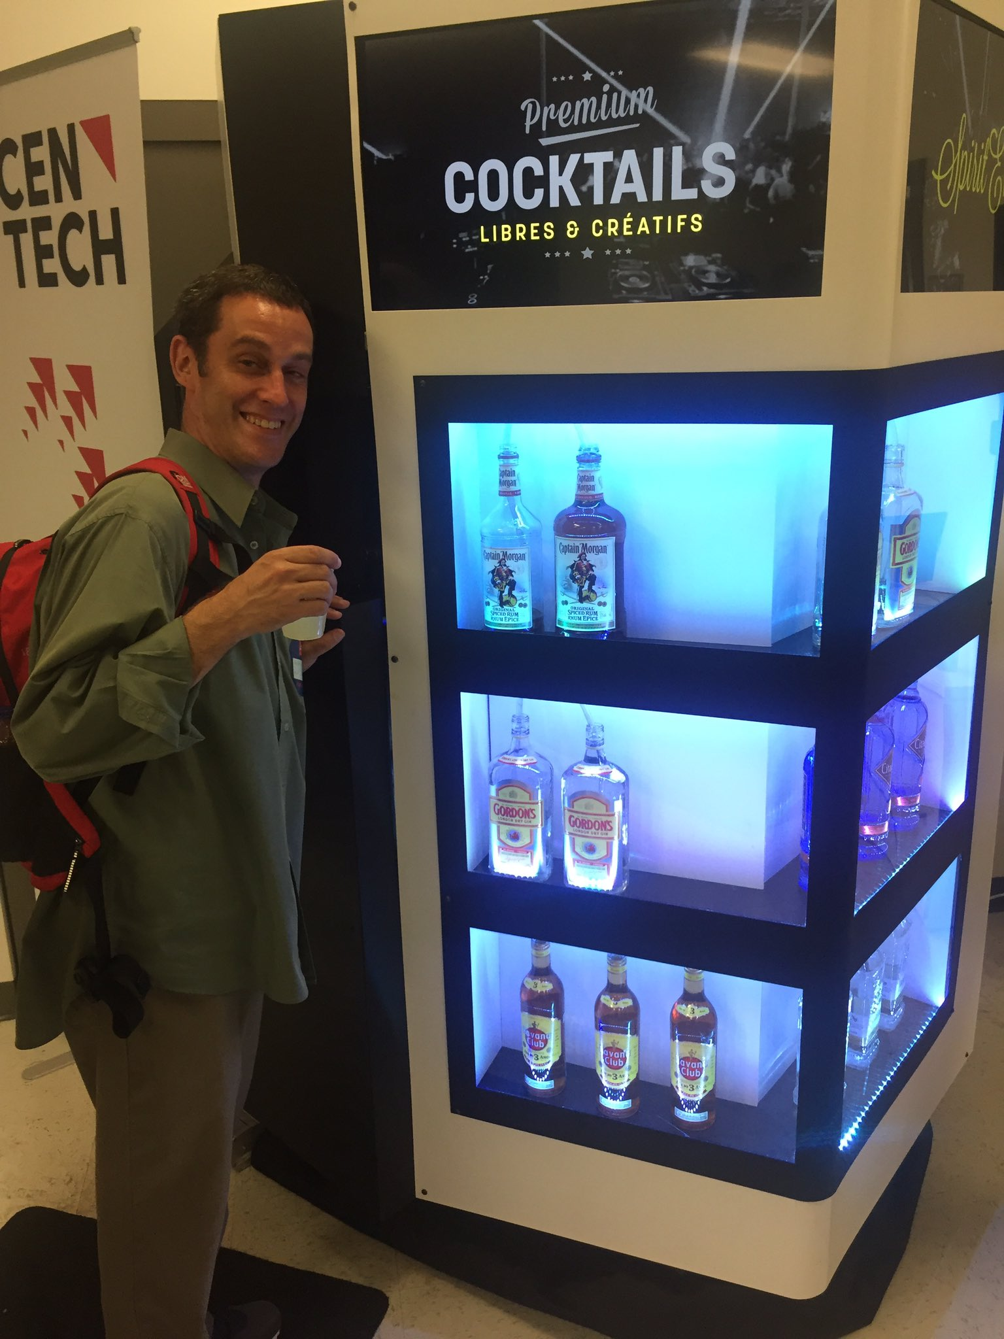
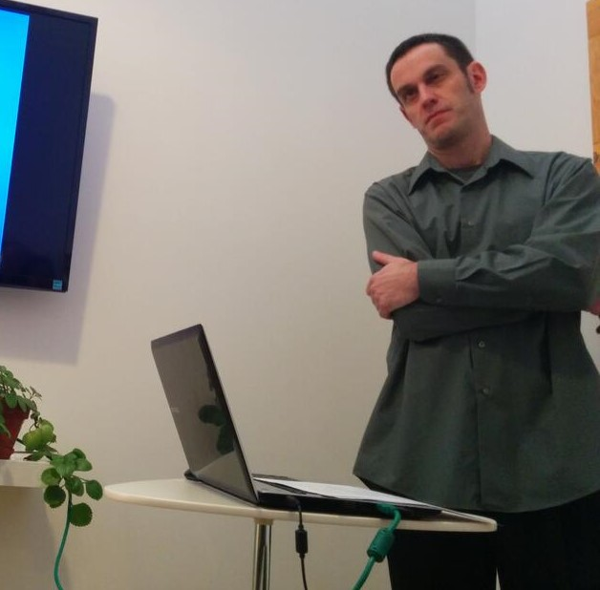
Personality Rights in play when…
$$$$$$$$$$$$$
Reputation / defamation
Notes:
$$$$$$$$$$ - commercial exploitation

Slide 11
Personality Rights in play when…
$$$$$$$$$$$$$
Reputation / defamation
Recall Douez v. Facebook Class 3 – territorial jurisdiction
BUT underlying privacy rights case → Mrs. Douez’ (and potential class) photo and name used in FB advertisement
A.B. v Bragg Communications
2012 SCC 46
→ Fake FB profile with picture of A.B. and similar name, along with unflattering comments, sexual references
(see October 31 class)
Notes:
$$$$$$$$$$ - commercial exploitation

Slide 12
Personality Rights – Common Law
Specific references in Privacy Acts of British Columbia, Manitoba, Newfoundland, and Saskatchewan
Other common law provinces – tort of “appropriation of personality” or “wrongful appropriation of personality”

Slide 13
Common Law Statutes
MB, NL, SK
British Columbia
Personality rights are a subset of the right to privacy
Name, likeness, voice
No proof of damages required
Personality rights violations are a tort in and of themselves
Name and likeness only
No proof of damages required

Slide 14
e.g. Manitoba The Privacy Act
2. A person who substantially, unreasonably, and without claim of right, violates the privacy of another person, commits a tort against that other person.
3. Without limiting the generality of section 2, privacy of a person may be violated
(…)
(c) by the unauthorized use of the name or likeness or voice of that person for the purposes of advertising or promoting the sale of, or any other trading in, any property or services, or for any other purposes of gain to the user if, in the course of the use, that person is identified or identifiable and the user intended to exploit the name or likeness or voice of that person

Slide 15
British Columbia – The Privacy Act
3. (1) In this section, “portrait” means a likeness, still or moving, and includes
(a) a likeness of another deliberately disguised to resemble the plaintiff, and
(b) a caricature.
(2) It is a tort, actionable without proof of damage, for a person to use the name or portrait of another for the purpose of advertising or promoting the sale of, or other trading in, property or services, unless that other, or a person entitled to consent on his or her behalf, consents to the use for that purpose.

Slide 16
Common law tort
Krouse v. Chrysler Canada Ltd. et al.
(1974), 1 O.R. (2d) 225 (Ont. CA)
F – pictures of a football game, players with numbers on jerseys used in car ad
“…there may well be circumstances in which the Courts would be justified in holding a defendant liable in damages for appropriation of a plaintiff's personality, amounting to an invasion of his right to exploit his personality by the use of his image, voice or otherwise with damage to the plaintiff, but… “

Slide 17
Various defenses at common law
Consent
Public interest
Fair comment
Not recognizable
Group picture unless identified
Non-intentional
Incidental to another legal act
Law enforcement images
Notes:
Note – these vary jurisdiction to jurisdiction
Sometimes they are elements of the tort itself
→ Most would probably apply in Quebec as well

Slide 18
Personality Rights in Quebec
Quebec Charter
4. dignity, honour and reputation; and 5.respect for private life
C.C.Q.
35. Every person has a right to the respect of his reputation and privacy.
36. The following acts, in particular, may be considered as invasions of the privacy of a person (...)
(3) appropriating or using his image or voice while he is in private premises; (…)
(5) using his name, image, likeness or voice for a purpose other than the legitimate information of the public;

Slide 19
Personality Rights in Quebec
Aubry c. Éditions Vice-Versa inc. [1998] 1 SCR 591
F – Aubry (17 years old) had her photo taken in a public place, sitting on some steps, and published in an arts magazine without her consent
Issue – Does publication of photograph without permission lead to liability?
Held: Yes!

Slide 20
Aubry c. Éditions Vice-Versa inc (cont.)
“Since the right to one’s image is included in the right to respect for one’s private life, it is axiomatic that every person possesses a protected right to his or her image. This right arises when the subject is recognizable. There is, thus, an infringement of the person’s right to his or her image, and therefore fault, as soon as the image is published without consent and enables the person to be identified.”
“Since every person is entitled to protection of his or her privacy, and since the person’s image is protected accordingly, it is possible for the rights inherent in the protection of privacy to be infringed even though the published image is in no way reprehensible and has in no way injured the person’s reputation.”

Slide 21
Aubry c. Éditions Vice-Versa inc (cont.)
“The public’s right to information, supported by freedom of expression, places limits on the right to respect for one’s private life in certain circumstances. This is because the expectation of privacy is reduced in certain cases.”
Depends on context, e.g. public interest. So here…
“In our view, the artistic expression of the photograph, which was alleged to have served to illustrate contemporary urban life, cannot justify the infringement of the right to privacy it entails. It has not been shown that the public’s interest in seeing this photograph is predominant.”

Slide 22
Aubry c. Éditions Vice-Versa inc (cont.)
“The appellants argued that there was no causal connection between the publication of the photograph and the damages. In our view, no particular problem arises here since the damages are the logical, direct and immediate consequence of the fault. A teenager’s sensitivity and the possibility of being teased by her friends are eminently foreseeable.”
“In this regard, the respondent is correct in stating that the magazine does not cease to be “commercial” merely because it has an artistic content. In the case at bar, the photograph was used for commercial purposes, in particular to sell the magazine.”
Notes:
no damage to reputation, but still damages

Slide 23
Aubry c. Éditions Vice-Versa inc (cont.)
Notes:
Case facts from 1989, CCLC applies, does not have specific CCQ right to image; case decided under s. 5 of Charter → right to image held to be included in right to privacy
dissent → no damages here! Some classmates laughing at her is not enough; Aubry never said she felt humiliated

Slide 24
News Item 1
Oksana Werbowy presentation

Slide 25
Non-consensual pornography (a.k.A. Revenge porn?)

Slide 26
Nonconsensual pornography
The distribution of sexual or pornographic images of individuals without their consent
No revenge motive per se
images originally obtained without consent (e.g. using hidden cameras, hacking phones, or recording sexual assaults)
images consensually obtained within the context of an intimate relationship

Slide 27
e.g. B.C. Privacy Act
L.A.M. v. J.E.L.I., 2008 BCSC 1147
F – D videotaped nude P and her young daughter in the bathroom
(D also convicted for child pornography)
Held - $60k total damages (including $35k punitive) for violating BC Privacy Act
Note – no distribution here, but privacy violation

Slide 28
e.g. B.C. Privacy Act
T.K.L. v. T.M.P., 2016 BCSC 789
F – D videotaped nude P (his stepdaughter) in bedroom and bathroom / shower, said he did it for humiliation and revenge
Held - ~ $94k total damages for violating BC Privacy Act

Slide 29
What if there is no Privacy Act?
Doe 464533 v. N.D., 2016 ONSC 541
Katrina Sole Kahler presentation

Slide 30
Doe 464533 v. N.D. takeaway
[45] To permit someone who has been confidentially entrusted with such details – and in particular intimate images - to intentionally reveal them to the world via the Internet, without legal recourse, would be to leave a gap in our system of remedies. I therefore would hold that such a remedy should be available in appropriate cases.
[46] I would essentially adopt as the elements of the cause of action for public disclosure of private facts the Restatement (Second) of Torts (2010) formulation, with one minor modification: One who gives publicity to a matter concerning the private life of another is subject to liability to the other for invasion of the other’s privacy, if the matter publicized or the act of the publication (a) would be highly offensive to a reasonable person, and (b) is not of legitimate concern to the public. [modification shown by underlining]

Slide 31
Doe 464533 v. N.D., part deux
2016 ONSC 4920 (September 2016)
“Guided by the factors detailed above, the overall interest of justice favours the granting of the order with terms. That is, the finding of liability on the defendant and the assessment of damages are to be set aside upon the defendant paying to the plaintiff her costs thrown away within 90 days”
→ Should allow a defense to be mounted
Notes:
Original Jx was January 2016
Was a default Jx, court here sets it aside based on standard analysis of factors

Slide 32
Doe 464533 v. N.D., part trois
2017 ONSC 127 (January 2017)
Motion for leave to appeal of decision in part deux that set aside the default judgment, denied
“I am not persuaded that the motion judge erred in his conclusion that both liability and damages should be the subject of a trial on the merits.”
“I am not persuaded that the motion judge erred in his application of the Mountain View factors. ”

Slide 33
Doe 464533 v. N.D., part trois (cont.)
“I do not see the dismissal of this motion for leave to appeal as a discouragement of victims. Indeed, it is a matter of general importance that the facts in this case be the subject of a hearing on its merits so that the significant legal conclusions deriving therefrom will have more weight in future cases as opposed to findings made as a result of a hearing where only one side participated, albeit through the fault of the other side. The uniqueness of the case and the prospect for a decision on the merits making a contribution to the development of torts in an important area of the law is a compelling reason to conclude that it is a question of general importance that the defendant have the opportunity to participate in a trial.”

Slide 34
Manitoba legislation
Intimate Image Protection Act, in force 2017-1-15
"intimate image" means a visual recording of a person made by any means, including a photograph, film or video recording,
(a) in which the person depicted in the image
(i) is nude, or is exposing his or her genital organs or anal region or her breasts, or
(ii) is engaged in explicit sexual activity;
(b) which was recorded in circumstances that gave rise to a reasonable expectation of privacy in respect of the image; and
(c) if the image has been distributed, in which the person depicted in the image retained a reasonable expectation of privacy at the time it was distributed
Notes:
Also provincial agency to deal with complaints

Slide 35
Manitoba legislation
Intimate Image Protection Act, in force 2017-1-15
11(1). A person who distributes an intimate image of another person knowing that the person depicted in the image did not consent to the distribution, or being reckless as to whether or not that person consented to the distribution, commits a tort against that other person.
11(2). An action for the non-consensual distribution of an intimate image may be brought without proof of damage.
12. In an action for the non-consensual distribution of an intimate image, the person depicted in the image does not lose his or her expectation of privacy in respect of the image if he or she
(a) consented to another person recording the image; or
(b) provided the image to another person;
Notes:
Also provincial agency to deal with complaints

Slide 36
Alberta legislation
Protecting Victims of Non-Consensual Distribution of Intimate Images Act, SA 2017, in force 2017-8-4
3. A person who distributes an intimate image of another person knowing that the person depicted in the image did not consent to the distribution, or is reckless as to whether or not that person consented to the distribution, commits a tort against that other person.

Slide 37
Legislation in the works
An Act Respecting the Unauthorized Distribution of Intimate Images and Protection Against Cyber-bullying
Cited as the Intimate Images and Cyber-protection Act
First reading in Nova Scotia legislature October 7, 2017

Slide 38
Previously in Nova Scotia…
Crouch v. Snell, 2015 NSSC 340
re the Cyber-safety Act
“In conclusion, I find that the Act has both the purpose and effect of controlling or restricting freedom of expression.” (s. 2b. Charter)
“There is no "limit prescribed by law" and the impugned provisions of the Act cannot be justified under s. 1.”
“The Act must be struck down in its entirety.”
Notes:
F – cyberbullying case, P sought protection order under the Act
New act requires malice or recklessness, old Act said anything “reasonably expected to cause harm”

Slide 39
Non-consensual Pornography – Criminal Code
Publication, etc., of an intimate image without consent
162.1 (1) Everyone who knowingly publishes, distributes, transmits, sells, makes available or advertises an intimate image of a person knowing that the person depicted in the image did not give their consent to that conduct, or being reckless as to whether or not that person gave their consent to that conduct, is guilty
(a) of an indictable offence and liable to imprisonment for a term of not more than five years; or
(b) of an offence punishable on summary conviction.
Notes:
2014 → after events of Jane Doe case

Slide 40
Non-consensual Pornography – Criminal Code (cont.)
Definition of intimate image
(2) In this section, intimate image means a visual recording of a person made by any means including a photographic, film or video recording,
(a) in which the person is nude, is exposing his or her genital organs or anal region or her breasts or is engaged in explicit sexual activity;
(b) in respect of which, at the time of the recording, there were circumstances that gave rise to a reasonable expectation of privacy; and
(c) in respect of which the person depicted retains a reasonable expectation of privacy at the time the offence is committed.
(3) No person shall be convicted of an offence under this section if the conduct that forms the subject-matter of the charge serves the public good and does not extend beyond what serves the public good.
Notes:
Definition just about the same as under Manitoba and Albert tort acts

Slide 41
Non-consensual Pornography – Criminal law
162.2 (1) When an offender is convicted, or is discharged on the conditions prescribed in a probation order under section 730, of an offence referred to in subsection 162.1(1), the court that sentences or discharges the offender, in addition to any other punishment that may be imposed for that offence or any other condition prescribed in the order of discharge, may make, subject to the conditions or exemptions that the court directs, an order prohibiting the offender from using the Internet or other digital network, unless the offender does so in accordance with conditions set by the court.

Slide 42
Non-consensual Pornography – Criminal Code (cont.)
R. v. A.C. 2017 ONCJ 317
F – Victim searched her name, found videos and pictures of her having intercourse with A.C., which she had consented to as they were in a relationship; uploaded by A.C. after relationship ended
Issue – guilty under s. 162.1 of the Criminal Code? Sentence?
Held – Yes, he pleaded guilty. Issue was mostly about sentence, 162.2 order. LOTS of aggravating factors (e.g. attached name and other PI to pics and videos); five months imprisonment
“It is difficult to overstate the seriousness of this offence. The offender deliberately set out to violate C.S.’s privacy in a most obscene and far-reaching way. He did so, motivated by revenge, with the intent to degrade and humiliate her.”
Notes:
Good history of 162.1, summary of other cases

Slide 43
Discussion Question
Does Facebook, or Google, Porntube.com or TheDirty.com have a legal obligation to remove non-consensual pornography uploaded by a user?
Notes:
A – no, s 230 Comm Decency Act
UNLESS violates Terms and Conditions, or copyright law

Slide 44
Non-consensual Pornography - USA
38 states have criminal laws
Generally stronger privacy torts in USA
No national criminal or civil law
Problem of s. 230 CDA

Slide 45
FIN

