Slide 1
Class 10 – November 14 “A whole bunch of important and fun tech and internet stuff”

Slide 2
Admin Crap / Announcements
Office hours today - room 420
Missing essay topic paragraphs
Course evaluations on Minerva. Just do it! THE FUTURE OF TECH LAW AT THIS FACULTY DEPENDS ON IT FFS AUUUGHHHHHHHHHHHH!!!!111!!!11!!!!
Innovation in Context 2: Scaling Up, Saturday November 18, 9-5

Slide 3
In the News
NY Times report - NSA hack by the “Shadow Brokers”
Wikileaks and Donald Trump Jr.’s Twitter DMs
CRTC Communications Monitoring Report 2017:
Communications $66.6B in 2016
Telecommunications and Broadcasting

Slide 4
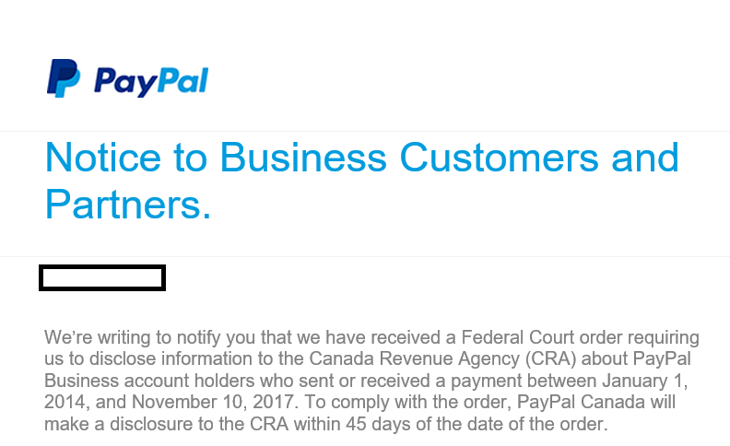
In the News – breaking!
About last night…

Slide 5
In the news jurisprudence
R. v. Livingston, 2017 ONCJ 747, 2017-11-9
342.1 Cr. Code, Unauthorized use of a computer
deleting file from Ontario Premier’s Office
cites R v. Parent QCCA

Slide 6
In the news jurisprudence
R. v. Owen, 2017 ONCJ 729, 2017-11-3
Searches of computers for child pornography violated s. 8 Charter, evidence excluded b/c warrant issues regarding IP adresses:
“The only way to tie internet activity to a physical address is with evidence that the IP address at which the activity took place was being used at a particular place, at a particular moment in time. (…) Given the dynamic nature of IP address assignment, there was a very real probability that the subscribers were different”
“without the subscriber information obtained as a result of the production order, there would have been no basis in the search warrant to search the applicant’s home. The result is that the search warrant must also be set aside”

Slide 7
In the News Presentation
Gregory Corosky

Slide 8
Totally RANDOM practical INTERNET, PRIVACY, TECHNOLOGY AND CYBERSECURITY LAW TOPICS that i have dealt with over the years that we haven’t covered in class so far, AND WON’T in the last two weeks, BUT figured you should know the basics of or at least know of their existence
Notes:
Kind of practical from a Quebec lawyer’s perspective – apologies to the graduate students and exchange students.

Slide 9
Bilingual websites in Québec
Article 52 Charte de la langue française :
Les catalogues, les brochures, les dépliants, les annuaires commerciaux et toute autre publication de même nature doivent être rédigés en français.
Exceptions → cultural, non-profit, English media, personal
$20k in fines
Notes:
Office says “toute autre publication” includes websites
Head office of company, establishment in Quebec, not the server

Slide 10
Bilingual websites in Québec
Procureur général du Québec v. Hyperinfo Canada Inc., 550-61-000887-014
F: English only website with disclaimer – « Les produits et les services sur ce site web ne sont pas disponible aux résidants du Québec dus à la Charte de la langue française »
Held: Article 52 Charte is public order, can’t contract out of it.
Notes:
Unilingual English site, Quebec presence

Slide 11
“This Contest is not Open to Residents of Quebec”???
Regie des alcools, des course et des jeux
Rules respecting publicity contests, Ch. L-6, r-6
Applies to any contest where the prize is $100 or more
Applies to anyone running a contest in QC, not just Que companies

Slide 12
Contests in Quebec
Prize Value $100-999.99 or $1000-1999.99
Submit the Régie form 5 days / 30 days prior to contest opening
PAY THE FEES! → % of total prize value:
10% if Quebec residents only
3% all of Canada
0.5% anything else (e.g. North America)

Slide 13
Contests in Quebec
Prize Value $2000+
Régie form 30 days prior
Fees
Text of contest rules 10 days prior
Text of all advertising 10 days prior
Written report within 60 days of contest close

Slide 14
Rules must include:
the conditions for entering the contest;
the places where the public must deposit or send the contest entry forms;
the deadline for entering the contest;
a description of the method of awarding the prizes;
the number and a detailed description of the prizes offered and the value of each prize;
the place, date and precise time the prizewinner will be named;
the media used to inform the winners of the prizes won;
Notes:
Rule 5 (and 12)

Slide 15
Rules must include:
the place, date and deadline for claiming prizes, or where applicable, whether the prizes will be delivered to the winner;
the information that the winners will be selected by a jury, where applicable;
the information that as a minimum the persons specified in section 12* must be excluded in all cases;
the following text: “Any litigation respecting the conduct or organization of a publicity contest may be submitted to the Régie des alcools, des courses et des jeux (the “Régie”) for a ruling. Any litigation respecting the awarding of a prize may be submitted to the Régie only for the purpose of helping the parties reach a settlement.”
the nature of the skill-testing requirement that a winner has to satisfy in order to claim his prize.
*A person for whom a publicity contest is carried on, his employee, representative or mandatary, a member of the jury and the persons with whom they are domiciled may not enter the contest.

Slide 16
I was told there would be no math
The “skill-testing question”
(3 +5) x 2 - 1
3 + 5 x 2 - 1
3 + 5 x (2 – 1)
Why?
Competition Act → Does not allow games of chance, allows games of skill
cf. USA → “Sweepstakes” good, skill bad
Notes:
15
12
8

Slide 17
Online Contests – e.g. Facebook
1. If you use Facebook to communicate or administer a promotion (ex: a contest or sweepstakes), you are responsible for the lawful operation of that promotion, including:
a. The official rules;
b. Offer terms and eligibility requirements (ex: age and residency restrictions); and
c. Compliance with applicable rules and regulations governing the promotion and all prizes offered (ex: registration and obtaining necessary regulatory approvals)
2. Promotions on Facebook must include the following:
a. A complete release of Facebook by each entrant or participant.
b. Acknowledgement that the promotion is in no way sponsored, endorsed or administered by, or associated with, Facebook.
3. Promotions may be administered on Pages or within apps on Facebook. Personal Timelines and friend connections must not be used to administer promotions (ex: “share on your Timeline to enter” or “share on your friend's Timeline to get additional entries”, and "tag your friends in this post to enter" are not permitted).
4. We will not assist you in the administration of your promotion, and you agree that if you use our service to administer your promotion, you do so at your own risk.

Slide 18
COPPA!
“You must be at least 13 years of age to use this online service”
Children's Online Privacy Protection Act, 2000
15 U.S.C. §§ 6501–6506
→ Applies to anyone who collects personal info from American children

Slide 19
COPPA! Requirements
clear and comprehensive online privacy policy describing their information practices for PI collected online from kidz
reasonable efforts to provide direct notice to parents of the operator’s practices with regard to the collection, use, or disclosure of PI from kidz
obtain verifiable parental consent, prior to any collection, use, and/or disclosure of PIfrom kidz
PIPEDA-like requirements of access to and deletion of PI of kidz, but belonging to parents

Slide 20
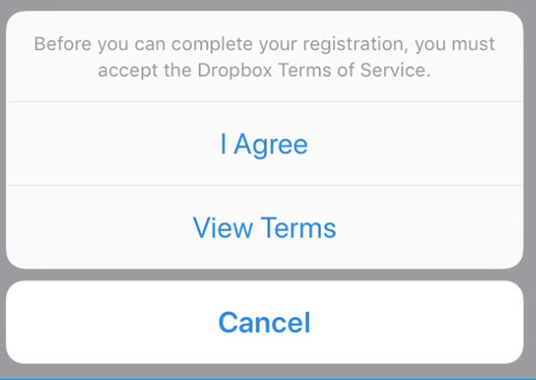
Terms of Use Enforceability
“Clickwrap”
“Browse(r)wrap”
By visiting the Website or using the Services on the Website, you hereby accept to be bound by these Terms of Use without any reservations, modifications, additions or deletions

Slide 21
Terms of Use Enforceabilty – Mixed

Slide 22
Terms of Use Enforceabilty Jurisprudence Factors
Visibility → IN YOUR FACE
$$$
Pre-checked box
Contract law → meeting of the minds
Contract law → contracts of adhesion
Summary points:
very fact-specific
positive act is good

Slide 23
App EULA Requirements
iOS
Android
You acknowledge and agree that (i) these TOU are concluded between you and Student Republic only, and not Apple, and (ii) Student Republic, not Apple, is solely responsible for the Application and content thereof. Your use of the Application must comply with the Apple App Store Terms and Conditions, which you are responsible to review from time to time.
You acknowledge that Apple has no obligation whatsoever to furnish any maintenance and support Services with respect to the Application.
Apple will have no warranty obligation whatsoever with respect to the Application. As between Student Republic and Apple, any other claims, losses, liabilities, damages, costs or expenses attributable to any failure to conform to any warranty will be the sole responsibility of Student Republic, or as further specified and limited hereinafter.
You and Student Republic acknowledge that, as between Student Republic and Apple, Apple is not responsible for addressing any claims you have or any claims of any third party relating to the Application or your possession and use of the Application, including, but not limited to: (i) product liability claims; (ii) any claim that the Application fails to conform to any applicable legal or regulatory requirement; and (iii) claims arising under consumer protection or similar legislation.
You and Student Republic acknowledge that, in the event of any third party claim that the Application or your possession and use of the Application infringes that third party’s intellectual property rights, Student Republic, not Apple, shall be solely responsible for the investigation, defense, settlement and discharge of any such intellectual property infringement claim, as specified in section 3 above and elsewhere in this TOU.
You and Student Republic acknowledge and agree that Apple, and Apple’s subsidiaries, are third party beneficiaries of these TOU as related to your license of the Application, and that, upon your acceptance of these TOU, Apple will have the right (and will be deemed to have accepted the right) to enforce these TOU as related to your license of the Application against you as a third-party beneficiary thereof.
You acknowledge that (i) you are not located in a country that is subject to a U.S. Government embargo, or that has been designated by the U.S. Government as a “terrorist supporting” country; and (ii) you are not listed on any U.S. Government list of prohibited or restricted parties.
Without limiting any other of these TOU, you must comply with all applicable third party terms of agreement when using the Application.
You acknowledge that updates to the iOS Application are subject to the approval of Apple, and Student Republic and its affiliates, and their respective shareholders, officers, directors, employees, agents, partners, principals, representatives, successors and assigns (collectively “Representatives”) shall not be held responsible for any losses or damages, direct or indirect, pecuniary or non-pecuniary, resulting from any delay in the approval of updates by Apple.

Slide 24
UNCITRAL
United Nations Commission on International Trade Law
Conventions!
Model laws!

Slide 25
UNCITRAL
Arbitration rules and Model Law on International Commercial Arbitration
United Nations Convention on Contracts for the International Sale of Goods
United Nations Convention on the Use of Electronic Communications in International Contracts
UNCITRAL Model Law on Electronic Signatures
UNCITRAL Model Law on Electronic Commerce

Slide 26
E-Comm Laws in Canada
All common law provinces based on UNCITRAL model law
e.g. Electronic Commerce Act, S.O. 2000, c. 17
Quebec – An Act to Establish a Legal Framework for Information Technology, R.S.Q., ch. C-1.1 → DOCUMENTS
Quebec – Distance Contracts (ss. 54.1 ff.) in the Consumer Protection Act, R.S.Q. Ch. P-40.1

Slide 27
So you wanna be a lawyer?

Slide 28
Cybersecurity for lawyers
Online insurance
Confidential information
T-shirt sales
Free sounds for iPad
Hockey goalies
Regulated industry

Slide 29
Cybersecurity for Lawyers
http://guideti.barreau.qc.ca/
“The advice and recommendations in this guide have not been specifically encoded in legislation or regulations for the practice of the legal profession (including the Code of Professional Conduct of Lawyers). This guide can therefore be considered a description of best practices…”

Slide 30
The Codes
Code de déontologie (Code of Professional Conduct for Lawyers)
4. …honour, dignity, integrity…
13. …protect his integrity…
20. A lawyer owes his client duties of integrity, competence, loyalty, confidentiality, independence, impartiality, diligence and prudence.
Code des professions
59.2: No professional may engage in an act derogatory to the honour or dignity of his profession or to the discipline of the members of the order

Slide 31
Confidential Information
Act to establish a legal framework for information technology, R.S.Q. ch. C-1.1
34. Where the information contained in a document is declared by law to be confidential, confidentiality must be protected by means appropriate to the mode of transmission, including on a communication network.

Slide 32
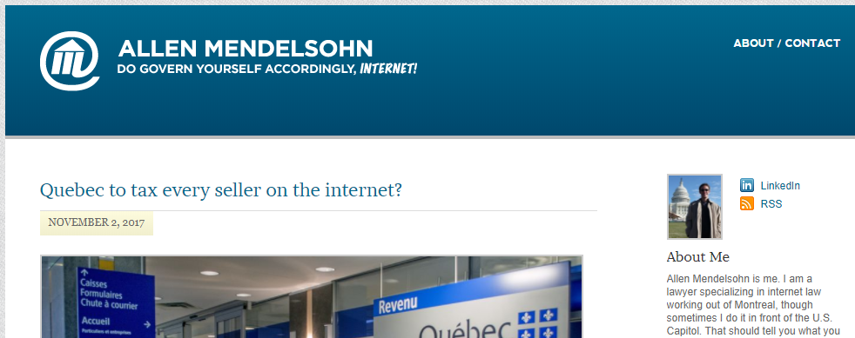
Lawyers on Social Media

Slide 33
Can lawyers use social media?
Code de déontologie
17. Provided he complies with this code, a lawyer may communicate information to the media, make public appearances or make public communications, including on a website, blog or online social network, by means of statements, photographs, images or videos.
18. → if pending before a tribunal don’t influence
19. …must not, directly or indirectly, publish, broadcast, communicate or send writings or comments which are false

Slide 34
Social Media and the Courts
18. L’avocat ne doit pas faire de déclarations publiques ni communiquer des renseignements aux médias au sujet d’une affaire pendante devant un tribunal s’il sait ou devrait savoir que ces renseignements ou ces déclarations risquent de porter atteinte à l’autorité d’un tribunal ou au droit d’une partie à un procès ou à une audition équitables.

Slide 35
Kristian brabandeR

