Slide 1
Grant v Torstar (2009 SCC 61)
…or the ink that spilled.
Presentation by Natalia Koper

Slide 2
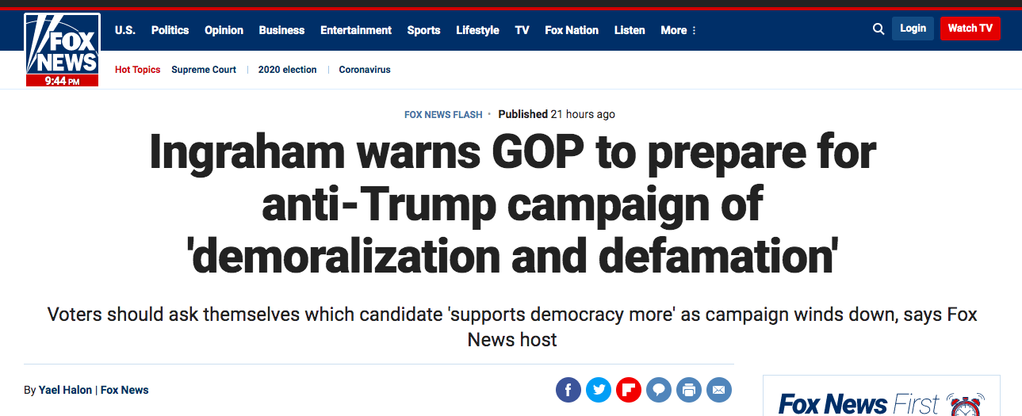
What’s at stake?

Slide 3
Wait, what’s libel again?
What constitutes libel
2 Defamatory words in a newspaper or in a broadcast shall be deemed to be published and to constitute libel.
Meaning of words extended
1(2) Any reference to words in this Act shall be construed as including a reference to pictures, visual images, gestures and other methods of signifying meaning.
Libel and Slander Act, RSO 1990, c L.12

Slide 4
Background
Who?
The Plaintiff
“Everyone thinks it’s a done deal because of Grant’s influence — but most of all his Mike Harris ties,” says Lorrie Clark, who owns a cottage on Twin Lakes.
Who?
The Defendant
Peter Grant
(& Grant Forest Products Inc.)
Torstar
(& Toronto Star Newspapers Ltd., Bill Schiller, John Honderich, Mary Deanne Shears)
What?
Libel
Star article "Cottagers teed off over golf course; Long-time Harris backer awaits Tory nod on plan,” published on June 23, 2001.
(paras 8-17)

Slide 5
Judicial history:
Trial level (Ontario Superior Court of Justice)
Plaintiff (Grant) | Defendant (Torstar)
The article accused Grant of using his influence to obtain government favours. | The article aired the real and legitimate concerns of local residents.
“This is a case about holding big media accountable to the law” (Grant's lawyer, Peter Downard) | Alternatively, a defence of public interest responsible journalism should apply.
 | Defences of truth and fair comment.
(paras 18-20)

Slide 6
Judicial history:
Appeal (Ontario Court of Appeal)
Respondent (Grant) | Appellant (Torstar)
 | Quan v. Cusson, responsible journalism.
 | The trial judge erred in the application of “fair comment” defence.
(paras 21-25)

Slide 7
Issues:
Should the common law provide a defence based on responsible communication in the public interest? [YES]
If so, what are the elements of the new defence? [2-STEP TEST]
If so, what procedures should apply? In particular, what are the respective roles of the judge and jury? [JUDGE-Q1; JURY-Q2]
Application to the case at bar
(a) Fair comment (b) Responsible communication
(para 26)

Slide 8
Tort of Defamation – strict liability
(1) Defamatory words – lower the plaintiff’s reputation in the eyes of a reasonable person;
(2) the words in fact referred to the plaintiff;
(3) the words were published, i.e. they were communicated to at least 1 person other than the plaintiff.
State of Law
(paras 28-37)
Defence of a statement of opinion:
the comment must be on a matter of public interest;
the comment must be based on fact;
the comment, though it can include inferences of fact, must be recognisable as comment;
the comment satisfies the objective test: could any person honestly express that opinion on the proved facts?;
was there express malice?
Defence of a statement of fact:
Justification: the statement was substantially true
Privilege: the statement was made under a protected context
(McLachlin C.J writing for the majority)

Slide 9
Why New Defence?
Principles:
democratic discourse
truth-finding
self-fulfillment
Jurisprudence:
UK
Australia
New Zealand
South Africa
…
(paras 38-84)

Slide 10
Test for Responsible Communication in Public Interest Defence
Factors:
The seriousness of the allegation
The public importance of the matter
The urgency
The reliability of the source
Whether the plaintiff’s side of the story was sought and accurately reported
Whether inclusion of the defamatory statement was justifiable
“Reportage”/ “Repetition rule”
2. The defendant must show that publication was responsible, in that he or she was diligent in trying to verify the allegation(s), having regard to all the relevant circumstances.
1. The publication must be on a matter of public interest.
(para 126)
(McLachlin C.J writing for the majority)

Slide 11
Seven Principles Guiding Defamation Law Reform in Ontario
Defamation Law Must Re-Balance Protection of Reputation and Freedom Of Expression
Defamation Law Needs to Be Updated
Defamation Law Is Evolving; New Reforms Must Complement These Developments
Access To Justice And Dispute Resolution Must Be Improved
Defamation Law Must Specifically Address Online Personal Attacks
There Must Be New Obligations For Intermediary Platforms
Defamation Law and Privacy Law Have Distinct Objectives and Should Remain Separate
(Defamation Law in the Internet Age. The Final Report. Law Commission of Ontario, March 2020)

Slide 12
Conclusion
The rise of new ways of online expression is a challenge to a traditional understanding of defamation law.
We can soon expect a major reform of the statutory framework of defamation law, which will take into account the growing role of social media platforms.
Grant v Torstar signals a broader protection of the freedom of expression, which (IMO) is consistent with how Internet users perceive their rights online.

Slide 13
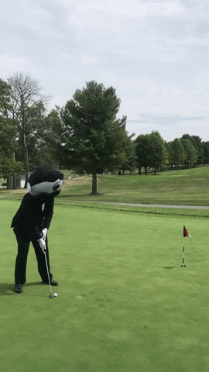
Inspirational Quote:
“We live in a free country where people have as much right to express outrageous and ridiculous opinions as moderate ones”
(WIC Radio, Binnie J.)
The End
Merci!

