Slide 1
Class 2 – September 15 Does Anyone Govern the Internet? A look at internet subject matter jurisdiction and net neutrality

Slide 2
Admin Crap
MyCourses - discussions
http://allenmendelsohn.com/mcgill/
Presentation sign-up (22/24 so far)
Office hours, emails, yada yada
?????

Slide 3
Other announcements
McGill IT Services Virtual Fair Thursday, September 17th, from 2-3 pm EST
https://www.mcgill.ca/it/channels/event/mcgill-it-services-virtual-fair-324419

Slide 4
SIMPSONS CLIP OF THE DAY
https://www.youtube.com/watch?v=YozC8yFrZKI

Slide 5
In the news!

Slide 6
TWEET OF THE DAY
Ottawa keeps draft internet regulation legislation under wraps
Postmedia News
Sep 15, 2020
No Policies on Real Issues and Harmful Policies on Non-Issues: How the Government Bungled the Internet Regulation File
Michael Geist
September 10, 2020
https://twitter.com/CPC_HQ/status/1305357313914609664

Slide 7
“Court rejects Bell, Rogers appeals of CRTC decision on wholesale internet rates”
Bell Canada v. British Columbia Broadband Association
2020 FCA 140
September 10, 2020

Slide 8
“’I Have Blood on My Hands’: A Whistleblower Says Facebook Ignored Global Political Manipulation”
https://www.buzzfeednews.com/article/craigsilverman/facebook-ignore-political-manipulation-whistleblower-memo
(Sept 14, 2020)

Slide 9
News Item 1
Caroline Schurman-Grenier presentation

Slide 10
INTERNET lawsuit Fun time!

Slide 11
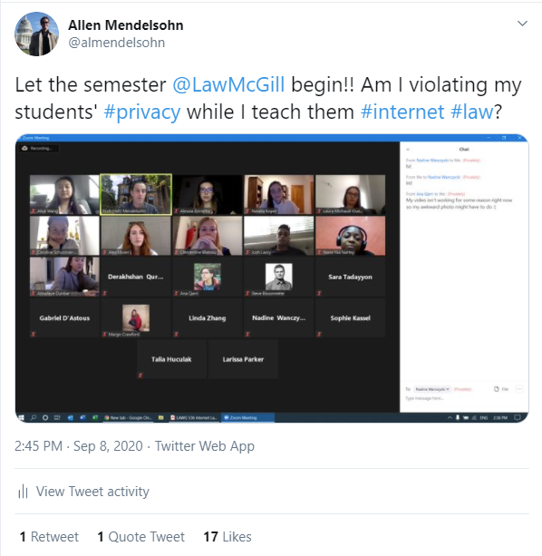
Recall:
(https://twitter.com/almendelsohn/status/1303404202874621956)

Slide 12
CLASS EXERCISE
Prof. Mendelsohn is an a**hole. I asked him nicely to remove that Tweet, and he refused. I need to go after both him and Twitter to get that Tweet taken down. But there seem to be a crapload of legal issues here, like _____________________

Slide 13
five-minute musical interlude for THINKING / working

Slide 14
Top three legal issues? Biggest?

Slide 15
Prof A**hole’s Legal Issues
Government regulation?
Twitter in USA
@almendelsohn – who is that?
Your “privacy” →
Your right to your image or name
My copyright
Is this criminal?
McGill liability?
Twitter Terms / PP?
Is Twitter even responsible?
I want the internet to “forget” I ever took Prof. A**hole’s course, now it won’t; he’ll stain me forever

Slide 16
WHO OR WHAT HAS JURISDICTION OVER THE INTERNET? DOES ANYBODY? or…

Slide 17
is there some government or independent body I can complain to so that PROF. mendelsohn will remove that tweet???

Slide 18
Introductory Notes
Looking at Canada here (and USA & Euro, but distinctly)
“Extraterritoriality” next week → subject matter jurisdiction vs. territorial jurisdiction

Slide 19
Introductory Note: Teaching methodology in times of COVID-19
Take a deep breath!
Lots of text here
(Enhanced) slides are available, as is video
Questions in chat, raise hand, or just scream at me!
Also in-depth discussions time at end of class

Slide 20
Canada - CRTC
Notes:
CLICK banner to go to site
Show Internet list

Slide 21
Meet Ian Scott, CRTC Chair
Before rejoining the CRTC in 2017, Ian held various executive positions in the communications industry, including at Telesat Canada, Telus and Call-Net Enterprises

Slide 22
What does the CRTC do?
“The CRTC is an administrative tribunal that regulates and supervises broadcasting and telecommunications in the public interest.”
Broadcasting Act → CanCon esp.
Telecommunications Act
(+ others - Radiocommunications Act, CASL)
Notes:
Broadcasting Act – All that CanCon crap

Slide 23
What does the CRTC give us?
Public Notices / Notices of Consultations
Information bulletins / circulars
Regulatory Policies
Orders
Decisions
→ All theoretically independent

Slide 24
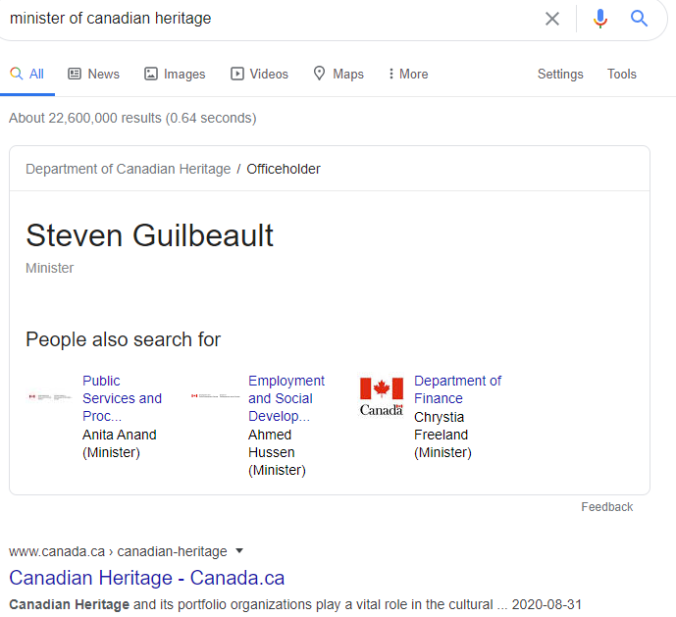
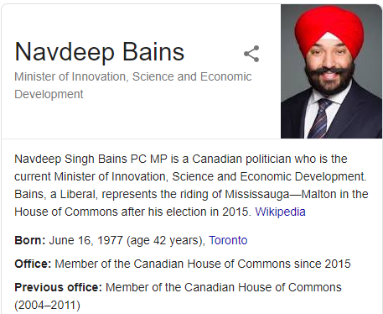
Still kinda political? - Ministers
Broadcasting Act
Telecommunications Act
Notes:
Canadian Heritage for Broadcasting Act
Innovation, Science and Economic Development Canada (old Minister of Industry) for Telecommunications Act Navdeep Bains

Slide 25
Still kinda political?
Telecommunications Act
47. The Commission shall exercise its powers and perform its duties under this Act and any special Act
(…)
(b) in accordance with any orders made by the Governor in Council under section 8 or any standards prescribed by the Minister [ed. – ISED] under section 15.
Notes:
Minister – Industry now Innovation, Science and Economic Development (Navdeep Bains)

Slide 26
Still kinda political? Minister Guilbault’s mandate (Dec 13, 2019)
I will expect you to work with your colleagues and through established legislative, regulatory and Cabinet processes to deliver on your top priorities. In particular, you will:
Create new regulations for social media platforms, starting with a requirement that all platforms remove illegal content, including hate speech, within 24 hours or face significant penalties. This should include other online harms such as radicalization, incitement to violence, exploitation of children, or creation or distribution of terrorist propaganda.
Co-lead work with the Minister of Innovation, Science and Industry to modernize the Broadcasting Act and the Telecommunications Act, examining how best to support Canadian content in English and French and ensure quality affordable internet, mobile and media access. (…)
Notes:
Prime Minister’s Appointment letter to Minister Guilbault

Slide 27
Still kinda political? Minister Bains this week
"On the basis of its review, the (cabinet) considers that the (August 2019) rates do not, in all instances, appropriately balance the policy objectives of the wholesale services framework and is concerned that these rates may undermine investment in high-quality networks, particularly in rural and remote areas," Industry Minister Navdeep Bains said.
(see Bell Canada v. British Columbia Broadband Association)
Notes:
Prime Minister’s Appointment letter to Minister Guilbault

Slide 28
Telecommunications Act s. 7
Canadian Telecommunications Policy
It is hereby affirmed that telecommunications performs an essential role in the maintenance of Canada’s identity and sovereignty and that the Canadian telecommunications policy has as its objectives
(a) to facilitate the orderly development throughout Canada of a telecommunications system that serves to safeguard, enrich and strengthen the social and economic fabric of Canada and its regions;
(b) to render reliable and affordable telecommunications services of high quality accessible to Canadians in both urban and rural areas in all regions of Canada;
(c) to enhance the efficiency and competitiveness, at the national and international levels, of Canadian telecommunications;
(d) to promote the ownership and control of Canadian carriers by Canadians;
(e) to promote the use of Canadian transmission facilities for telecommunications within Canada and between Canada and points outside Canada;
(f) to foster increased reliance on market forces for the provision of telecommunications services and to ensure that regulation, where required, is efficient and effective;
(g) to stimulate research and development in Canada in the field of telecommunications and to encourage innovation in the provision of telecommunications services;
(h) to respond to the economic and social requirements of users of telecommunications services; and
(i) to contribute to the protection of the privacy of persons.
Notes:
Note 1993, not written for the internet, BUT used that way

Slide 29
Public Notice CRTC 1999-197
“Therefore, pursuant to subsection 9(4) of the [Broadcasting] Act, the Commission exempts persons who carry on, in whole or in part in Canada, broadcasting undertakings of the class consisting of new media broadcasting undertakings, from any or all of the requirements of Part II of the Act or of a regulation thereunder. New media broadcasting undertakings provide broadcasting services delivered and accessed over the Internet, in accordance with the interpretation of "broadcasting" set out in…”
→ The “New Media Exemption”
Notes:
Act – Broadcasting Act

Slide 30
CRTC 1999-197 (cont.)
“The Commission wishes to clarify that, for the purpose of the Act, a single corporate entity (or other person) may carry on more than one distinct broadcasting undertaking. It considers that the new media activities of a company (or any person) involve a separate undertaking from any other type of broadcasting undertaking that the company or person is licensed to operate”
Notes:
So Bell, Videotron, Rogers, etc. who do many of the things (ISP+)

Slide 31
Reference re Broadcasting Act
2012 SCC 4
Nana Yaa Nartey Presentation

Slide 32
Reference re Broadcasting Act
Takeaway:
ISPs (when acting as such, i.e. just access) are not “Broadcasting Undertakings” →
Not subject to Broadcasting Act →
CRTC won’t regulate them in that context

Slide 33
CRTC FAQs
Why doesn't the CRTC regulate Internet services?
Although the CRTC plays a role in ensuring competition among Internet service providers, and prohibits internet service providers from requiring customer to give 30-days’ notice before cancelling Internet services, it has determined that the market for Internet services in Canada is competitive enough to ensure ongoing creativity and innovation without regulation. As a result, it does not regulate Internet retail rates, quality of service, billing, marketing practices, equipment offered, and customer relations of Internet service providers except in rare cases where competition is not sufficient.

Slide 34
CRTC FAQs (cont.)
Why doesn't the CRTC regulate Internet content?
The CRTC does not regulate internet content because consumers can already control access to unsuitable material on the internet using filtering software. Any potentially illegal content on the internet can be addressed with civil action, existing hate crime legislation, and the courts.

Slide 35
CRTC Conclusion
The CRTC may regulate access to the internet, but not the content of the internet.
→ See e.g. 2nd part of this class (net neutgrality)…

Slide 36
CRTC Conclusion in effect: Telecom Regulatory Policy CRTC 2019-269
“The Internet Code”
“a mandatory code of conduct for providers (i.e. Internet service providers [ISPs]) of retail fixed Internet access services (Internet Services)”
The Internet Code will:
make it easier for individual customers to obtain and understand the information in their Internet service contracts;
establish consumer-friendly business practices for the Internet service industry where necessary;
contribute to a dynamic Internet service market; and
further the policy objectives out in paragraphs 7(a), (b), (f), and (h) of the Telecommunications Act.
Notes:
Note bold → There was a wireless code in 2017
7(a) etc → economic ones generally

Slide 37
CRTC Conclusion in effect: Telecom Regulatory Policy CRTC 2019-269
The Internet Code
The Code will take effect on 31 January 2020 and will apply in full to all renewed, amended, or extended contracts. Certain provisions related to the clarity of communication will also apply to existing contracts to ensure that customers have the necessary information to make informed decisions.
Upon taking effect, the Code will apply to large facilities-based ISPs that provide retail fixed Internet access services: Bell Canada (including Bell MTS, NorthernTel, and Télébec), Cogeco, Eastlink, Northwestel, RCCI, SaskTel, Shaw, TCI, Videotron, and Xplornet.

Slide 38
Federal matter dammit!
Association canadienne des télécommunications sans fil c. Procureure générale du Québec, 2018 QCCS 3159
F: Quebec wants to have ISPs block internet gambling sites (stuffed in the 2015 budget bill!)
Issue: Can they?
Held: F *** no, that’s a federal matter, both for Telecom and Criminal law reasons, provision declared ultra vires
Notes:
Being appealed

Slide 39
General regulation of the internet
See the Tariff-22 case next week (cited in Reference re Broadcasting Act)
See every other case and law we’ll discuss this semester
How much do we regulate the internet?
How much should we?

Slide 40
U.S. Approach (intro)
Federal Communications Commission (FCC)
Communications Act 1934 → “information services” exempted from regulation (foreshadowing for net neutrality!)
Telecommunications Act 1996 → updated 1934 Act to address internet issues (+more…)

Slide 41
Telecommunications Act 1996
Policy objectives (s. 706) → required the FCC to help accelerate deployment of "advanced telecommunications capability” (i.e. high-speed internet) – This is why Al Gore said he “invented the internet”
Title V, "Obscenity and Violence“ aka the Communications Decency Act

Slide 42
Telecommunications Act 1996 s. 706
47 U.S. Code § 1302 - Advanced telecommunications incentives
(a) In general
The Commission and each State commission with regulatory jurisdiction over telecommunications services shall encourage the deployment on a reasonable and timely basis of advanced telecommunications capability to all Americans (including, in particular, elementary and secondary schools and classrooms) by utilizing, in a manner consistent with the public interest, convenience, and necessity, price cap regulation, regulatory forbearance, measures that promote competition in the local telecommunications market, or other regulating methods that remove barriers to infrastructure investment.
(b) Inquiry (c) Demographic Information for Unserved Areas (d) Definitions:
(1) Advanced telecommunications capability
The term “advanced telecommunications capability” is defined, without regard to any transmission media or technology, as high-speed, switched, broadband telecommunications capability that enables users to originate and receive high-quality voice, data, graphics, and video telecommunications using any technology.

Slide 43
Communications Decency Act
Regulate Content? (s. 223)
Can’t use the internet to send or display to minors any message “that, in context, depicts or describes, in terms patently offensive as measured by contemporary community standards, sexual or excretory activities or organs”
Reno v. American Civil Liberties Union 521 U.S. 844 (1997)
→ Congress shall make no law ... abridging the freedom of speech → s. 223 (part above) struck down
Notes:
Not child pornography
Adults would be blocked from seeing legitimate expression, this part of 223 struck down

Slide 44
Communications Decency Act
s. 230 – ISP (-ish) Immunity (-ish)
No provider or user of an interactive computer service shall be treated as the publisher or speaker of any information provided by another information content provider.
2nd (-ish) → Exceptions: criminal law, IP law, communications Privacy laws
→ See you October 6 (defamation)

Slide 45
Content regulation anyway?
Canada
United States
CASL (Canada’s Anti-Spam Law)
Copyright Modernization Act
Canadian Content (CanCon) ????? (see slide 65!)
CAN-SPAM Act (U.S. anti-spam law)
Digital Millennium Copyright Act

Slide 46
Parting thought for this section

Slide 47
THROTTLE THIS! Net neutrality

Slide 48
TWO MINUTE POP QUIZ (CLASS EXERCISE)
Zoom chat to me only, or by email:
Define net neutrality in one sentence; bonus points for the shortest answer (that I think is accurate)
2 minute musical interlude (Prof only, silence for you this time)… GO!!!
Notes:
Francais ok

Slide 49
Prof. answer
All internet traffic treated equally.

Slide 50
Net Neutrality Defined
“Network neutrality is best defined as a network design principle. The idea is that a maximally useful public information network aspires to treat all content, sites, and platforms equally. This allows the network to carry every form of information and support every kind of application”
Tim Wu, http://www.timwu.org/network_neutrality.html , A Proposal For Network Neutrality paper, June 2002
Notes:
Tim Wu – A Proposal For Network Neutrality paper, June 2002, U Virginia law school (now at Columbia)

Slide 51
Net Neutrality Defined
“the idea that Internet service providers (ISPs) should treat all data that travels over their networks fairly, without improper discrimination in favor of particular apps, sites or services”
-- Electronic Frontier Foundation (EFF)
“broadband providers must treat all internet traffic the same regardless of source”
-- U.S. Court of Appeals

Slide 52
Hear it from someone important
https://youtu.be/uKcjQPVwfDk

Slide 53
Canadian History - 2005
Telus workers on strike, set up a website called Voices for Change; Telus blocked access to the site for its subscribers!
Notes:
Telus workers on strike, set up a website called Voices for Change; Telus blocked access to the site by its subscribers

Slide 54
s. 27(2) Telecommunications Act
No Canadian carrier shall, in relation to the provision of a telecommunications service or the charging of a rate for it, unjustly discriminate or give an undue or unreasonable preference toward any person, including itself, or subject any person to an undue or unreasonable disadvantage.

Slide 55
“ITMP framework” - Telecom Regulatory Policy CRTC 2009-657
Review of the Internet traffic management practices of Internet service providers
(ITMP = Throttling)
Telecommunications Act:
Content of messages
36. Except where the Commission approves otherwise, a Canadian carrier shall not control the content or influence the meaning or purpose of telecommunications carried by it for the public.
Notes:
ITMP → Throttling!

Slide 56
“ITMP framework” - Telecom Regulatory Policy CRTC 2009-657
(para. 122) “The Commission finds that where an ITMP would lead to blocking the delivery of content to an end-user, it cannot be implemented without prior Commission approval.”
(126) “the Commission finds that use of an ITMP resulting in the noticeable degradation of time-sensitive Internet traffic will require prior Commission approval”
Notes:
ITMP → Throttling!

Slide 57
Broadcasting and Telecom Decision CRTC 2015-26
Complaint against Bell Mobility Inc. and Quebecor Media Inc., Videotron Ltd. and Videotron G.P. alleging undue and unreasonable preference and disadvantage in regard to the billing practices for their mobile TV services Bell Mobile TV and illico.tv
F → Bell and Videotron not charging against data caps for their mobile TV services (“zero rating”)
Held → violates 27(2)
Note: we call this the “Mobile TV Decision”
Notes:
Precursor to the 2017 stuff

Slide 58
Mobile TV decision
Step 1: → Are they subject to the Act?
“The Commission therefore rejects Bell Mobility’s and Videotron’s arguments that the relief claimed pursuant to the Telecommunications Act should be denied on the basis that they are not subject to that Act. Section 4 of the Telecommunications Act does not apply as a shield to the application of the Telecommunications Act in this case given that Bell Mobility and Videotron are acting as Canadian carriers in providing transport and data connectivity services required for the delivery of their mobile TV services”
Step 2: → Violates 27(2)?
“The Commission therefore finds that in providing the data connectivity and transport required for consumers to access their respective mobile TV services on their mobile devices, Bell Mobility and Videotron have given a preference in favour of subscribers of their respective mobile TV services, as well as in favour of their own services, and have subjected consumers of other audiovisual content services, and other services, to a corresponding disadvantage.”
Notes:
Section 4 → Telecom Act doesn’t apply to broadcasters
Note → “undue and unreasonable” → so it might be reasonable to do so???

Slide 59
CRTC 2017-104 and 105
April 20, 2017
105 refers to 104, 104 refers to 105, 105 uses 104 criteria
CRTC standard practice (see also SCC)
Teaching confusion for your instructor!

Slide 60
Telecom Decision CRTC 2017-105
Margo Crawford presentation

Slide 61
Telecom Decision CRTC 2017-105 Takeaway
“the Commission finds that, in providing certain of its retail Internet access service customers with access to some content through Unlimited Music without charging those customers for the data involved … Videotron has conferred upon its eligible subscribers who access the Unlimited Music program, and upon the providers of the services included in that program, an undue and unreasonable preference, in violation of subsection 27(2) of the Act. In addition, Videotron has subjected to an undue and unreasonable disadvantage: (a) its ineligible subscribers; (b) its eligible subscribers who do not access the services in question; (c) providers whose content or services are not included in Unlimited Music but are substantially similar to those that are included, such as Internet radio stations that primarily play music; and (d) other excluded content providers” (para. 44)

Slide 62
Telecom Regulatory Policy CRTC 2017-104
Framework for assessing the differential pricing practices of Internet service providers
Headnote
“In order to provide clarity to stakeholders, including consumers, content providers, and Internet service providers (ISPs), the Commission establishes a framework and sets out the evaluation criteria it will apply to determine whether an ISP’s specific differential pricing practice is or is not consistent with subsection 27(2) of the Telecommunications Act.”

Slide 63
Telecom Regulatory Policy CRTC 2017-104
Framework for assessing the differential pricing practices of Internet service providers
4 criteria
Agnostic treatment of data
Exclusiveness of the offering
Impact on internet openness and innovation
Whether there is financial compensation involved
Notes:
4 criteria explained at para. 126 → READ
1st one most important

Slide 64
CRTC 2017-104: We have net neutrality!
(para. 15) So, while there is no all-encompassing Commission decision or regulatory framework on the broad issue of net neutrality, when the various legislative and regulatory elements are put together – including subsection 27(2), the ITMP framework, and the Mobile TV decision – the meaning of net neutrality in the Canadian context is clear. The current proceeding is about adding another perspective to Canada’s net neutrality framework.
(156) the Commission considers that there is no need to create a new, separate code for net neutrality in Canada. Parliament’s intentions as expressed through the Act (in particular subsection 27(2)), together with this decision, the ITMP framework, the Mobile TV decision, and the Commission’s decision regarding Videotron’s Unlimited Music program [ed.: 2017-105] effectively constitute Canada’s net neutrality code.

Slide 65
Net neutrality Tweet of the Day
Thanks Margo!

Slide 66
Net Neutrality U.S.A.
2014-2015
FCC classifies broadband internet as a “public utility” and “telecommunications”→ Title II of Communications Act applies, and FCC can regulate ISPs in certain ways as a “common carrier” including (…)
Notes:
Intro → this was a big deal!
Note there was some debate as to whether they could have also used s. 706 of Telecommunications Act 1996

Slide 67
Net Neutrality U.S.A.
§ 202(1) Communications Act
“It shall be unlawful for any common carrier to make any unjust or unreasonable discrimination in charges, practices, classifications, regulations, facilities, or services for or in connection with like communication service, directly or indirectly, by any means or device, or to make or give any undue or unreasonable preference or advantage to any particular person, class of persons, or locality, or to subject any particular person, class of persons, or locality to any undue or unreasonable prejudice or disadvantage”
Notes:
Communications Act from 1930s

Slide 68
Sound familiar?
Canada s. 27(2)
USA s. 202(1)
unjustly discriminate
undue or unreasonable preference toward any person, including itself…
or subject any person to an undue or unreasonable disadvantage
unjust or unreasonable discrimination
make or give any undue or unreasonable preference or advantage
to subject any particular person, class of persons, or locality to any undue or unreasonable prejudice or disadvantage

Slide 69
But a difference
USA s. 202(1) application
Canada s. 27(2) application
ISPs are telecommunications carriers, point finale, pretty much by definition in the Telecommunications Act
Courts pretty much let FCC define broadband internet (and thus ISPs) however they want
2015 – Democrats (3-2) say common carriers
2017 – Republicans ! Trump !
Ajit Pai – May 18 2017 said broadband should be information service, began process to repeal

Slide 70
Net Neutrality U.S.A.
2015
Reclassification as a common carrier allowed for the Net Neutrality Rules
Upheld (2-1) June 14, 2016 in United States Telecom Association v FCC, U.S. Ct. App. (Dist. C.)

Slide 71
American Net Neutrality Rules 2015 “Open Internet Order”
Protecting and Promoting the Open Internet
FCC 15-24
ISPs are common carriers and there should be:
No Blocking
No Throttling
No Paid Prioritization
(in 400 pages…)

Slide 72
Going backwards?
December 2017 → FCC votes 3-2 (R-D) to repeal Open Internet Order, in effect June 2018 (upheld in Mozilla v. FCC, Oct 2019, DC App. Ct.))
June 11, 2018 → “Restoring Internet Freedom” (irony!) comes into effect
Notes:
Passed Senate – but nothing in the house

Slide 73
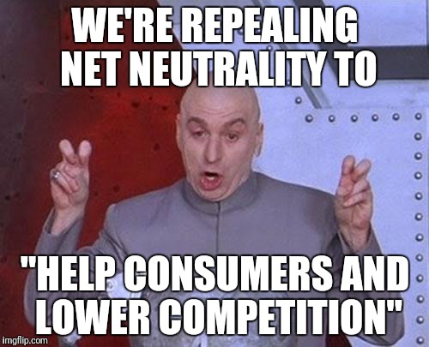
“Restoring Internet Freedom”
“provides a framework for protecting an open Internet while paving the way for better, faster and cheaper Internet access for consumers. It replaces unnecessary, heavy-handed regulations that were developed way back in 1934”

Slide 74
Net neutrality USA – future?
Save the Internet Act (2019) (U.S. House of Reps)
California net neutrality law (2018)
→ Mozilla v FCC (States doing this was OK but FCC back in there asking for injunction…)

Slide 75
Net neutrality - Europe
Regulation (EU) 2015/2120 of the European Parliament and of the Council of 25 November 2015 laying down measures concerning open internet access and amending Directive 2002/22/EC on universal service and users’ rights relating to electronic communications networks and services and Regulation (EU) No 531/2012 on roaming on public mobile communications networks within the Union
→ CJEU - Judgment in Joined Cases C-807/18 and C-39/19 September 15, 2020

Slide 76
It’s 5 o’clock somewhere (here!)

